Slide 1
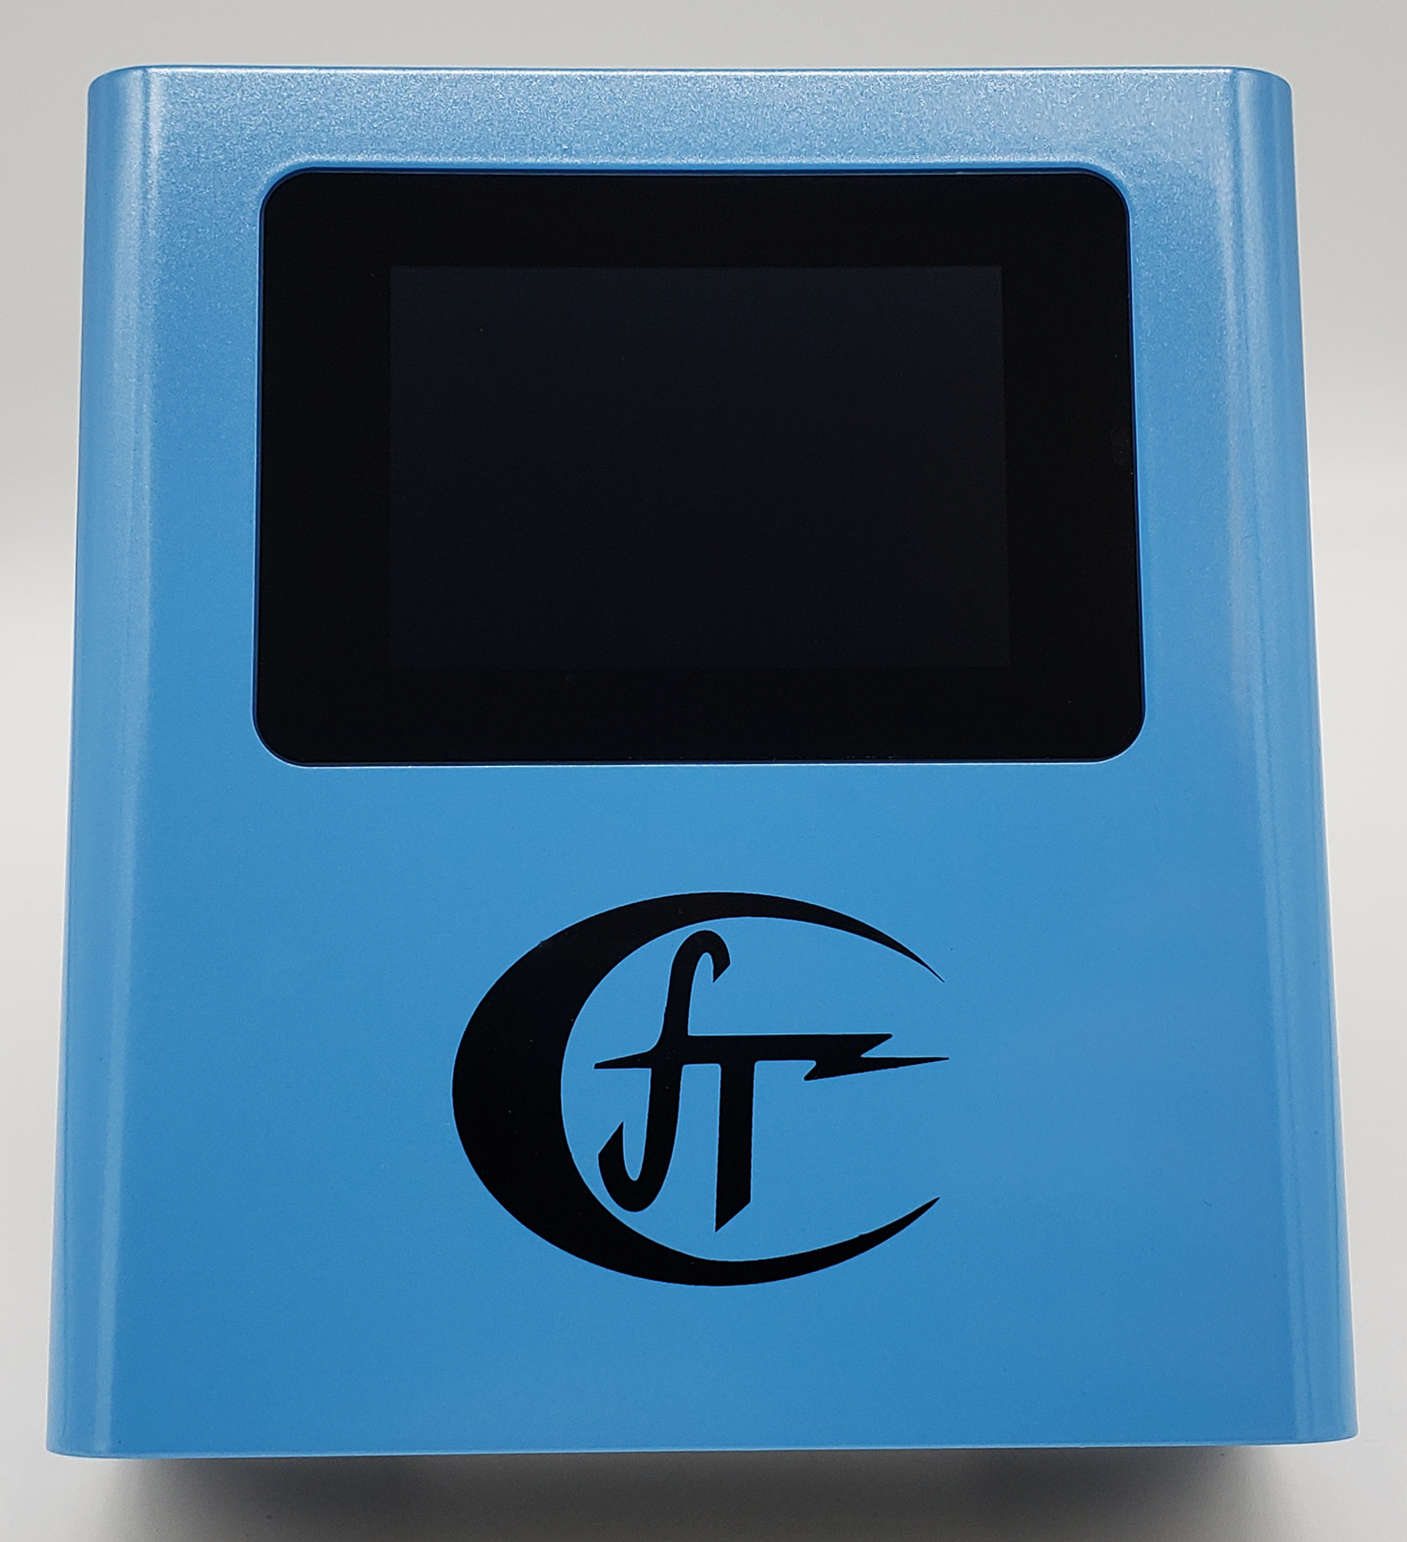
CRM-LPT
Device
Training
Device Training Course for
NRPP Certification

Slide 2

Course Objectives
- Understand the operation of CRM-LPT
- Learn touch screen interface & Rad-Lab integration
- Understand multi-sensor features
- What does the CRM-LPT test for?

Slide 3

What is Radon?
Radon is an invisible, odorless, tasteless, radioactive gas.
It is the product of decaying uranium found in the soil, rocks, and water all around the world.
As a gas, it seeps into your home or business through any cracks or holes present in the building's foundation, or even through your well water.
Once it makes it inside your building it becomes trapped, subjecting all residents to exposure.
Radon can also enter your home or business through gaps in suspended floors, gaps around service pipes, cavities inside walls, & construction joints.

Slide 4

Why Test for Radon?
Radon is the second leading cause of lung cancer in the United States.
Most people do not know that their home has high levels of radon or that they should test for it.
Many people do not realize how harmful radon is.
The longer your exposure, the higher the risk to you.
This means if exposed continually starting at a young age, children are at a higher risk of lung cancer as they grow into adulthood.

Slide 5
EPA & Industry Protocols
ANSI/AARST MAH-2023
  Protocol for Conducting Measurements of Radon and Radon Decay Products in Homes
ANSI/AARST MA-MFLB-2023
  Soil Gas Mitigation Standards for existing Multifamily, School, Commercial and Mixed-Use Buildings
ANSI/AARST MS-QA-2023
  Radon Measurement Systems Quality Assurance
ANSI/AARST MS-PC-2022
  Performance Specifications for Instrumentation Systems Designed to Measure Radon Gas in Air

Slide 6

Closed House Conditions & Placement
All exterior doors and windows closed, except for normal entry and exit.
Internal-external air exchange systems off.
  Total internal recycle is allowed.
  Combustion or make-up air must not be closed.
  Permanent radon mitigation systems remain on.

Slide 7
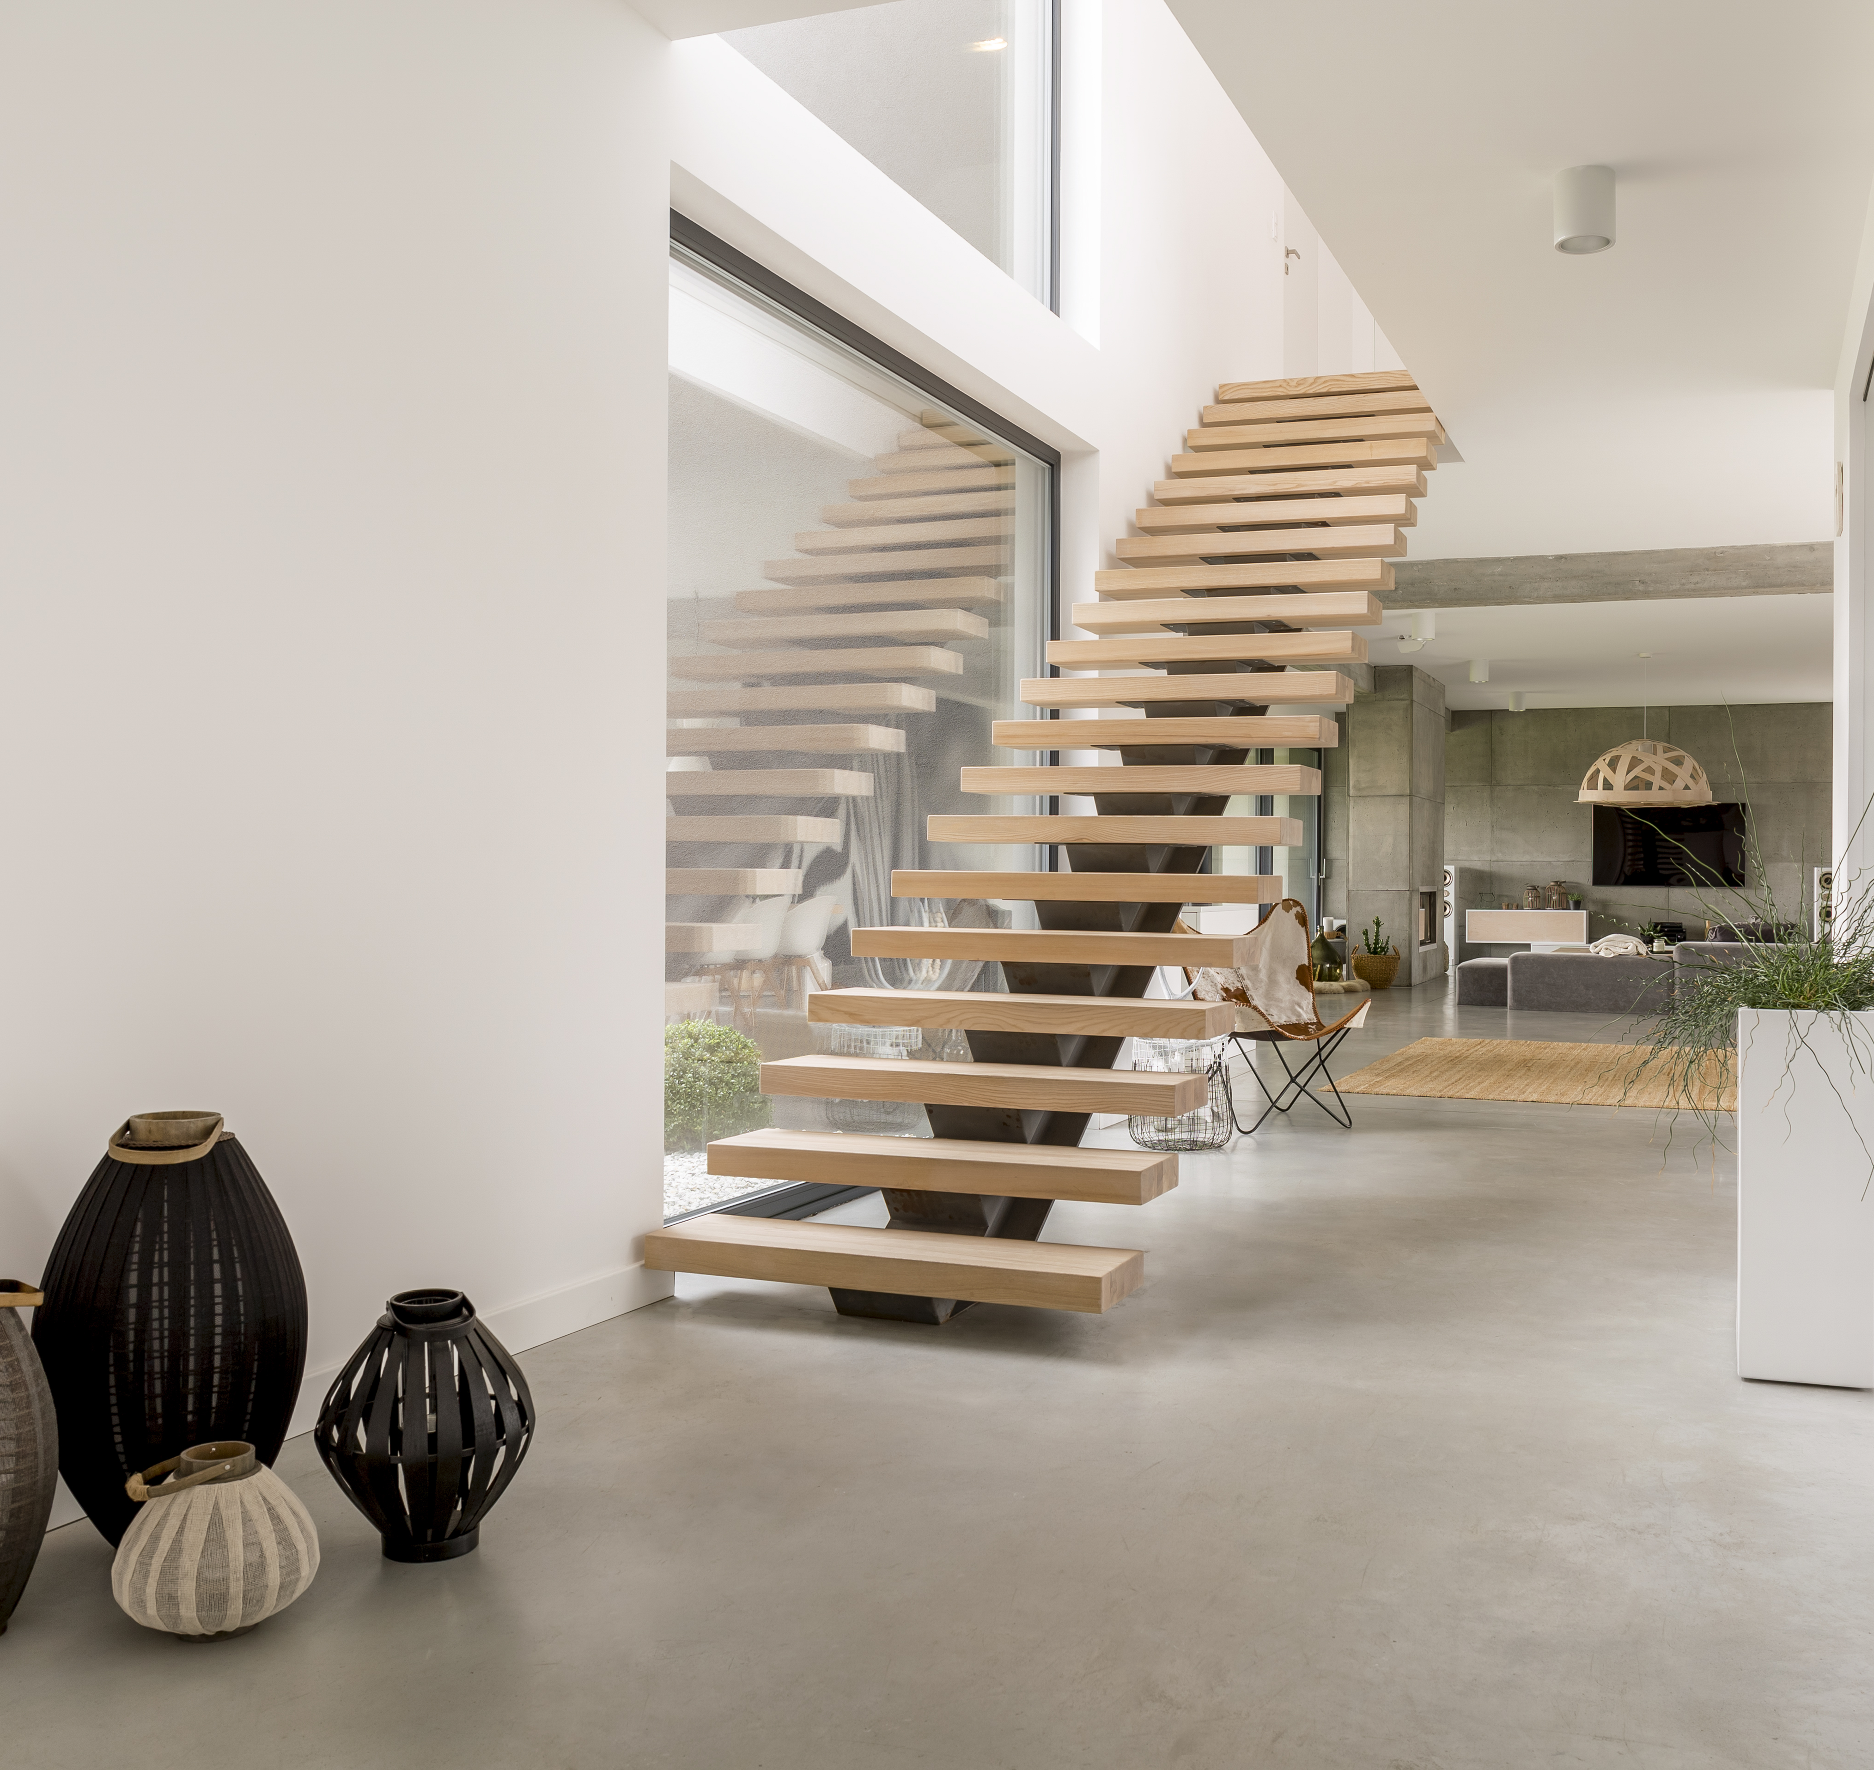
Where Does the Device Go Within the Chosen Room?
(All Protocols)
Where it will not be disturbed.
Away from drafts caused by heating, ventilating and air conditioning, exterior doors, fans, and windows.
Away from heat and areas of high humidity.
At least 50 cm or 20 inches from the floor.
At least 10 cm or 4 inches from other objects.
Not within 90 cm or 3 feet of exterior doors, windows, or other potential openings to the outside.
Not within 30 cm or 12 inches of an exterior wall.

Slide 8
Ways to Prevent or Detect Tampering
A report generated from the continuous monitor data helps detect unusual measurement swings.
A motion detector built into the monitor will help to determine if the device was moved.
The monitor’s environmental data can be paired with historical weather data using the RAD-LAB app.
Record room temperatures to assess the opening of windows.
Monitor is passcode protected

Slide 9
CRM-LPT Device Overview
Lightweight aluminum design
3.5” touchscreen interface
Bluetooth & USB-C
Long battery life (rechargeable)
Passive diffusion ion chamber
Virtually unlimited test storage
Standard ¼-20 tripod mount
24+ CPH/pCi/l
AARST-NRPP Approved CR-8445

Slide 10
CRM-LPT Environmental Sensors
Radon
CO
CO₂
PM2.5 / PM10
VOC/AQI
Temp
Humidity
Pressure

Slide 11

Radon Sensor
Pulsed Ion Chamber fed via passive air diffusion
Sensitivity: 24 cph/pCi/L | 96 cph @ 4 pCi/L
Self Check
  The CRM-LPT has a self test feature that is completed at the start of every test.
  This feature physically pulses the Ion Chamber to verify that everything is working exactly as expected.

Slide 12

Carbon Monoxide Sensor
Carbon monoxide is an odorless, colorless and toxic gas. Because it is impossible to see, taste or smell, CO can kill you before you are aware it is in your home. The effects of CO exposure can vary greatly from person to person depending on age, overall health and the concentration and length of exposure. Average levels in homes without gas stoves vary from 0.5 to 5 parts per million (ppm). Levels near properly adjusted gas stoves are often 5 to 15 ppm and those near poorly adjusted stoves may be 30 ppm or higher. The U.S. Environmental Protection Agency (EPA) strongly recommends taking further action when the average carbon monoxide level exceeds 9 ppm. Many questions you may have can be found in the EPA’s publication “Carbon Monoxide's Impact on Indoor Air Quality".

Slide 13

Carbon Dioxide Sensor
Carbon dioxide is an odorless, colorless gas. It is denser than air and at high concentrations it can persist in open pits and other areas below grade. The current OSHA, NIOSH, and ASHRAE standard is 5000 ppm as an 8- hour time-weighted average (TWA) concentration. Gaseous carbon dioxide is an asphyxiant. Concentrations of 10% (100,000 ppm) or more can produce unconsciousness or death. Lower concentrations may cause headache, sweating, rapid breathing, increased heartbeat, shortness of breath, dizziness, mental depression, visual disturbances or shaking. CO2 levels can serve as an indication of poor ventilation for the number of occupants in the building.

Slide 14

Volatile Organic Compounds (VOCs)
Volatile organic compounds, or VOCs, are gases that are emitted into the air from man-made products or natural processes. Some can be very harmful to our health and in some cases they can cause cancer. Breathing in VOCs can irritate your eyes, nose and throat, cause difficulty breathing, nausea, and damage your central nervous system as well as other organs. Concentrations of many VOCs are consistently higher indoors (up to ten times higher) than outdoors. Paints, varnishes and wax all contain organic solvents, as do many cleaning, disinfecting, cosmetic, degreasing and hobby products, even fuel. All of these products can release organic compounds while you are using them and to some degree when they are stored.

Slide 15

Particulate Matter 2.5/10
PM stands for Particulate matter (also called particle pollution): the term for a mixture of solid Particles and liquid droplets found in the air. Particles such as dust, dirt, soot, and even smoke are large enough to be seen with the naked eye, but some particles are so small they can only be detected using specialized equipment. Some particles less than 10 micrometers in diameter can get deep into your lungs and some may even get into your bloodstream. Particles less than 2.5 micrometers in diameter, also known as fine particles or PM2.5, pose the greatest risk to health. The EPA 24-hour standard for fine Particles (PM 2.5) is 35µg/m³, and for coarse particles (PM 10) is 150µg/m³.

Slide 16

Things to Avoid in the Test Environment
  Condensing humidity (moisture in the air can cling to the surfaces of electronics)
  Frequent vibrations (do not place on a washer/dryer or near something that could move the device)
  Wireless devices (place at least 10ft away from any wireless broadcasting device such as router/modem/radio transmitter) – these devices can cause interference when placed improperly

Slide 17

Self Test
  Are preformed on the CRM-LPT each time a test is started.
  It tests the battery, electrometer, and storage to ensure a reliable test.
  The electrometer self check electronically injects pulses into the ionization chamber to verify that it is sensing and measuring radon correctly.
  Takes less than 10 seconds in perfect conditions.
  If the Self Test fails, you will be notified of the error and what to do next by the monitor.

Slide 18

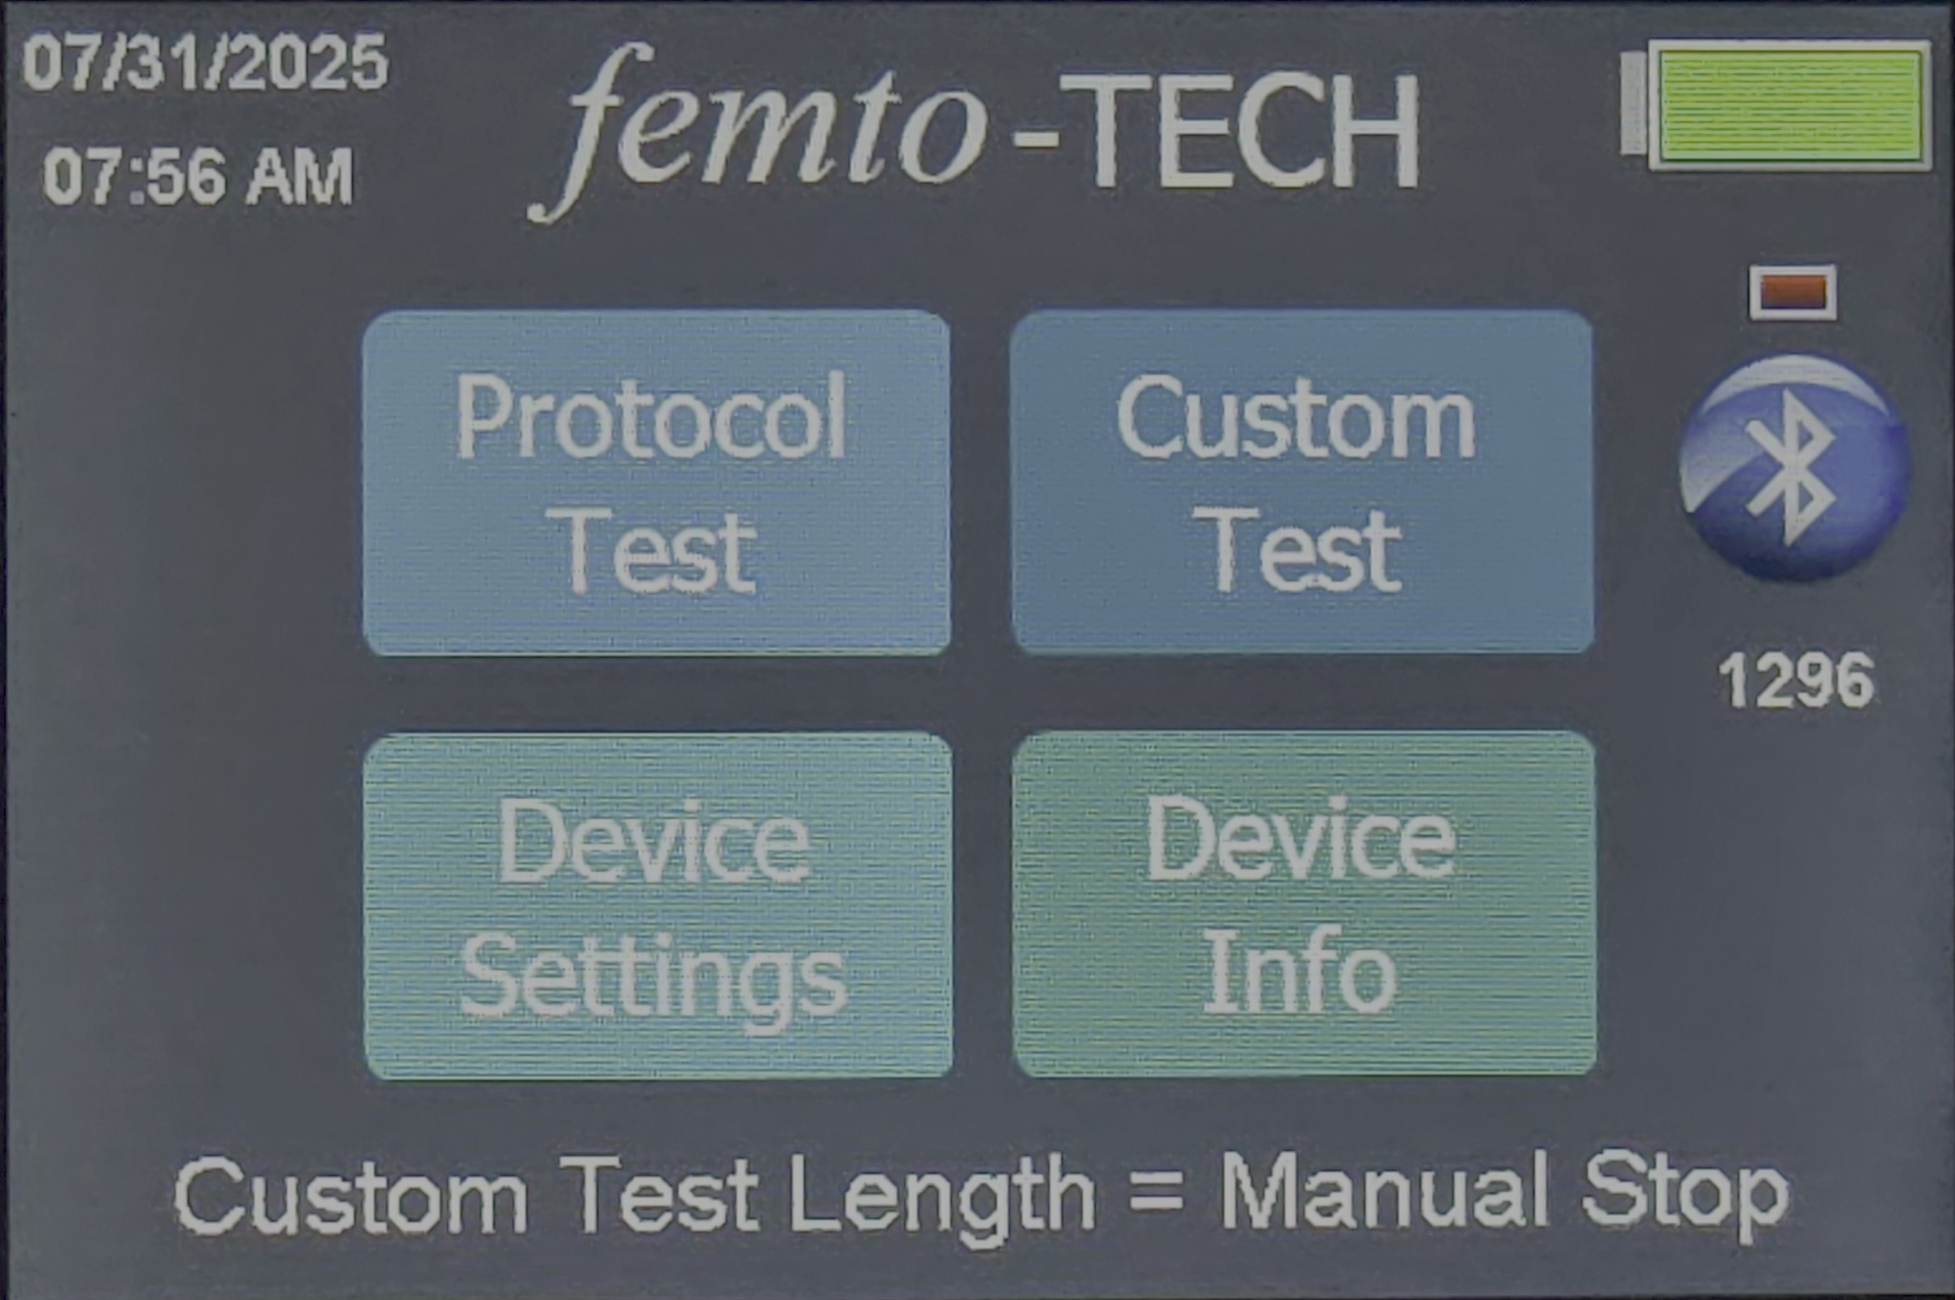
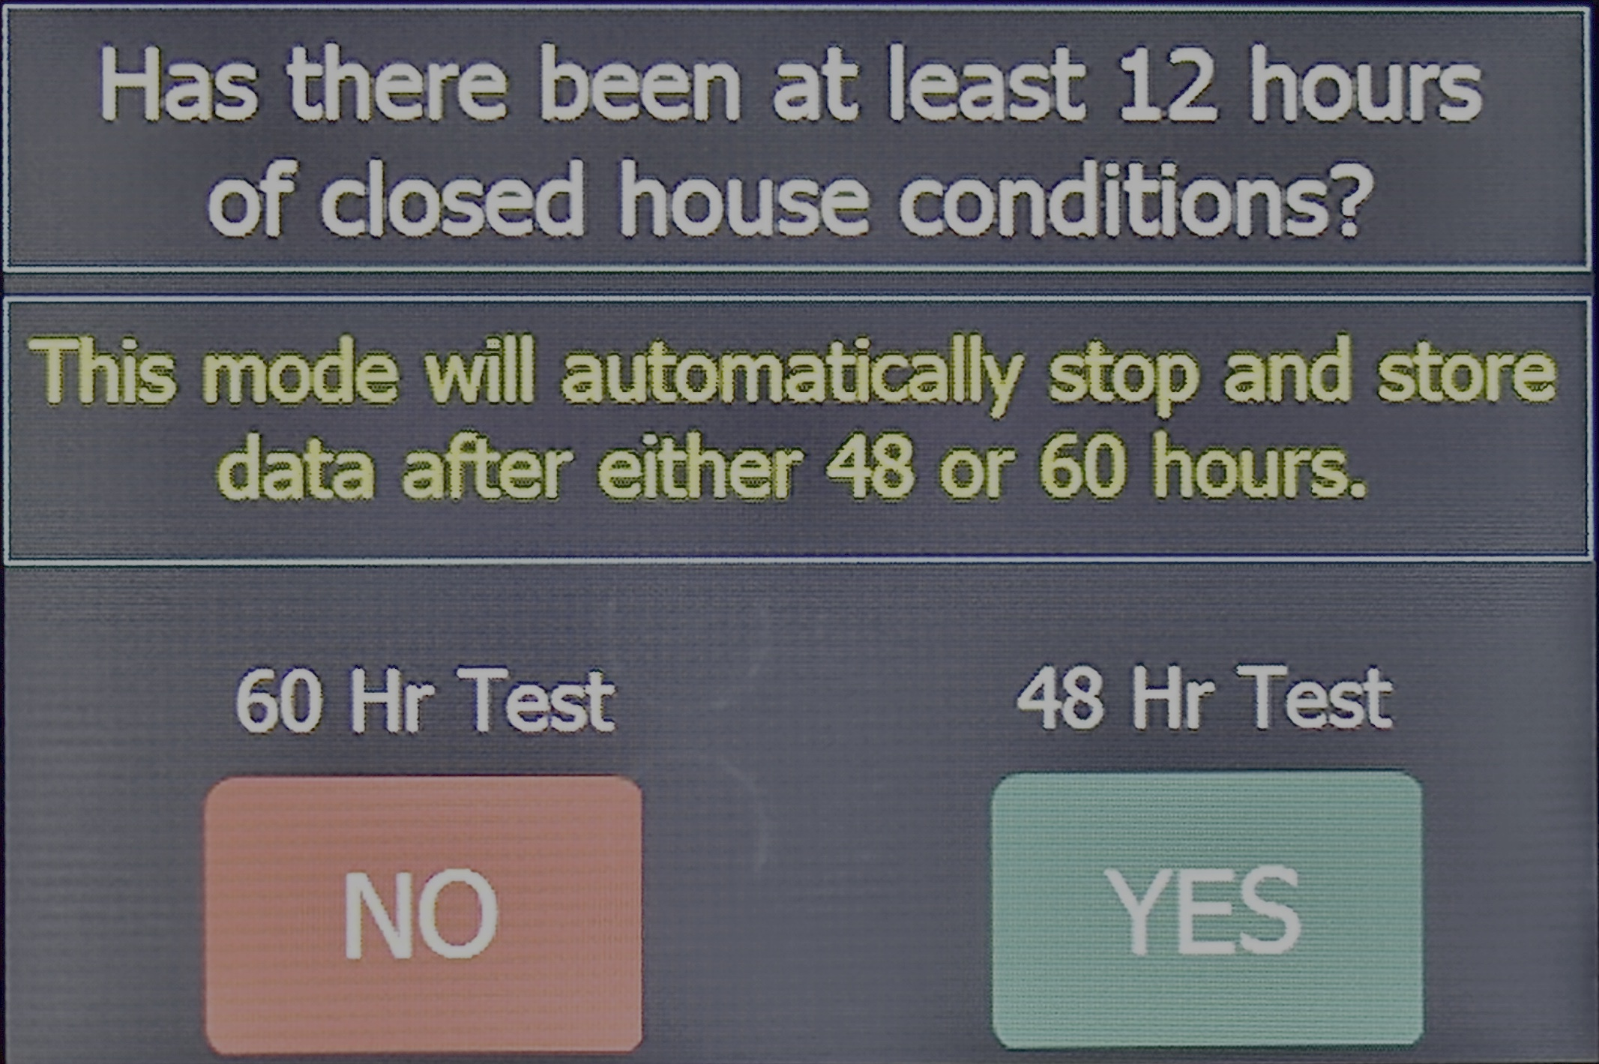
Starting a Protocol Test
Power on via front panel button
Select Protocol Test
Choose 48 or 60 hours
The LPT will start an automatic self-test
Device will power itself off after test is complete

Slide 19

Ending a Test Early
Press
- Press button to wake device
Enter
- Enter passcode (default: 51)
Stop
- Stop Test -> data saved, device shuts off

Slide 20

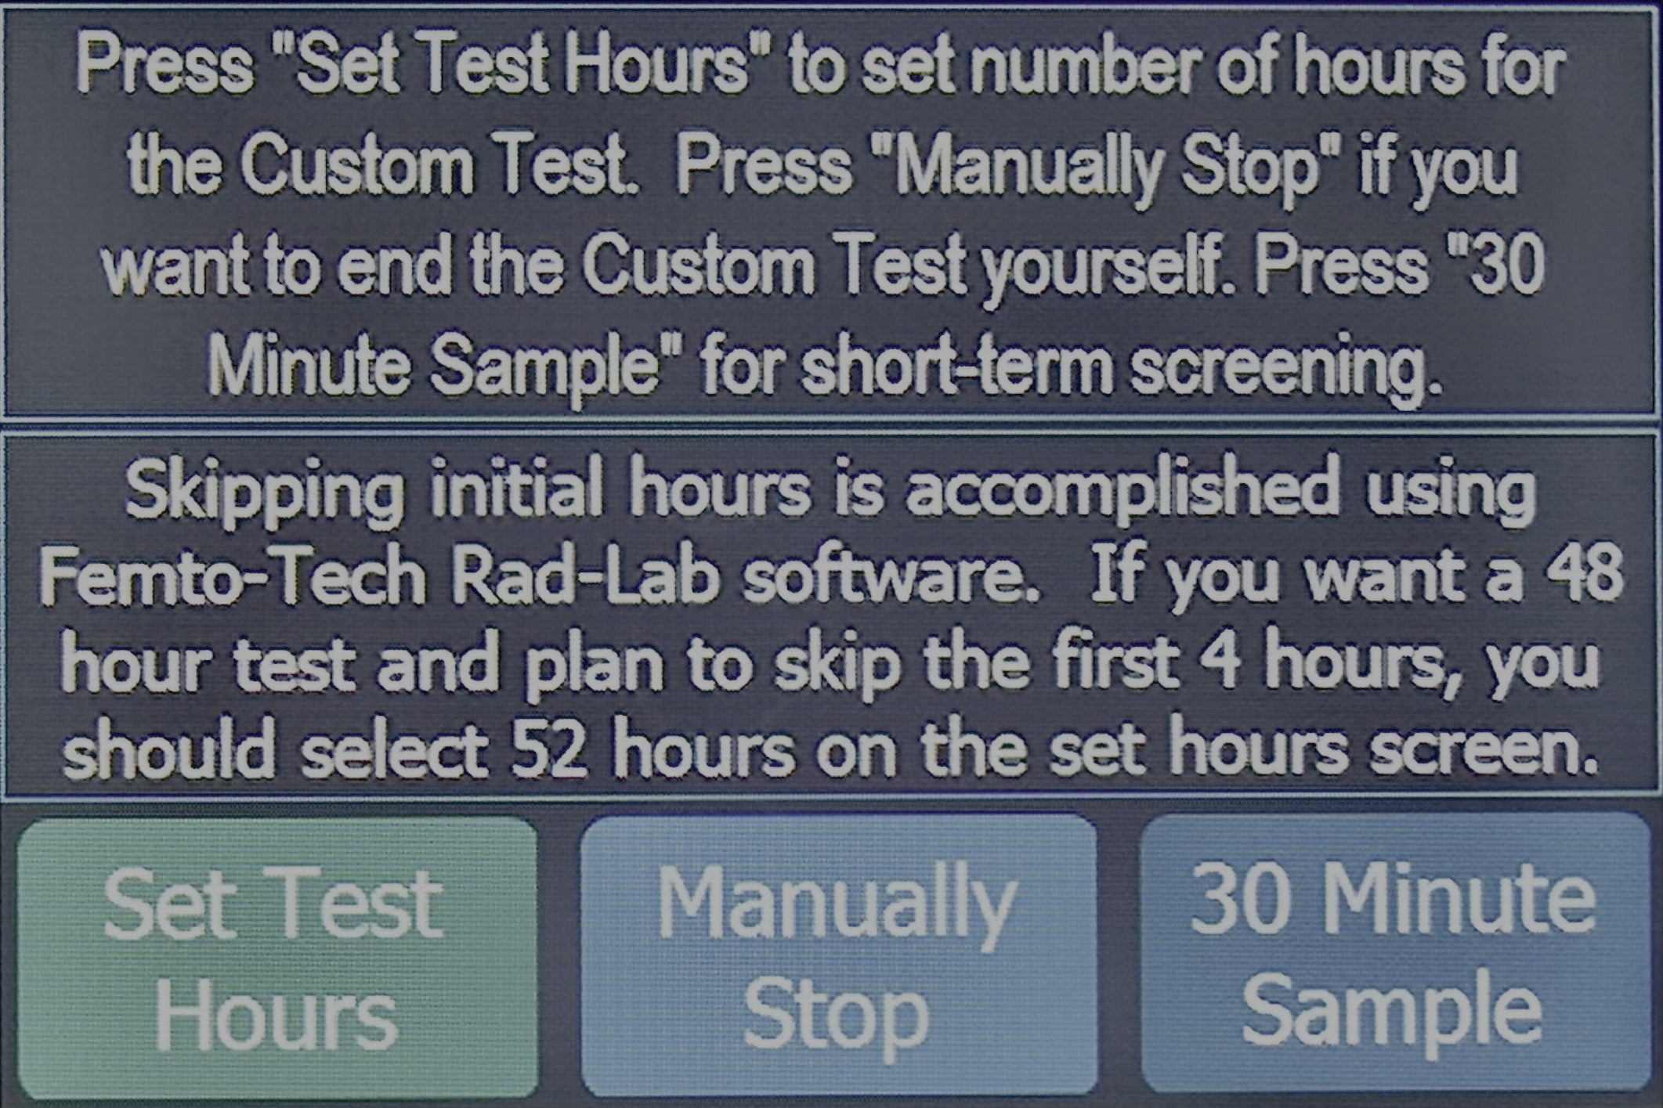
Custom Tests & Sample Modes
Found in Device Settings > Change Custom Test Length
  Set test hours (1–9999 – will shut off after final hour)
  Manual stop (continuous testing until stopped)
  30-minute sample (snapshot of tested volume)

Slide 21

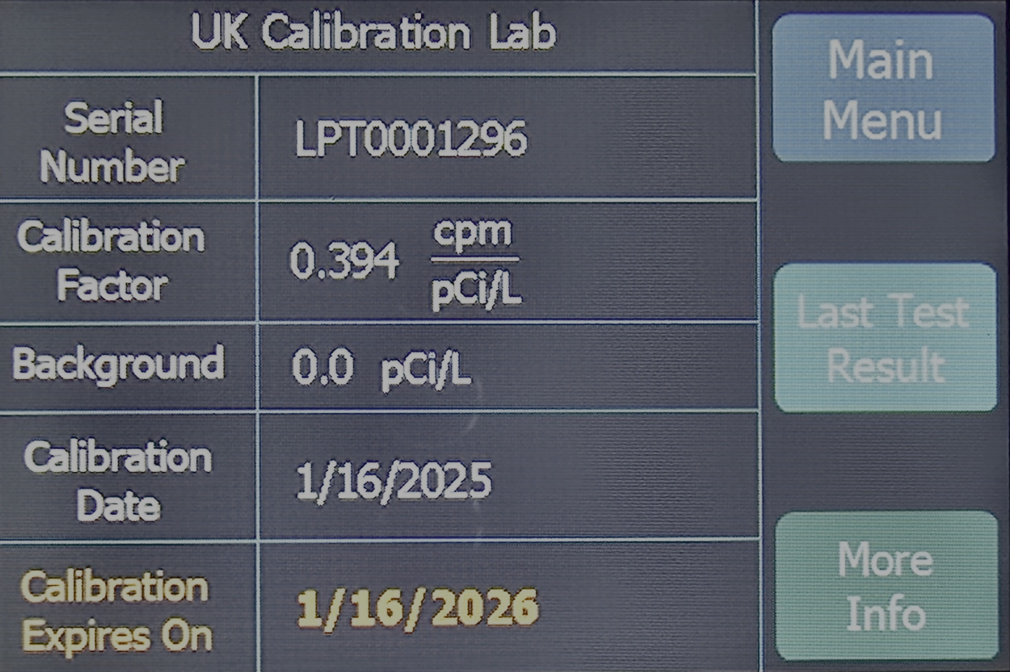
Calibration Information
Found by pressing ‘Device Info’
  Includes all information normally found on a Calibration Sticker
  The calibration information is only able to be changed by approved calibration labs.

Slide 22

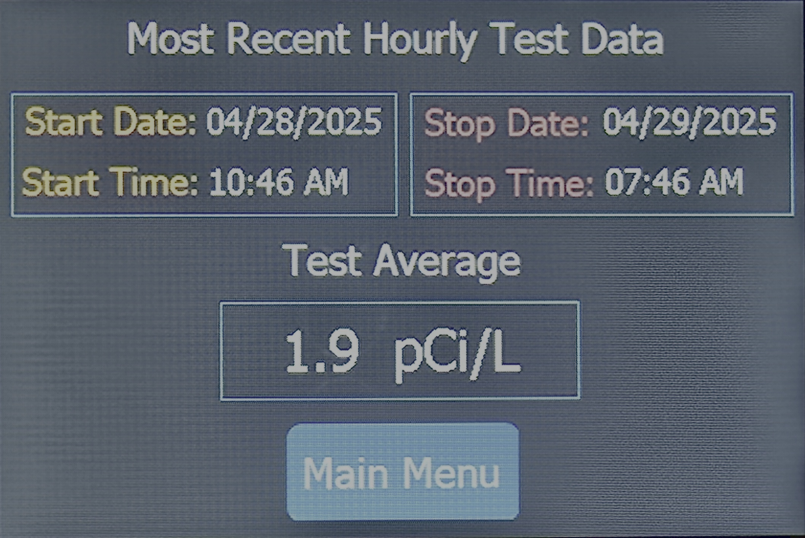
Last Test Result
Found by pressing ‘Device Info’ > ‘Last Test Result’
  Displays the final radon average for the previously saved test
  Includes the precise Start and Stop times that the device has logged data

Slide 23

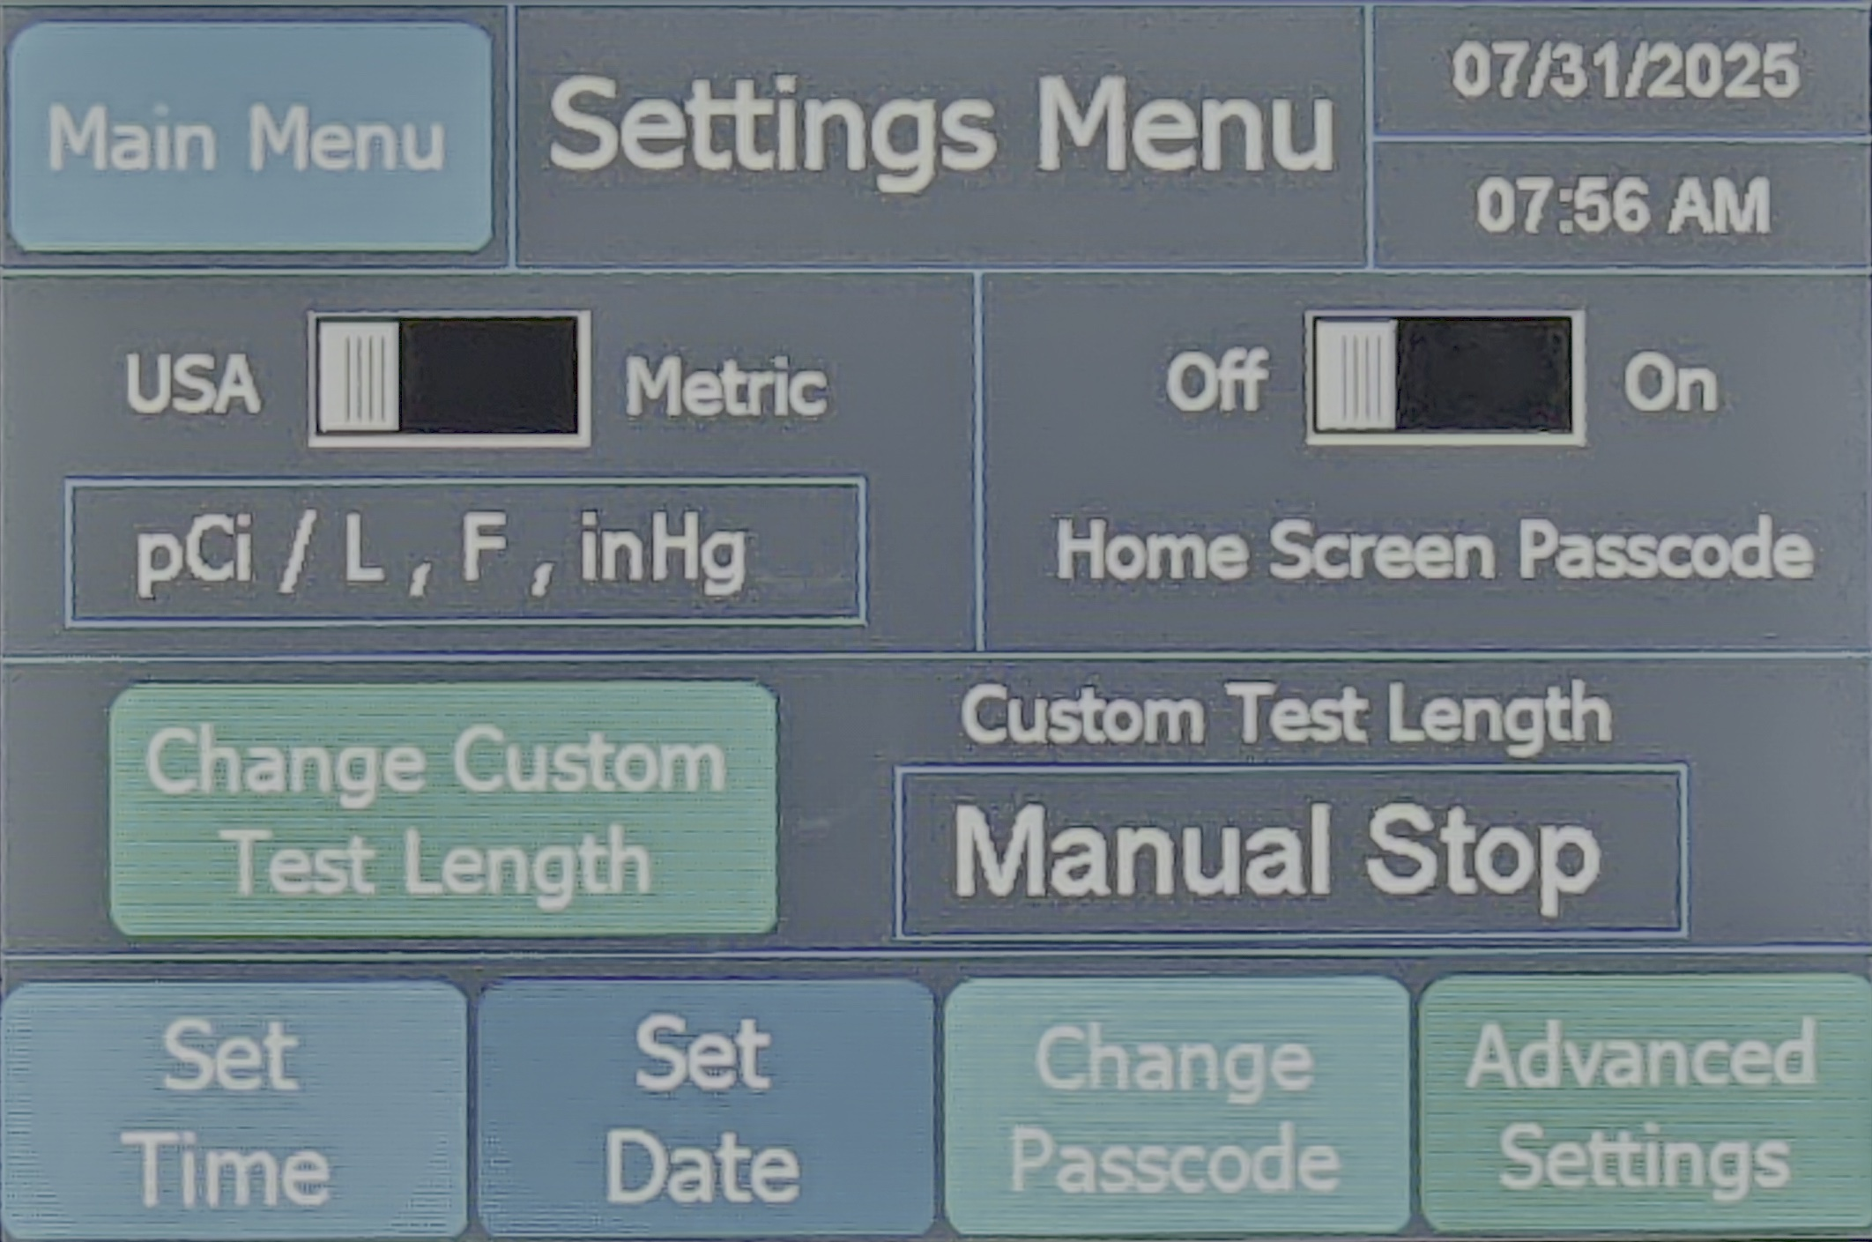
Device Settings
Found by pressing ‘Device Settings’
  SAE/Metric
    Use slider to select between US and EU-extended units
  Custom Test Length
  Set Time
    Press button and follow on-screen directions
  Set Date
    Press button and follow on-screen directions
  Enable Home Screen Passcode
  Change Passcode
    Press button and follow on-screen directions

Slide 24
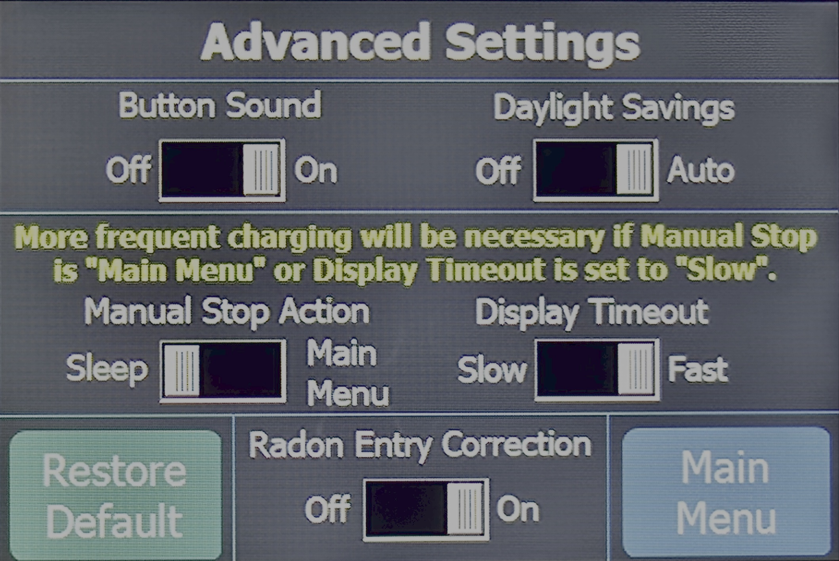
Advanced Settings
Found by pressing ‘Device Settings’
  Button Sounds
    Use slider to enable/disable the tone when pressing the screen
  Daylight Savings
    Use slider to enable/disable DST adjustment
  Manual Stop Test Action
    Use slider to select between going to sleep or returning to main menu
  Screen Timeout
    Use slider to select between a slow and fast timeout (fast saves battery)
  Radon Entry Correction
    Utilizes the high sensitivity of the CRM-LPT to quickly estimate the true radon level at the very start of a test

Slide 25

RAD-LAB Software
Explanation of Features & Operation
RAD-LAB allows you to connect your femto-TECH CRM to the computer or mobile device of your choice to download and manage report data. This version of the software is our most feature-packed version to date, giving you the tools you need to analyze your protocol tests and customize/manage your report data with ease.
Download Desktop App HERE
(Compatible with macOS and Windows)
Download Mobile App HERE
(Compatible with Android and iOS)

Slide 26
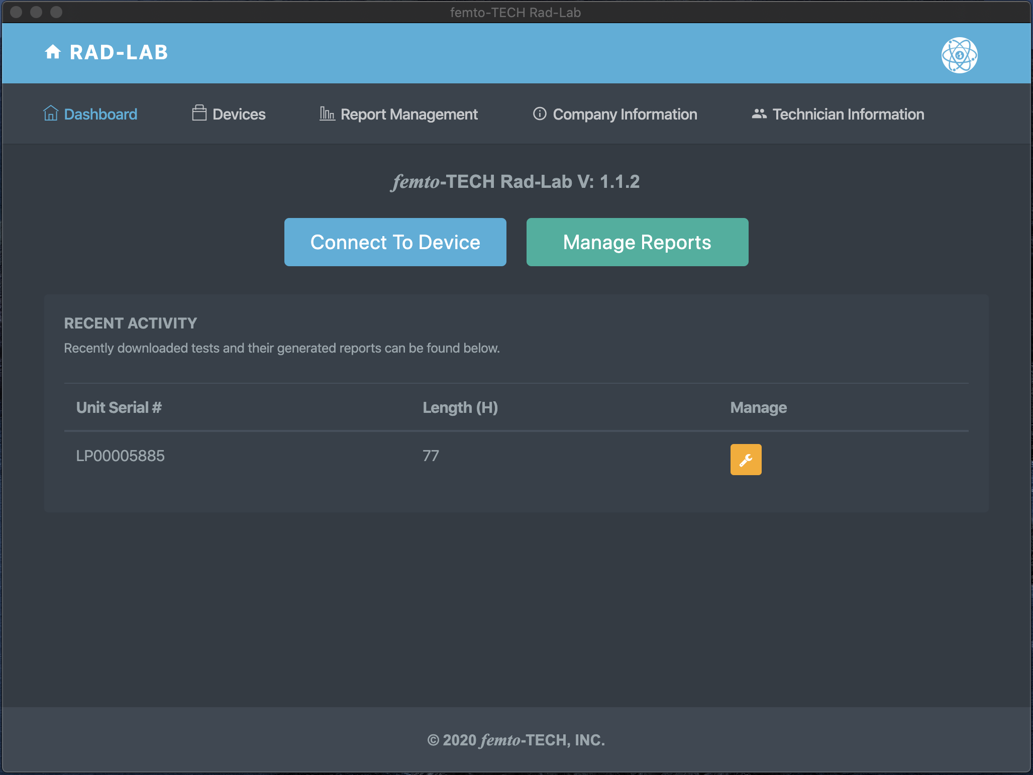
Getting Started
First things first, click the ‘Company Information’ tab to edit/save your company’s information and logo.
Once saved, this information will automatically be added to each of your generated reports.

Slide 27
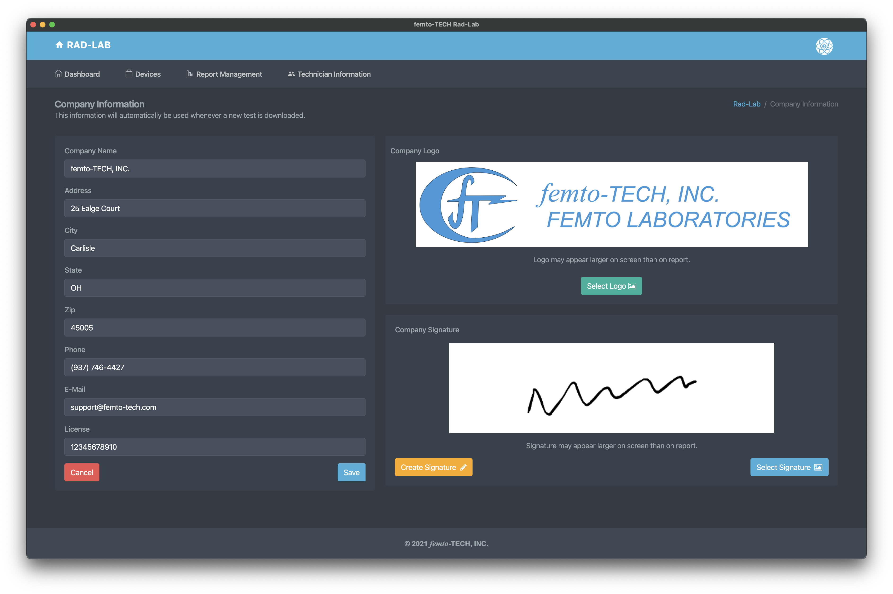
Company Information
Enter your company’s information to be automatically populated to each of your reports.
Select your company’s logo (optional) to be added to the top of each report.
Create or add a signature to be added on each of your reports.

Slide 28
Getting Started
(continued)
Next, click the ‘Technician Information’ tab to edit/save technician information

Slide 29
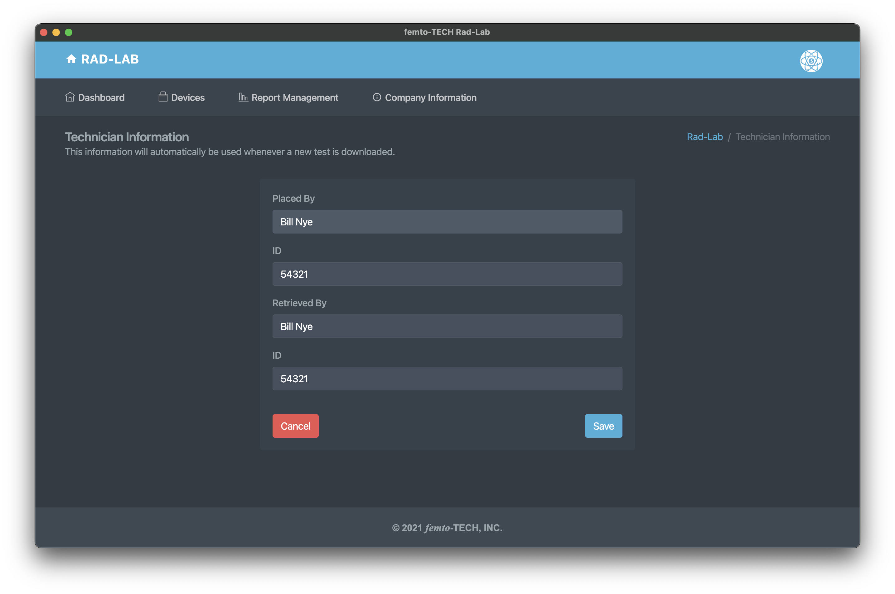
Technician
Information
Enter the name and ID of the technician(s) placing and retrieving the CRM that normally use the device.
This information can also be changed on the report itself.

Slide 30
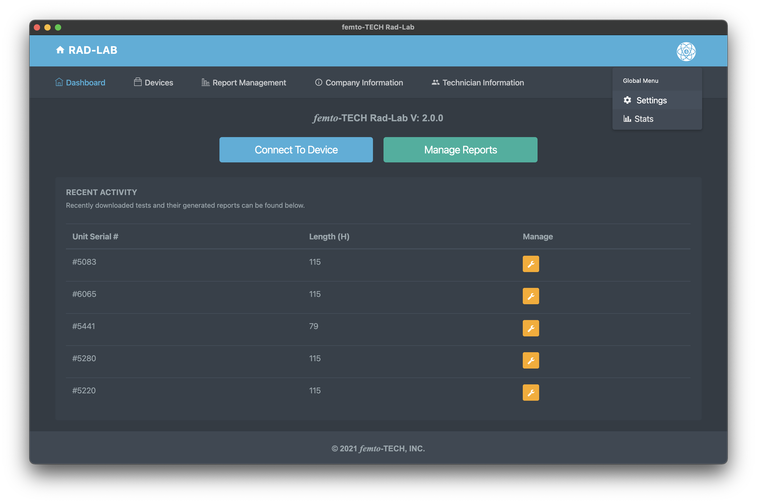
Getting Started
(continued)
Next, click the ‘Settings’ tab within the global menu in the top-right (circular icon) to further customize your generated reports.

Slide 31
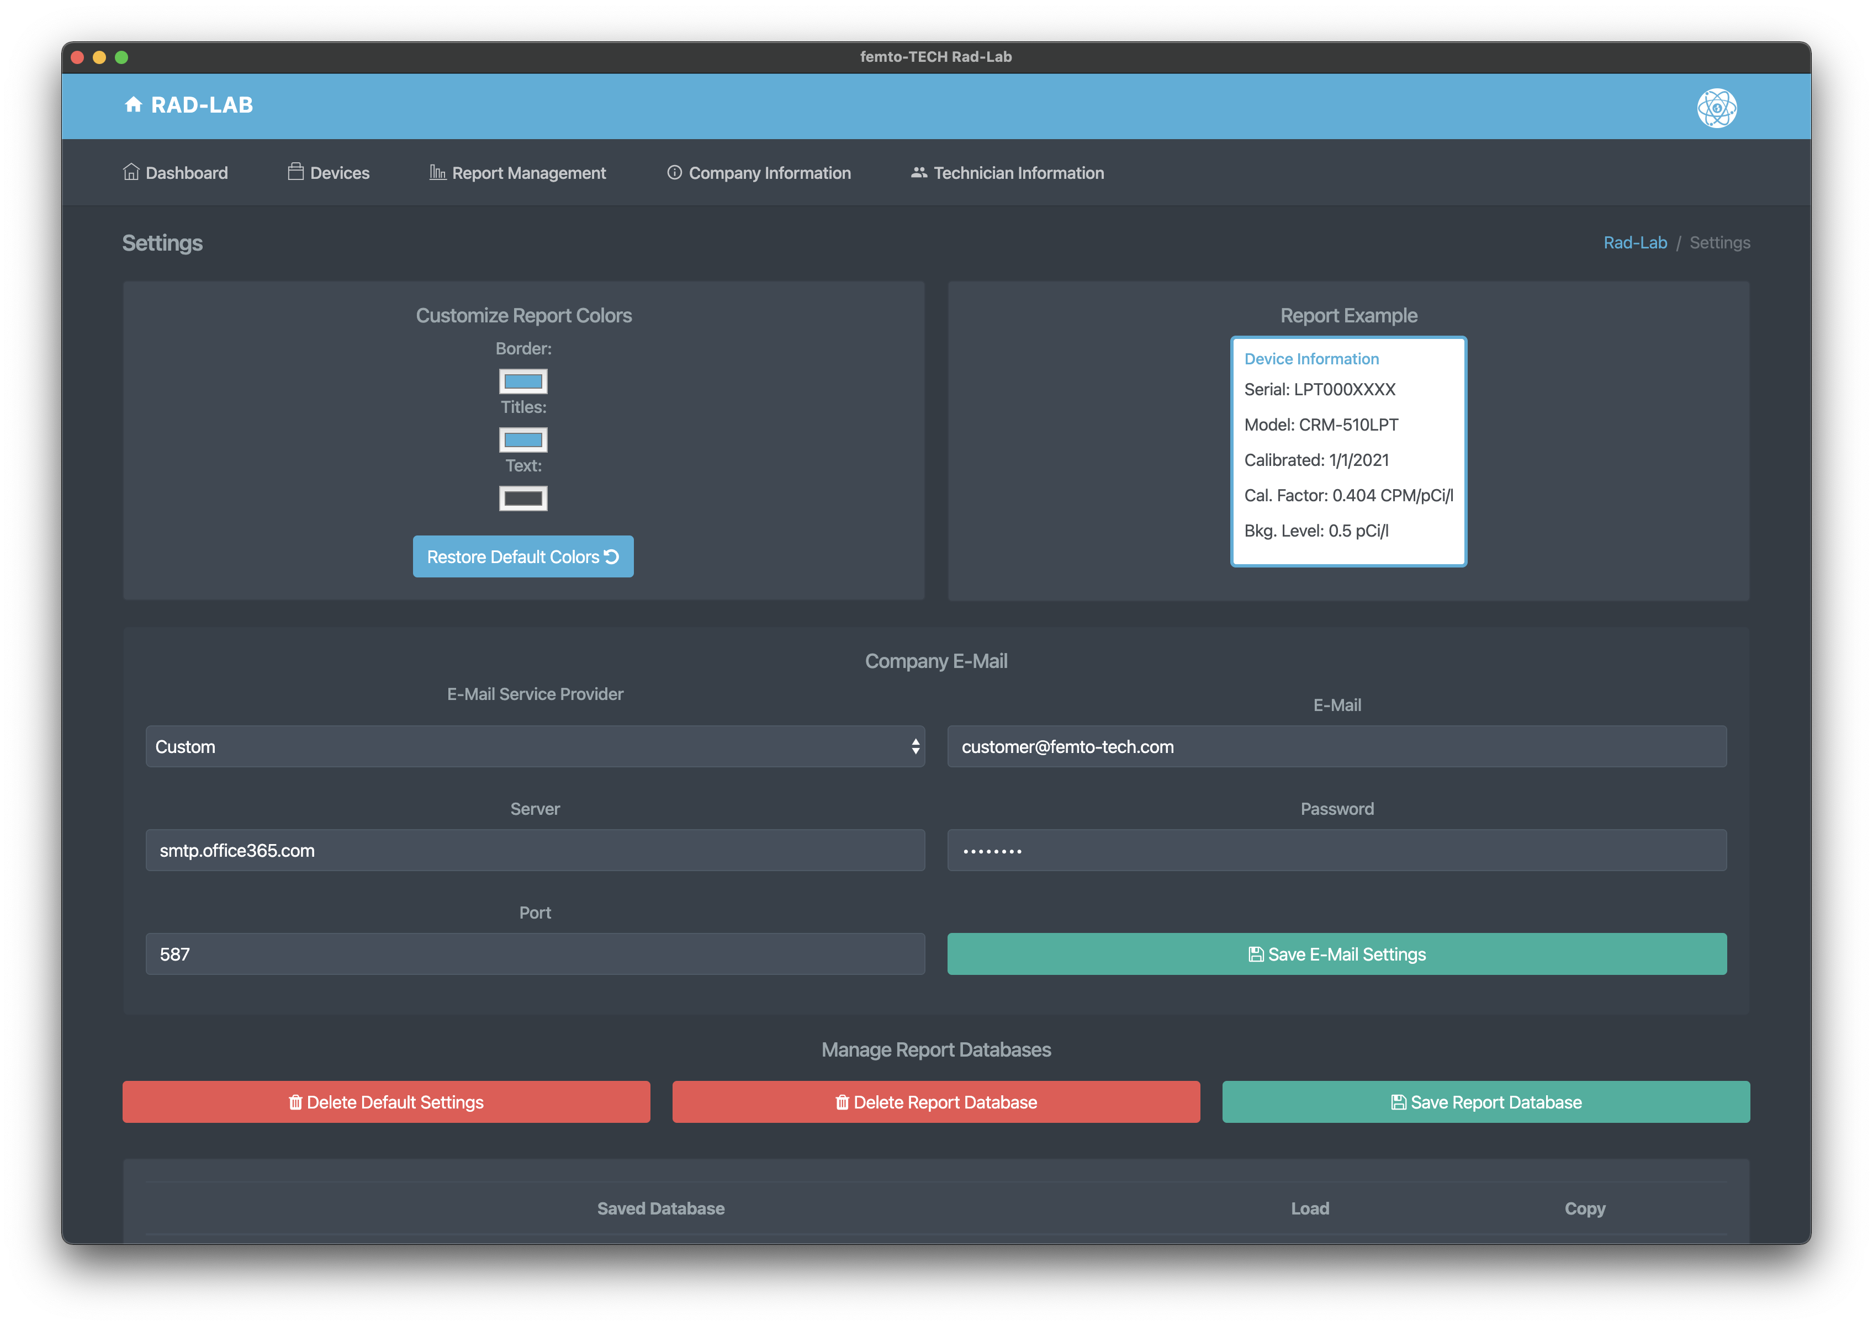
Customize Reports
Customize the colors on your reports by making color selections in the top-left.
Configure a company e-mail to be used to send reports directly once generated. If your company has no e-mail available or is unable to get it to work, femto-TECH provides an alternative option under ‘E-Mail Service Provider’. Select ‘femto-TECH’, and you will be able to send reports via customer@femto-tech.com. The Reply To address will be marked as your company’s e-mail from the ‘Company Information’ section, that way your customer can reply directly to you.
Company e-mail feature is optional. Most users prefer to save the report as a PDF and attach it to their own e-mail.

Slide 32
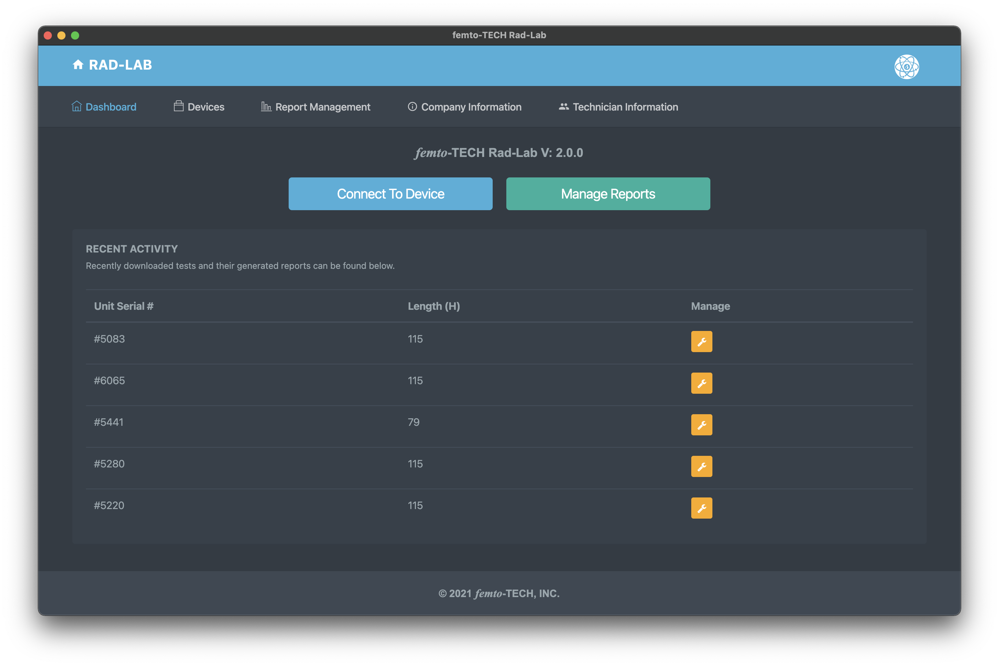
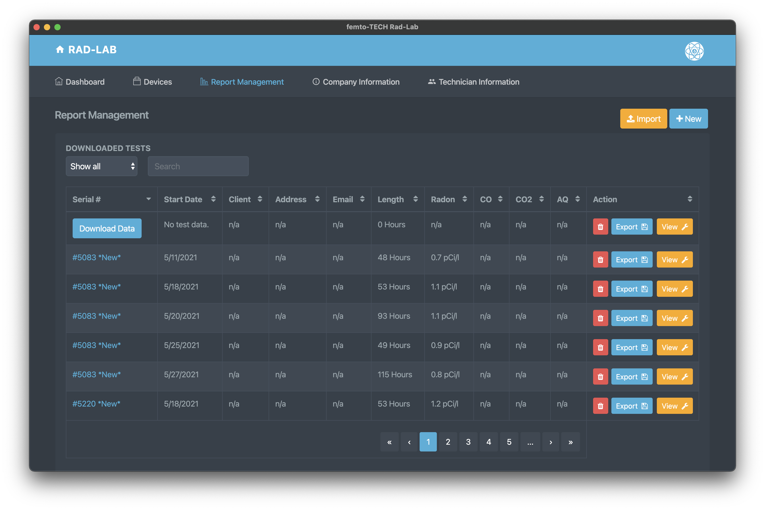
Download Data
Click either ‘Devices’ at the top left of the navigation bar or the ‘Connect To Device’ button on the Dashboard.
Data can also be downloaded to a previously created test entry by clicking ‘Download Data’ on the entry within the Report Management table.

Slide 33
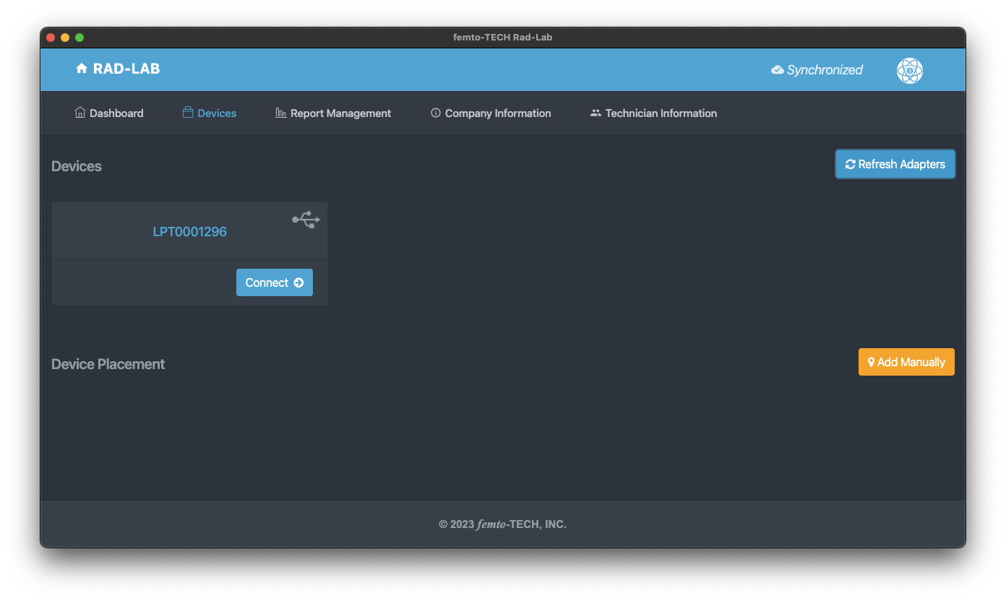
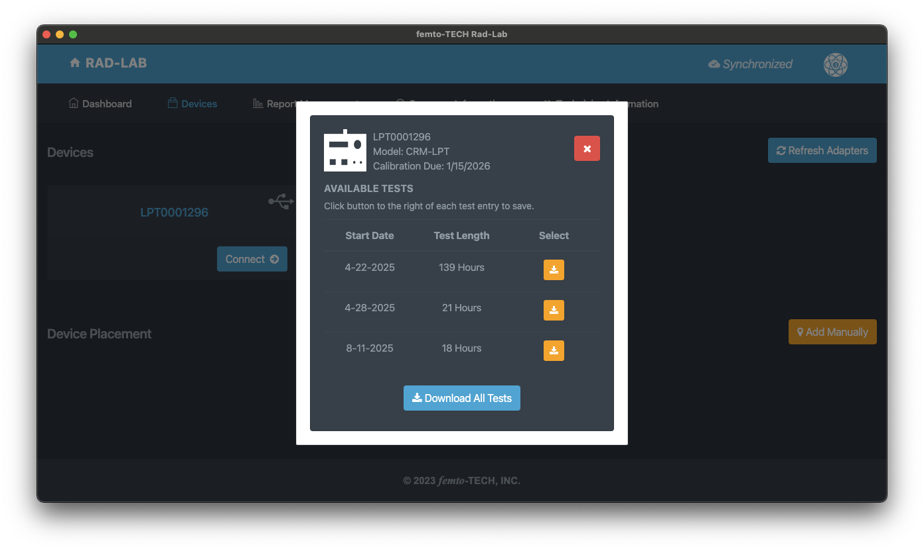
Download Data
(Desktop)
Plug the CRM-LPT into the computer using the provided download cable (USB-C cable), wake it up with the power button, and then click ‘Refresh Adapters’. Make sure the monitor is not currently running a test.
Click ‘Connect ->’ on the adapter displayed on the screen and then follow the on-screen instructions and select a test to download the data. Once the data has downloaded, a ’Download Complete!’ message will appear and then take you to the ’Report Setup’ screen.

Slide 34
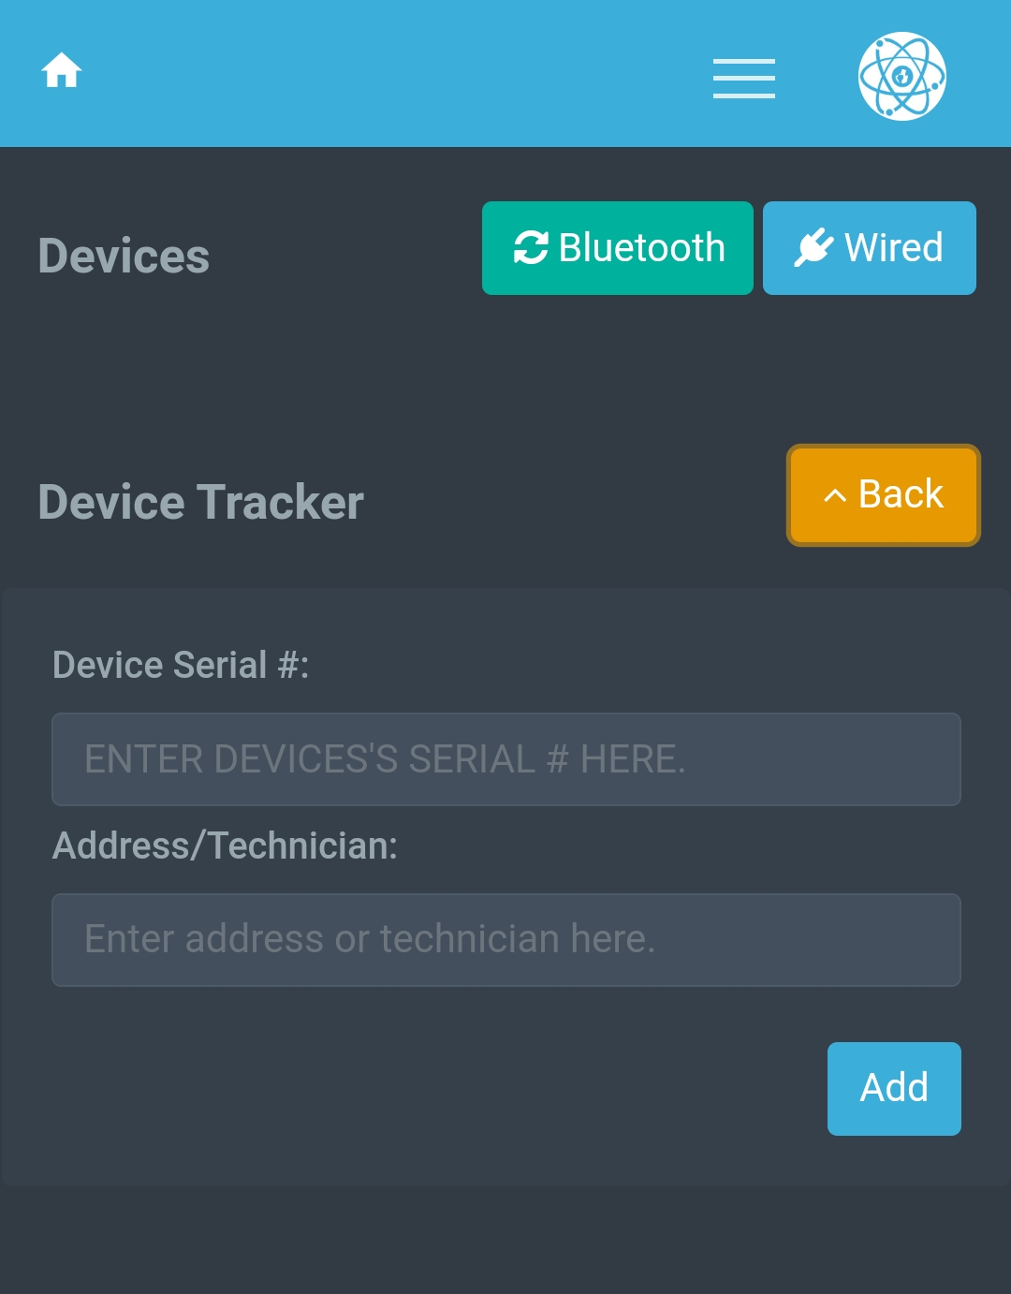

Download Data
(Mobile)
Wake the CRM-LPT up by pressing the button on the front panel. Make sure it is not currently running a test.
Click the ‘Bluetooth’ button to search for your monitor and then click ’Download’ once it appears on the screen.
Follow the on-screen instructions and select a test to download the data. Once the data has downloaded, a ’Download Complete!’ message will appear and then take you to the ’Report Setup’ screen.

Slide 35
Report Management
Use the search bar or table navigation menu to browse downloaded tests. Here you can edit, import/export, & delete existing tests.
Click anywhere within the test entry on the table to expand it for more information.
Click on the blue serial # of the entry or the ‘View’ button to load the test into the ‘Report Setup’ screen.

Slide 36
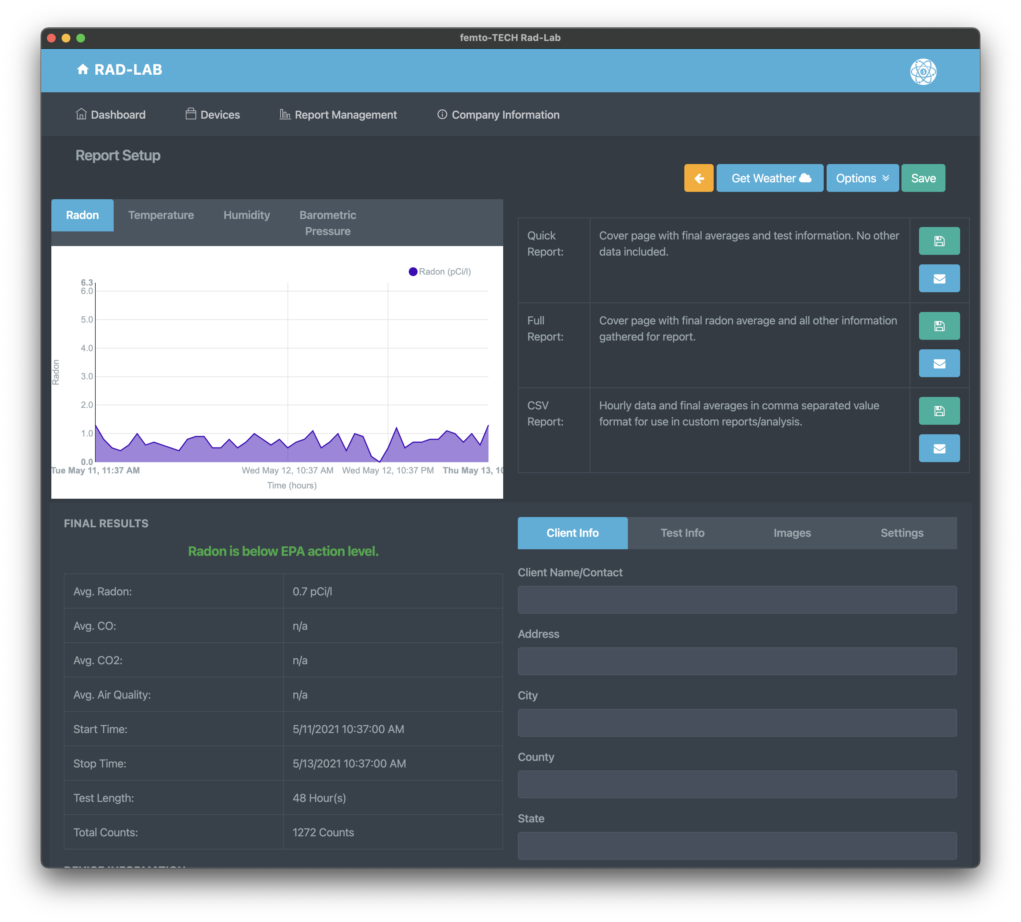



Report Management
Graphs plotted from the test data can be found in the top-left corner of the screen.
Results of the test can be found in the table on the bottom-left of the screen.
Hourly results can be read in table format via the button in the bottom-left corner below the ‘Final Results’ section.
The test-specific options menu can be found at the top-right of the screen. From here, you can change the units of each measurement as well as specify a span of time in which you would like to report on within the test.
The bottom-right section of the screen contains the report fields specific to the test being conducted. From here, you can add your customer’s information, test-specific information, images pertaining to the conducted test, and signatures.
Each section outlined on this slide will have a dedicated slide explaining its usage.

Slide 37
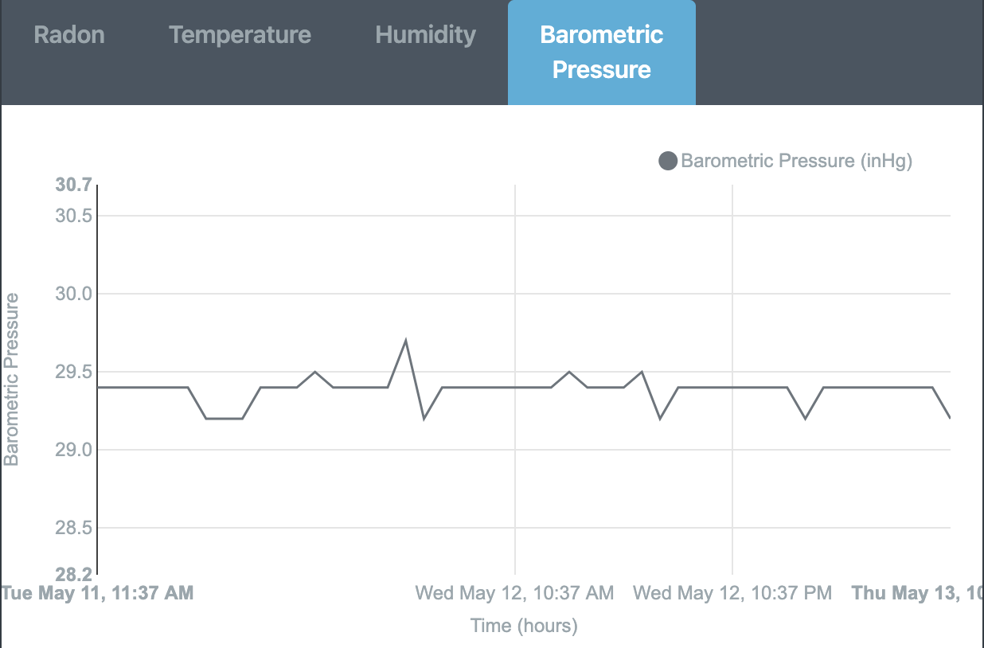
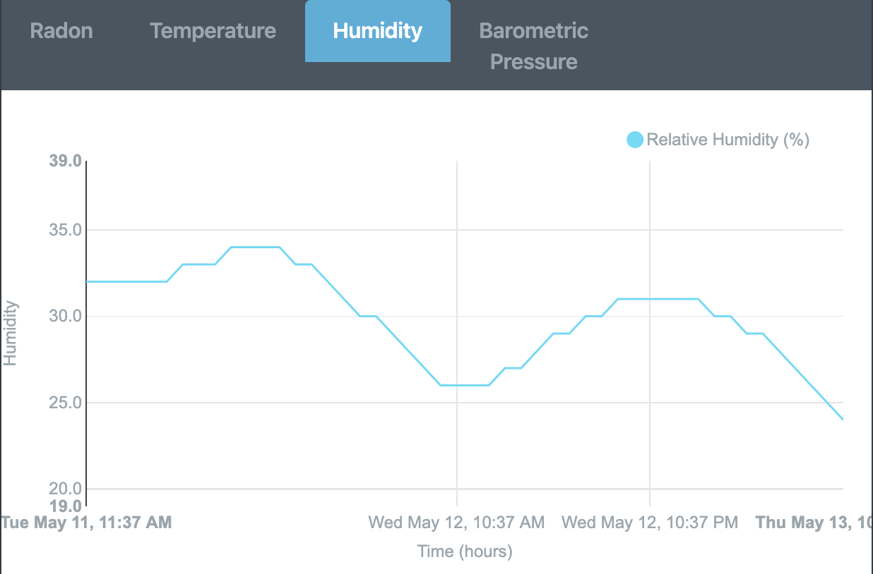
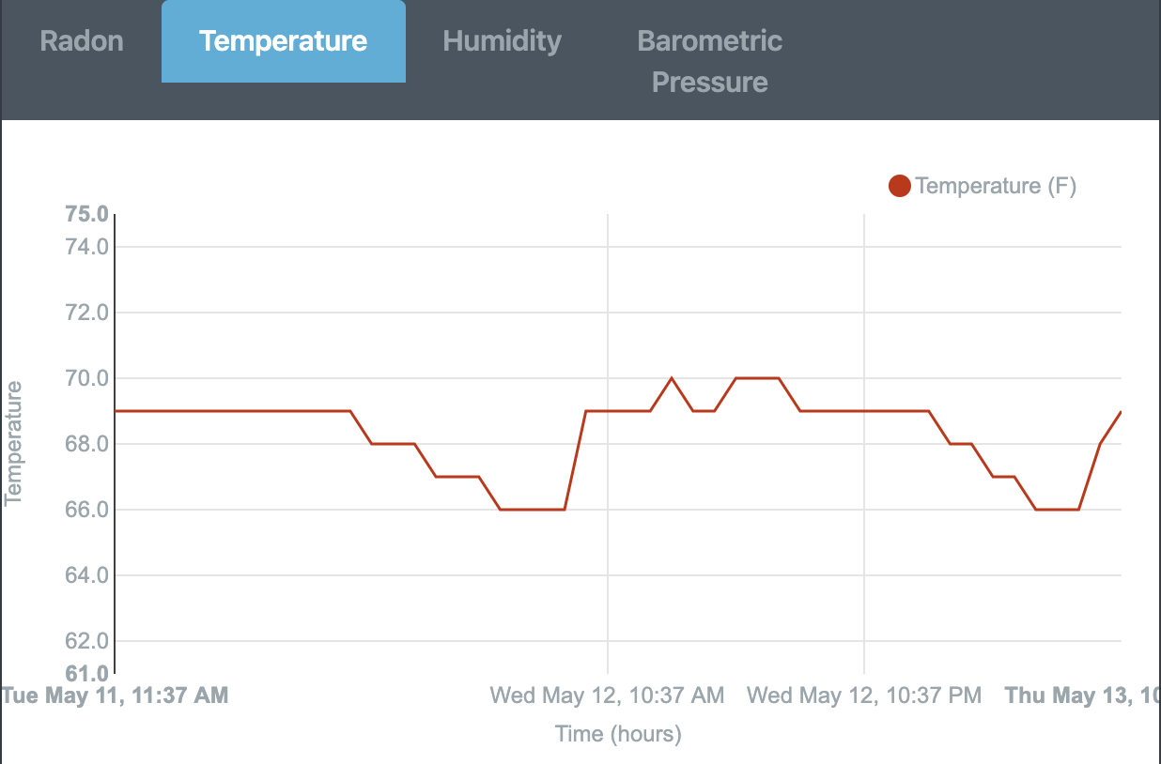
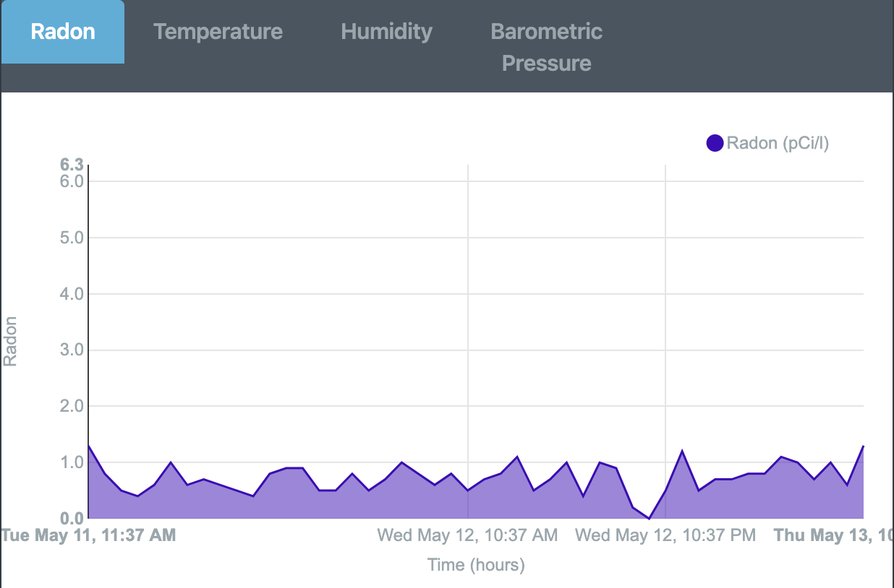
Report Setup (Graphing)
Each graph can be viewed by clicking its respective tab.
By hovering over the plots on each graph, you can view each hour’s value and exact time of recording.
Each graph is automatically adjusted/plotted whenever a specific range of hours is selected within the options menu (as seen on next slide).
The graphs can be enlarged by either maximizing your app window or turning your mobile device horizontally.

Slide 38
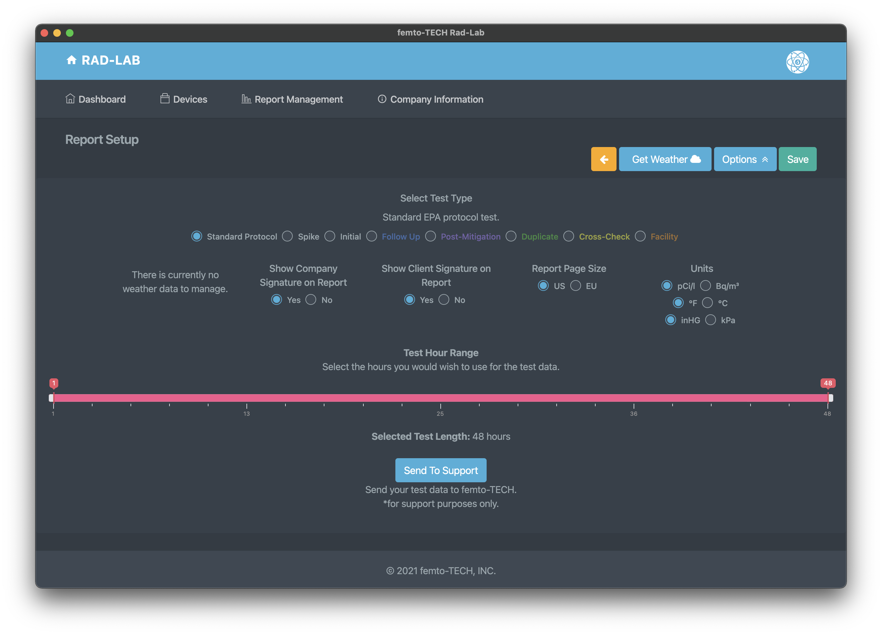

Report Setup (Options)
Click the ‘Options’ button to drop-down the options menu for the test.
From here, you can select the type of report you wish to generate. For most testing scenarios, the ‘Standard Protocol’ selection is adequate.
Below ‘Select Test Type’, you have the option to show weather data acquired for the test, as well as the company and client signatures. (All default to ‘Yes’ when applicable).
You can also change settings such as the report page size and the measurement units used for each field value and final average.
Select a test hour range to customize the hours that are being measured/reported. This feature can be used to accommodate a lack of closed-house conditions by running a longer test and manually selecting the span of hours. *Notice* a minimum of 44 continuous hours are required per the EPA for protocol testing.
Click the ‘Options’ button again to hide the menu and simultaneously save your changes.

Slide 39
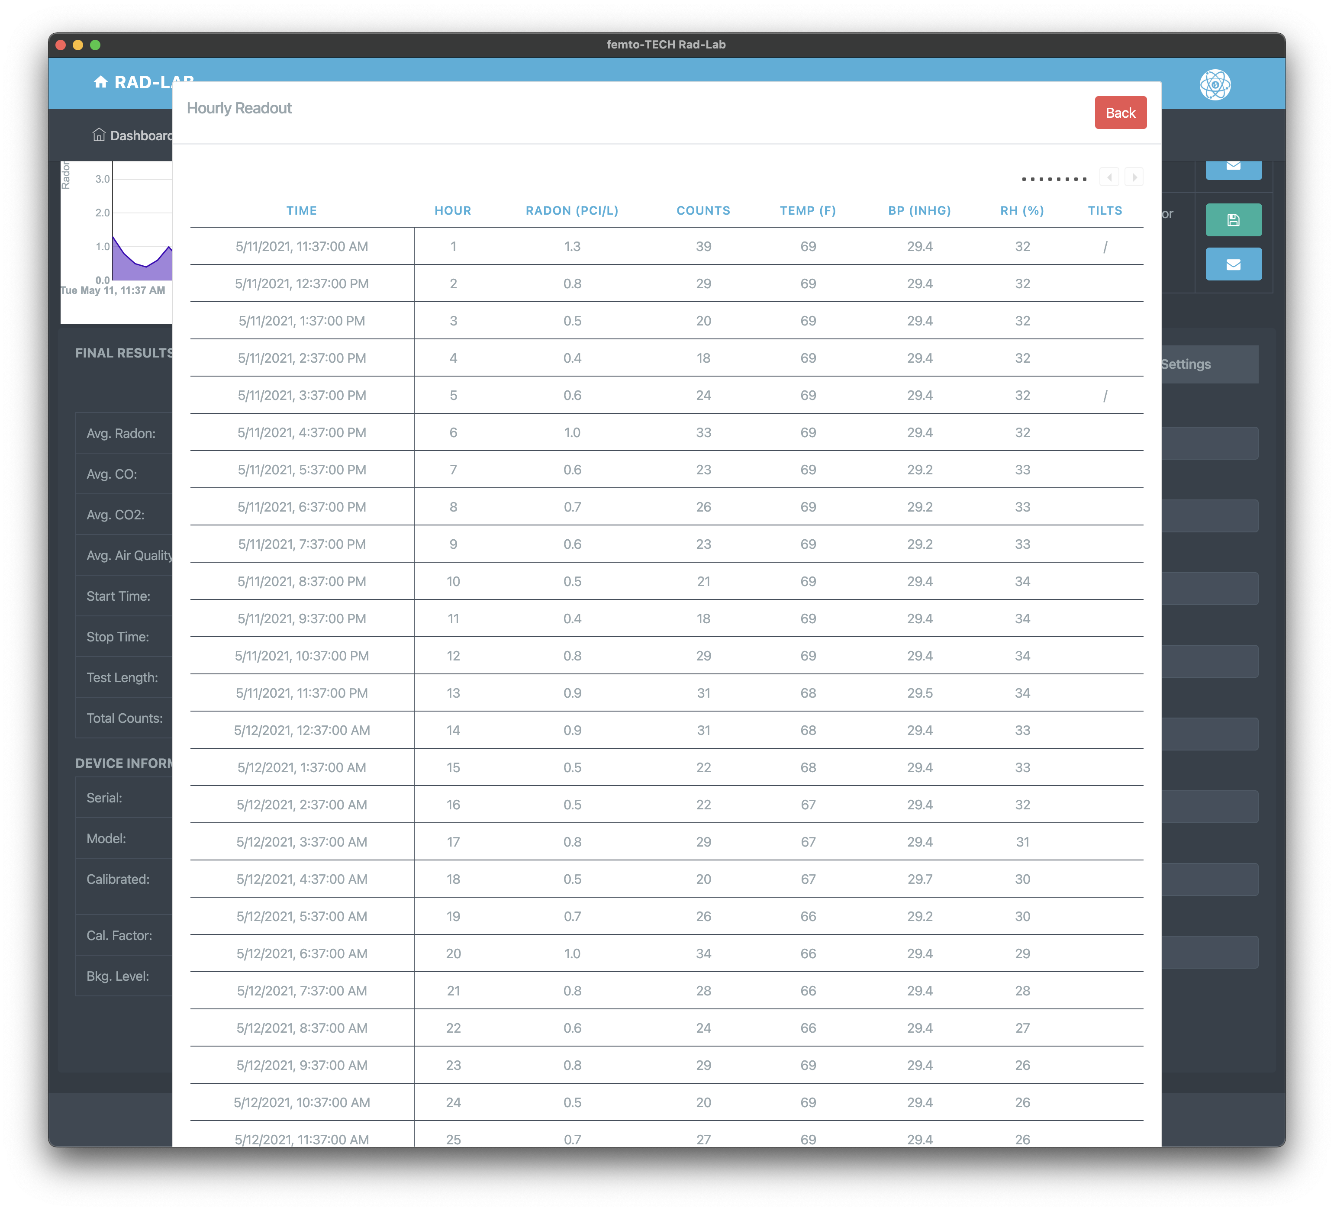
Report Setup (Hourly Readout)
Click the ‘View Readout’ button in the bottom-left side of the window to view the hourly table readout for each measured value.
If all columns are not showing on your screen, you can use the legend in the top-right of the table to navigate through the overflow columns.
Click the ‘Back’ button to close the hourly table readout and return to the previous screen.

Slide 40
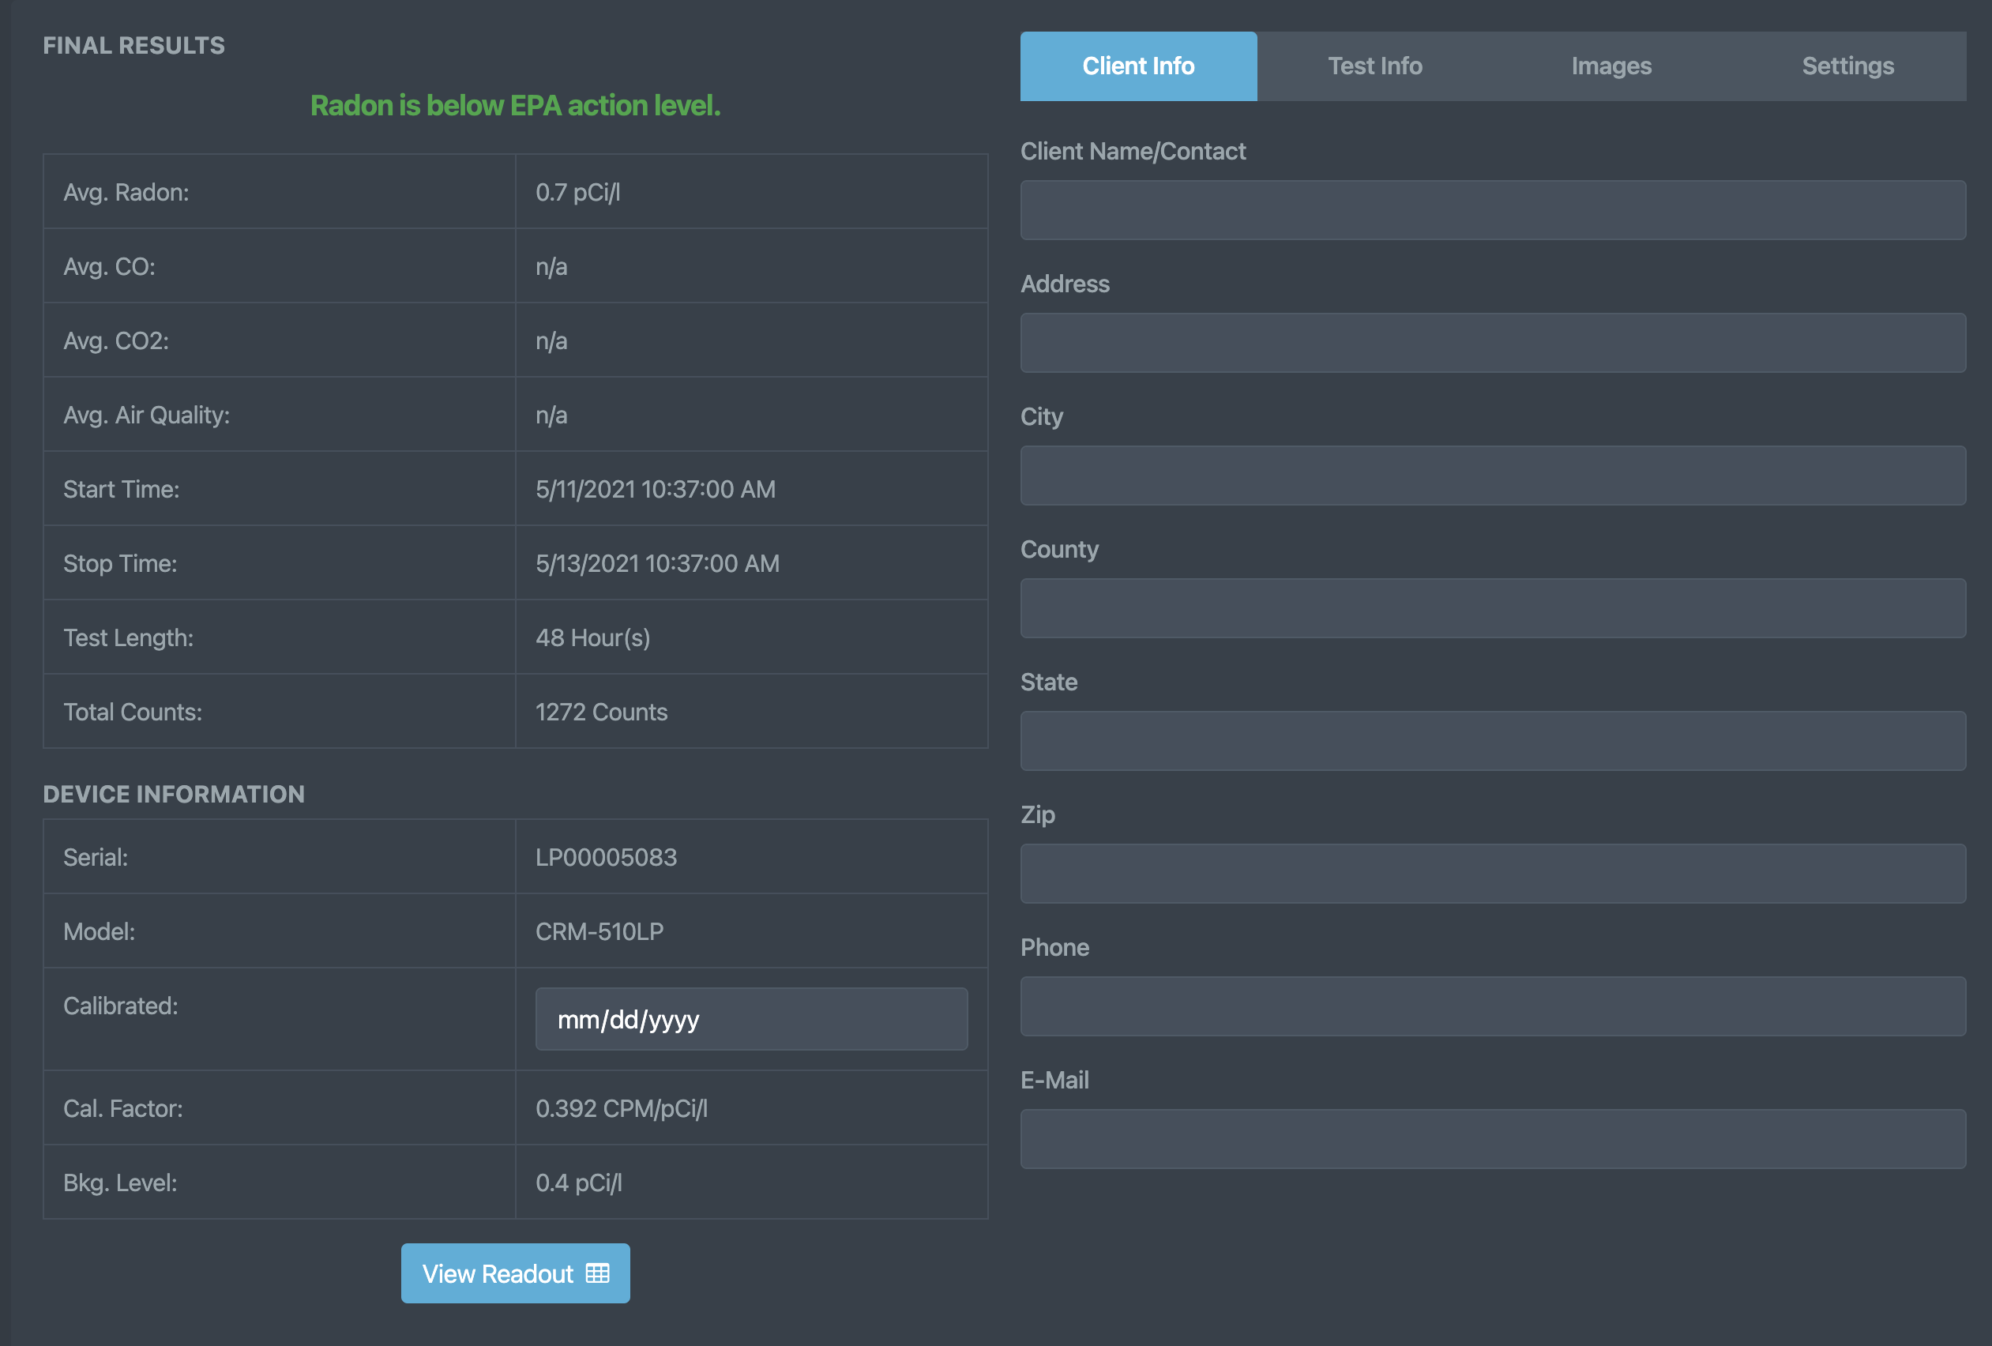
Report Setup (Client Information)
Click the ‘Client Information’ tab to enter/edit the information of the customer having the test completed.
These fields are used to populate the ‘Full Report’ as seen on the last slide of this show.

Slide 41
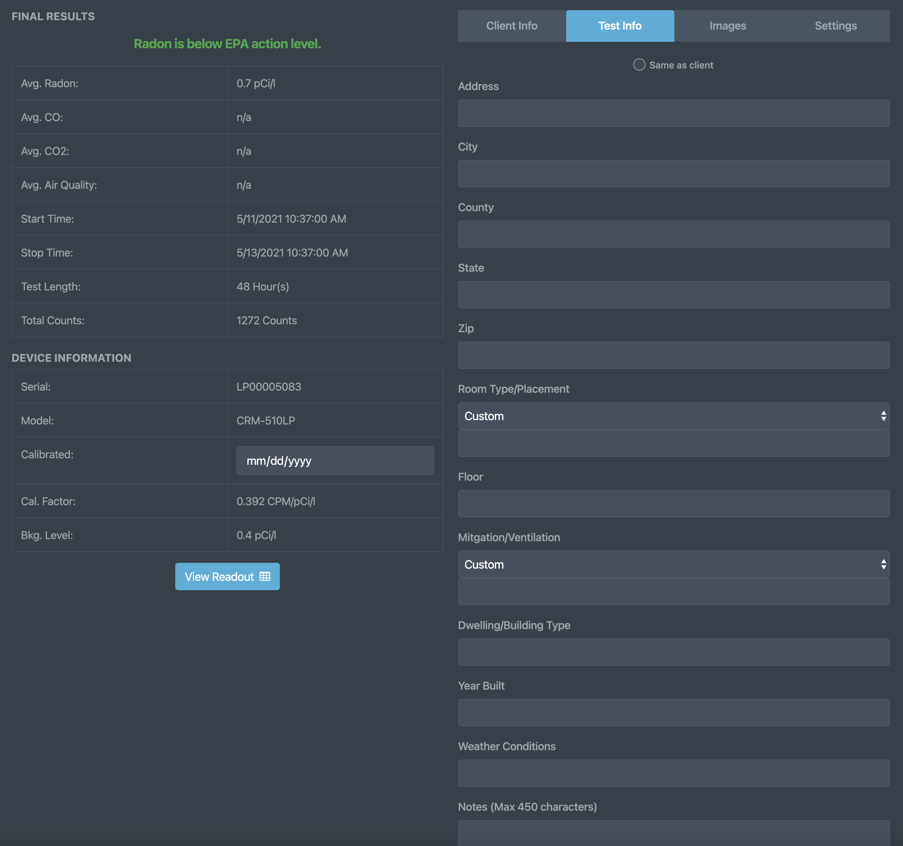
Report Setup
(Test Information)
Click the ‘Test Information’ tab to enter/edit any test-specific information.
These fields are also used to populate the ‘Full Report’ as seen on the last slide of this show.
Use the ‘Same as client’ button at the top to use the same address information as the client section.

Slide 42
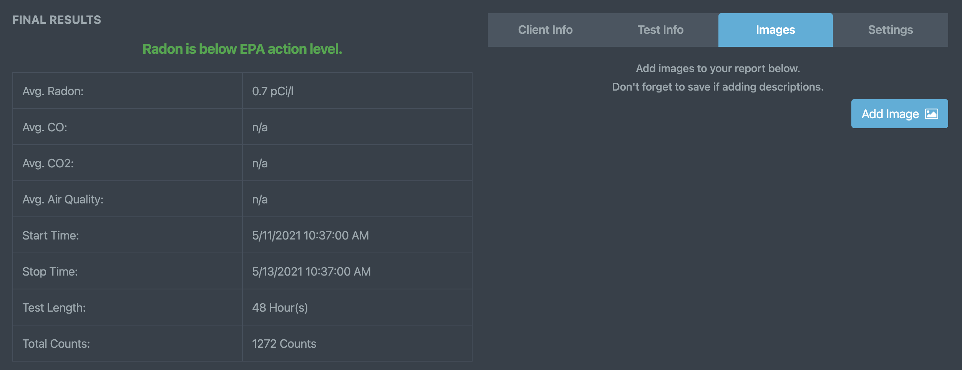
Report Setup
(Report Images & Attachments)
Click the ‘Report Images’ tab to add/take any images that are pertinent to the test being conducted.
Once an image is added, you will have the option to add an image description.
Each image and its accompanying description will automatically be added to your report once saved.
Click Add Report Page to add a PDF or other report material to the Radon Report within its own dedicated page.

Slide 43
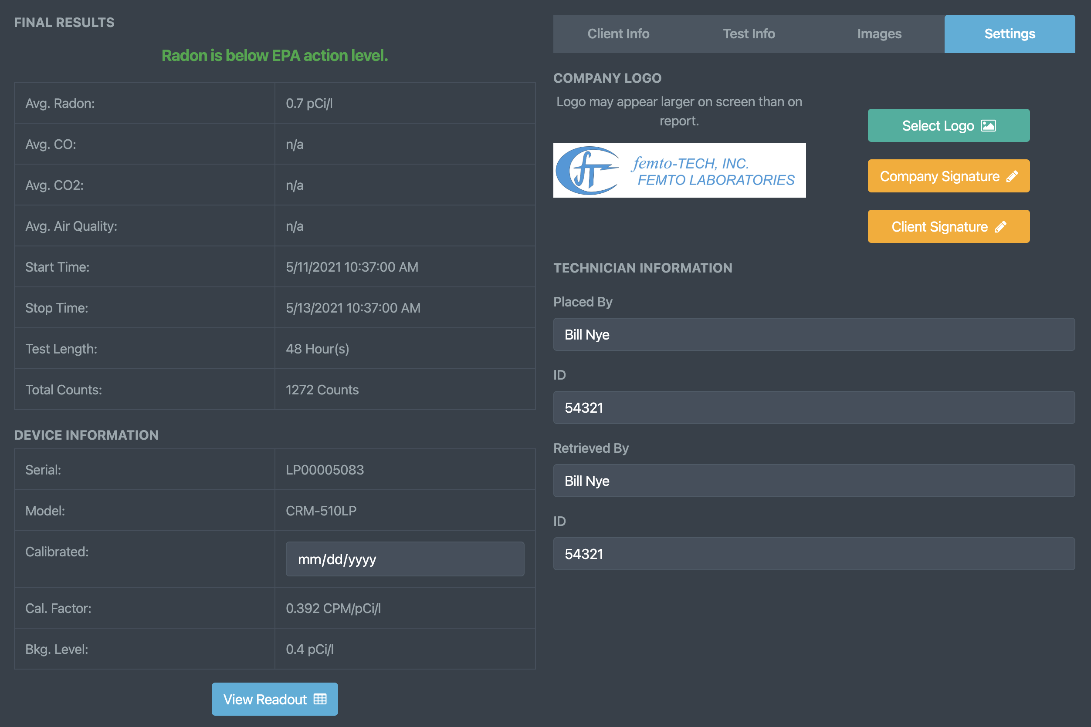
Report Setup
(Report Settings)
Click the ‘Report Settings’ tab to put the final touches on your generated report.
Click the ‘Select Logo’ button to change the logo you would like to be added to the top of the report.
Click ‘Company Signature’ to add/remove a signature for the person representing your company.
Click ‘Client Signature’ to add/remove a signature for the customer acknowledging the completion of the test.
The Technician Information can also be added/edited here in case that person were to change test-to-test.

Slide 44
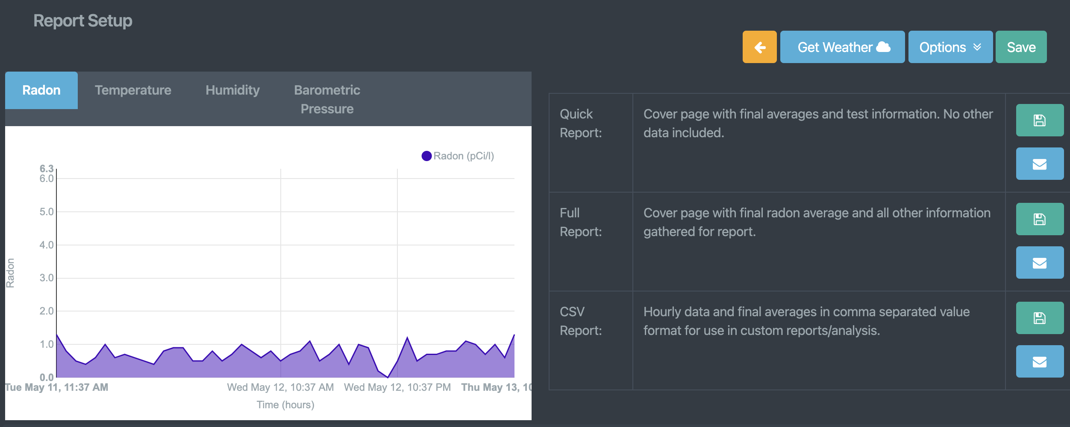



Report Setup
(Generating Report)
There are 3 types of reports that can be generated from your test data. (Quick, Full, & CSV Reports)
Quick - Cover page with final averages only. No other data included.
Full - Cover page with final test averages and all other information gathered for report.
CSV - Hourly data and final averages in comma separated value format for use in custom reports/analysis.
Mobile Only - Report can be shared/sent via your preferred method (email, message, other 3rd party apps) by clicking their respective ‘Share’ buttons.
Mobile Only - Report can be printed directly to a networked printer if the printer has already been installed for use on your phone and you are connected to the same network.
Mobile Only - Report can be printed directly to a supported BLE thermal printer from within the ‘Settings tab’ on your mobile device.

Slide 45



Report Setup
(Sharing via E-mail)
Click the button containing the mail icon for either of the 3 reports to generate and immediately share via e-mail. You can customize the e-mail that is sent and then save it as a template to be used for future e-mails. *Notice* - a valid e-mail account must be used for this feature to work properly. If you lack a valid e-mail or cannot get yours to work, femto-TECH provides a free option that can be found in the global settings menu. Select ‘femto-TECH’ as the email provider and be sure you have an e-mail configured in your company information for it to work properly.

Slide 46
Tamper Detection
Each CRM-LPT is equipped with an accelerometer that logs movement within the hour of detection (logs to graph and hourly readout).
Along with the accelerometer, the LPT also measures temperature, humidity, and barometric pressure – all of which can be used for tamper detection.
As you can see on the graphs to the right, there is clear indication of tampering occurring in this test due to the tilt indicators and sudden changes seen within those hours. Based on these indicators, it is also evident that this tampering has had a direct effect on the measured radon.

Slide 47





Data Interference
Condensing Humidity
EMF
Notice the sudden drop in temperature and rise in humidity at the start of the test. The average temperature and humidity are conducive to an environment in which condensing humidity can occur. With these conditions it is possible for the electrometer to ‘run away’.
It is possible to overwhelm the electrometer on the CRM-LPT if it is placed near high-powered radio equipment such as modems/routers/cellular devices. Make sure to place your CRM at least 10 feet away from any wireless transmitting devices.

Slide 48
Declaration of Voluntary Compliance Example

Slide 49
EXAMPLE
REPORT

Slide 50
Device QA Log Example

Slide 51
Environmental Interference
Avoid areas with condensing humidity
Keep away from strong EM sources (Wi-Fi, routers, radio transmitters)
The array of sensors included in the CRM-LPT help to isolate and display potential interference caused by the surrounding environment.
The CRM-LPT is designed to work at any traversable elevation. (from mines to mountains)
CRM-LPT Operating Humidity & Temperature:
  5-90% non-condensing & 35-105°F

Slide 52
Calibration & QA
Calibration information visible on device screen (Device Info Button)
Calibration factor is stored within the device and set by manufacturer (cannot be tampered with)
Quality Assurance reduces the risk of error and ensures reliable results
CRM-LPT is to be calibrated annually by an approved calibration lab.
Approved Calibration Facilities for the CRM-LPT:
femto-TECH
Bowser Morner
UKHSA
Click here for more information about our radon calibration services
Click here to download a Quality Assurance Plan (QAP) for your CRM

Slide 53
Battery & Charging
USB-C charging
Months of battery life per charge
Full recharge may take 12–24 hours
Can also run test while charging for continuous use

Slide 54
Handling & Storage
Use protective case resistant to water
Avoid car storage – let device acclimate to test volume before starting a test if it has been sitting in a hot/cold car to prevent condensation on surfaces of device
Designed for long life and daily use

Slide 55
Radon Concentration Calculation
Although the built-in computer normally performs all the computations and provides the radon concentration data in pCi/l or Bq/m3, it is advisable for the operator to know how to carry out "hand" calculations. A back-up "hand" calculation should be carried out after entering a new calibration factor or background value to verify their correct entry.
To perform a "hand" calculation, record the number of counts accumulated and the elapsed time shown on the LCD display, convert to counts per minute, and apply the conversion factor (C.F.) and background (BKG) values supplied with the instrument to obtain the radon level in units of pCi/l. The following formula is used for this conversion:
Rewritten:
pCi/l = (Ending Count – Beginning Count) - BKG
[Elapsed Time (in minutes) x C.F.]
The background subtraction is generally only necessary for radon levels below 10 pCi/l. The backgrounds of femto-TECH calibrated devices are determined from aged air measurements. The background does not vary significantly with time nor from unit to unit, because the pulsed ion counter detector and open grid chamber discriminates against all ionizing radiation other than airborne alpha.
A a sample calculation:
pCi/l = (3150 - 0) - 0.5 pCi/l
[2880 minutes x .357 cpm/pCi/l]
pCi/l = 3150/2880 - 0.5 pCi/l (background in pCi/l, NOT cpm counts per min)
.357
Or
2.5 pCi/l
(2880 minutes is 48 hours)

Slide 56

Training Complete!
Congratulations on completing CRM-LPT device training!

