Slide 1
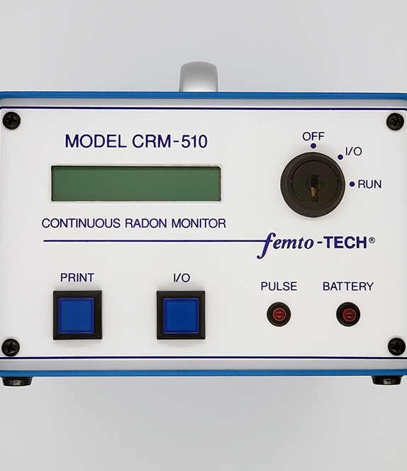
CRM-510LP Device
Training
Device Training Course for
NRPP Certification

Slide 2

Course Objectives
- Understand the operation of CRM-510LP
- Learn how to create reports with the Rad-Lab app
- Understand extra sensor features
- What does the CRM-510LP test for?

Slide 3

What is Radon?
Radon is an invisible, odorless, tasteless, radioactive gas.
It is the product of decaying uranium found in the soil, rocks, and water all around the world.
As a gas, it seeps into your home or business through any cracks or holes present in the building's foundation, or even through your well water.
Once it makes it inside your building it becomes trapped, subjecting all residents to exposure.
Radon can also enter your home or business through gaps in suspended floors, gaps around service pipes, cavities inside walls, & construction joints.

Slide 4

Why Test for Radon?
Radon is the second leading cause of lung cancer in the United States.
Most people do not know that their home has high levels of radon or that they should test for it.
Many people do not realize how harmful radon is.
The longer your exposure, the higher the risk to you.
This means if exposed continually starting at a young age, children are at a higher risk of lung cancer as they grow into adulthood.

Slide 5
EPA & Industry Protocols
ANSI/AARST MAH-2023
  Protocol for Conducting Measurements of Radon and Radon Decay Products in Homes
ANSI/AARST MA-MFLB-2023
  Soil Gas Mitigation Standards for existing Multifamily, School, Commercial and Mixed-Use Buildings
ANSI/AARST MS-QA-2023
  Radon Measurement Systems Quality Assurance
ANSI/AARST MS-PC-2022
  Performance Specifications for Instrumentation Systems Designed to Measure Radon Gas in Air

Slide 6
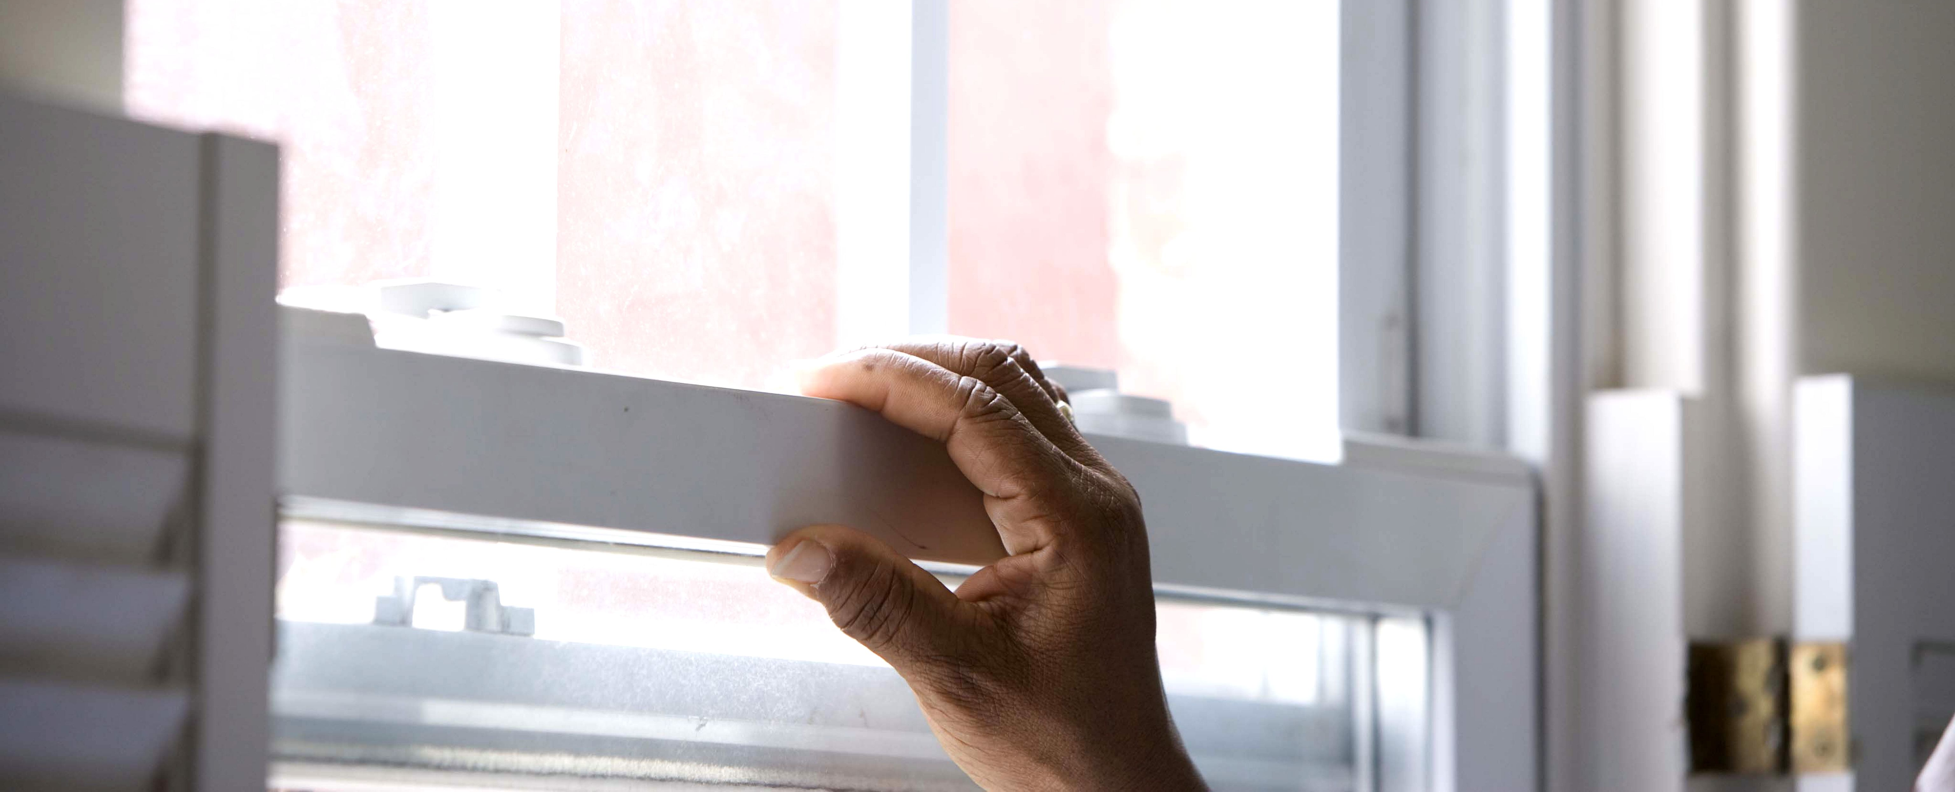
Closed House Conditions & Placement
All exterior doors and windows closed, except for normal entry and exit.
Internal-external air exchange systems off.
  Total internal recycle is allowed.
  Combustion or make-up air must not be closed.
  Permanent radon mitigation systems remain on.

Slide 7
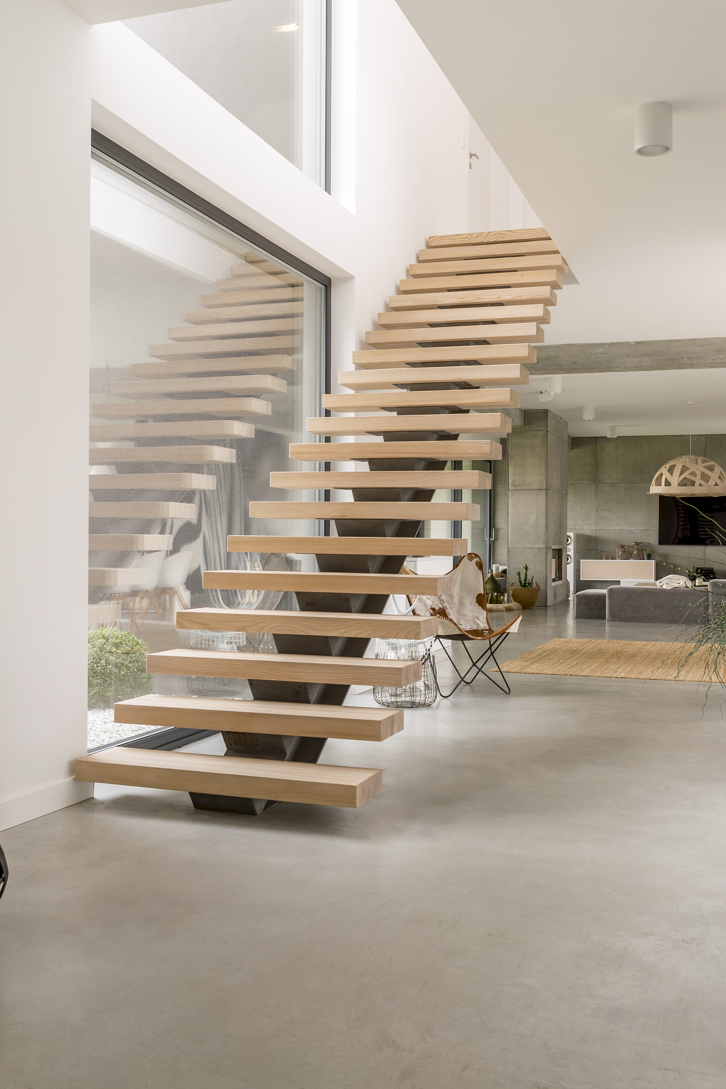
Where Does the Device Go Within the Chosen Room?
(All Protocols)
Where it will not be disturbed.
Away from drafts caused by heating, ventilating and air conditioning, exterior doors, fans, and windows.
Away from heat and areas of high humidity.
At least 50 cm or 20 inches from the floor.
At least 10 cm or 4 inches from other objects.
Not within 90 cm or 3 feet of exterior doors, windows, or other potential openings to the outside.
Not within 30 cm or 12 inches of an exterior wall.

Slide 8
Ways to Prevent or Detect Tampering
A report generated from the continuous monitor data helps detect unusual measurement swings.
A motion detector built into the monitor will help to determine if the device was moved.
The monitor’s environmental data can be paired with historical weather data using the RAD-LAB app.
Record room temperatures to assess the opening of windows.
Keyed security lock and passcode protection while test is running.

Slide 9
CRM-510LP Device Overview
Rugged Aluminum Chassis with Handle
Anti-Tamper Motion Detection
Long Battery Life
(1 year)
192 Hours of Data Storage
24+ CPH/pCi/l
AARST-NRPP Approved CR-8444
Passive Diffusion Ion Chamber
Keyed Security Lock
Real-Time Radon Measurements

Slide 10
CRM-510LP Environmental Sensors
Radon
CO
(on LPCO models)
Temp
Humidity
Pressure

Slide 11

Radon Sensor
Pulsed Ion Chamber fed via passive air diffusion
Sensitivity: 24 cph/pCi/L | 96 cph @ 4 pCi/L
Self Check
  The CRM-510LP has a self test feature that is completed at the start of every test.
  This feature physically pulses the Ion Chamber to verify that everything is working exactly as expected.

Slide 12

Carbon Monoxide Sensor
Carbon monoxide is an odorless, colorless and toxic gas. Because it is impossible to see, taste or smell, CO can kill you before you are aware it is in your home. The effects of CO exposure can vary greatly from person to person depending on age, overall health and the concentration and length of exposure. Average levels in homes without gas stoves vary from 0.5 to 5 parts per million (ppm). Levels near properly adjusted gas stoves are often 5 to 15 ppm and those near poorly adjusted stoves may be 30 ppm or higher. The U.S. Environmental Protection Agency (EPA) strongly recommends taking further action when the average carbon monoxide level exceeds 9 ppm. Many questions you may have can be found in the EPA’s publication “Carbon Monoxide's Impact on Indoor Air Quality".

Slide 13

Things to Avoid in the Test Environment
  Condensing humidity (moisture in the air can cling to the surfaces of electronics)
  Frequent vibrations (do not place on a washer/dryer or near something that could move the device)
  Wireless devices (place at least 10ft away from any wireless broadcasting device such as router/modem/radio transmitter) – these devices can cause interference when placed improperly

Slide 14

Self Test
  Are preformed on the CRM-510LP each time a test is started.
  The electrometer self check electronically injects pulses into the ionization chamber to verify that it is sensing and measuring radon correctly.
  If the Self Test fails, you will be notified on the screen of the monitor, so you know the test did not start.

Slide 15

Changing the Time on the CRM-510LP
Instructions
First, there must be no test data in the unit. Test Data must be cleared before changing the time!
(Be sure to print or download the data per printing instructions if you need data that is in the unit.)
To clear data: start a new test, waiting for the "SELF TEST ACTIVE" to complete and display "TEST STARTED!" Then, end the test by turning the key to OFF and pressing a button. The unit will display "TEST ENDED!" This will clear data from the unit.
Next, turn the key to I/O and press the PRINT button. As soon as "No Data to Print" is displayed, turn the key to RUN position.
The Time will be displayed in Hours/Minutes format, example: 9:17.
Use the PRINT button to change hours and the I/O button to change minutes. Pressing each button will accomplish this (hours will roll over at 23 to 0) (minutes will roll over at 59 to 0).
When the correct time is set, turn the key to the OFF position right away. The new time is set!
To check correct time setting, start a test and verify correct time during start up.

Slide 16
Operating Procedure for CRM-510LP
Start Test
Action | Screen Shows
(1) Turn-key to RUN position | Blank
(2) Push the PRINT button once | RUN, then goes to: pCi/l, "Hg, °F, or Bq/M³, kPa, °C
(3) Push the PRINT button again | DATE 01/01/20 (current date)
(4) Push and release both buttons at the same time | TIME 14:06 (current time)
(5) At this time, the device goes into Self-Test Mode This process takes about 20 seconds. When the test passes, the screen shows: At this time, the test is running If the screen says: Turn the key to OFF and push a button Start again from the beginning. If the device fails a second time, call femto-TECH for guidance | SELF TEST ACTIVE PASSED SELF TEST TEST STARTED! Count 0 SELF TEST FAILED
End Test
Action | Screen Shows
(1) Turn the key to the OFF position and push either of the buttons | TEST ENDED!
Note: Once you start a new test, the old data will be CLEARED!

Slide 17
Operating Procedure for CRM-510LP (Continued)
Print Test Using DPU-201G or HPU-245 Thermal Printers
Action | Screen Shows
(1) Attach printer cable to device and printer | Blank
(2) Turn the key to I/O, turn printer on | Blank
(3) Press PRINT button once | TIME: xxxx min.
(4) Press PRINT button again | pCi/l "Hg, °F
(5) Press IO Button to select between TABLE or GRAPH printout. Press PRINT to select | TABLE | GRAPH
(6) Press IO button to select between USE ALL or SKIP 12. Press PRINT to select | USE ALL DATE | SKIP 1st 12 HRS
(7) Press PRINT button and data will begin printing
(8) Data may be printed again by repeating the above steps
Note: If closed house conditions were not met and the test time was extended:
During step #6, press the I/O button and the screen will say (Skip 1st 12 hrs), then push PRINT. This will skip the first 12 hours of data, preventing it from being included in the final test average.

Slide 18

RAD-LAB Software
Explanation of Features & Operation
RAD-LAB allows you to connect your femto-TECH CRM to the computer or mobile device of your choice to download and manage report data. This version of the software is our most feature-packed version to date, giving you the tools you need to analyze your protocol tests and customize/manage your report data with ease.
Download Desktop App HERE
(Compatible with macOS and Windows)
Download Mobile App HERE
(Compatible with Android and iOS)

Slide 19
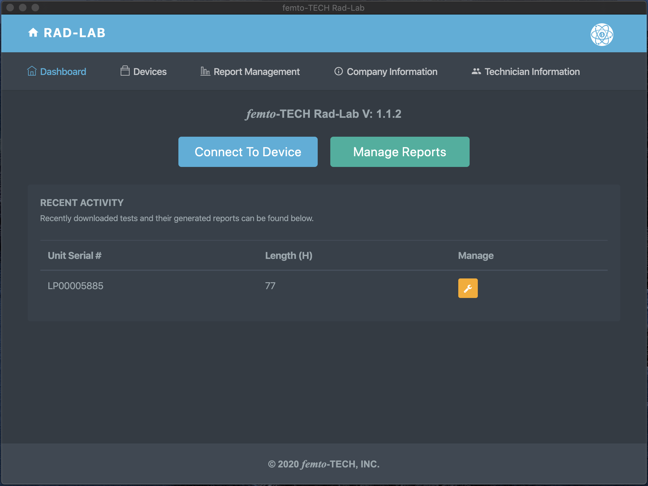
Getting Started
First things first, click the ‘Company Information’ tab to edit/save your company’s information and logo.
Once saved, this information will automatically be added to each of your generated reports.

Slide 20
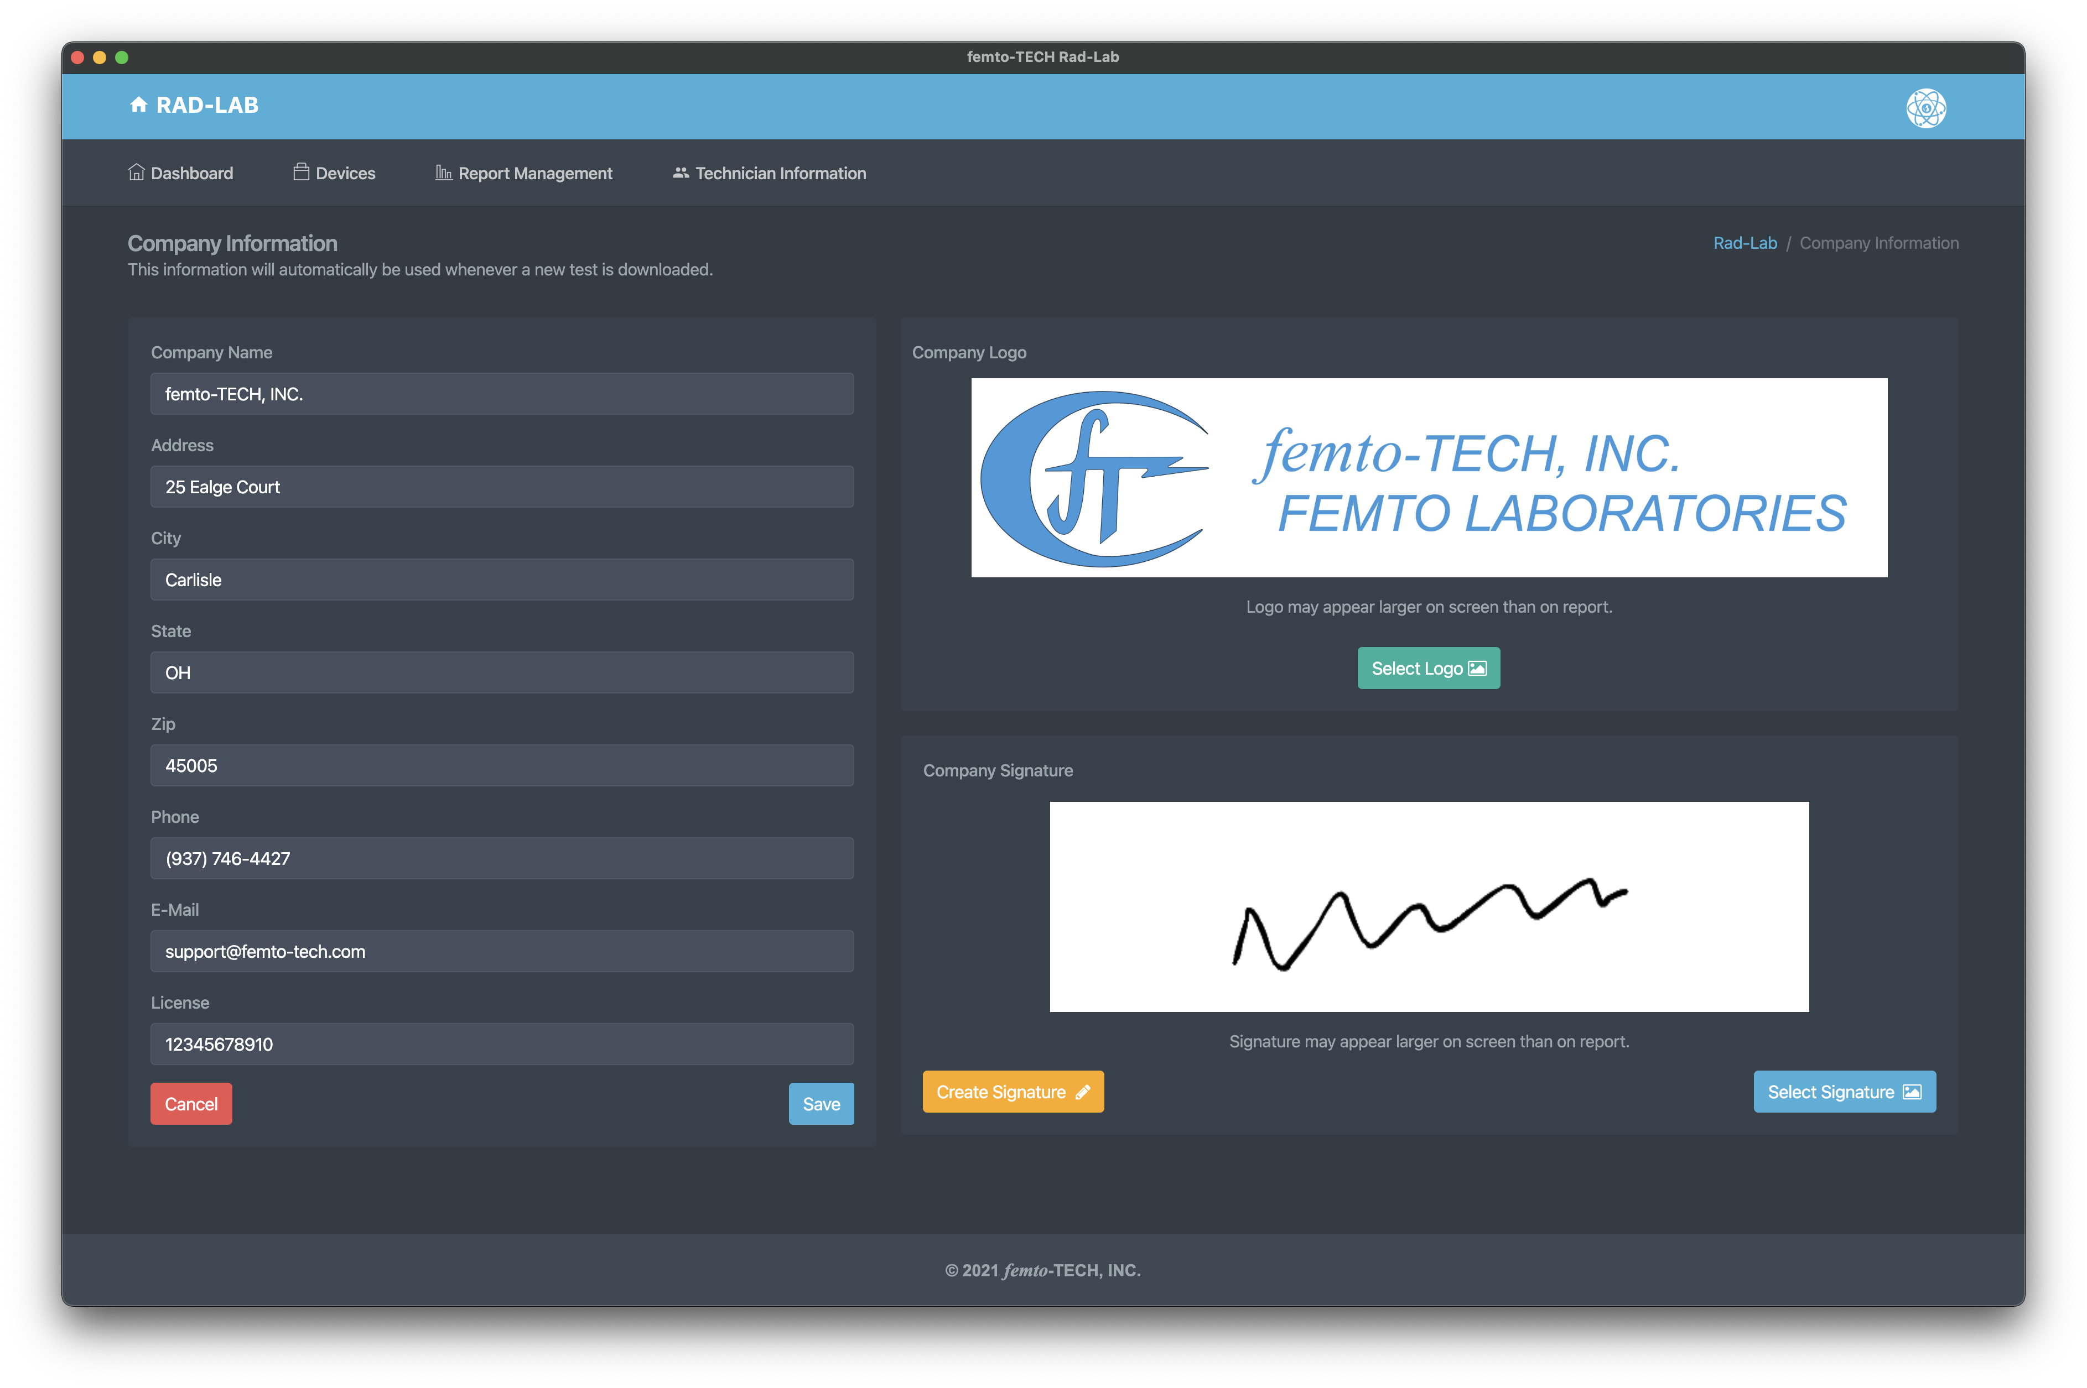
Company Information
Enter your company’s information to be automatically populated to each of your reports.
Select your company’s logo (optional) to be added to the top of each report.
Create or add a signature to be added on each of your reports.

Slide 21
Getting Started
(continued)
Next, click the ‘Technician Information’ tab to edit/save technician information

Slide 22
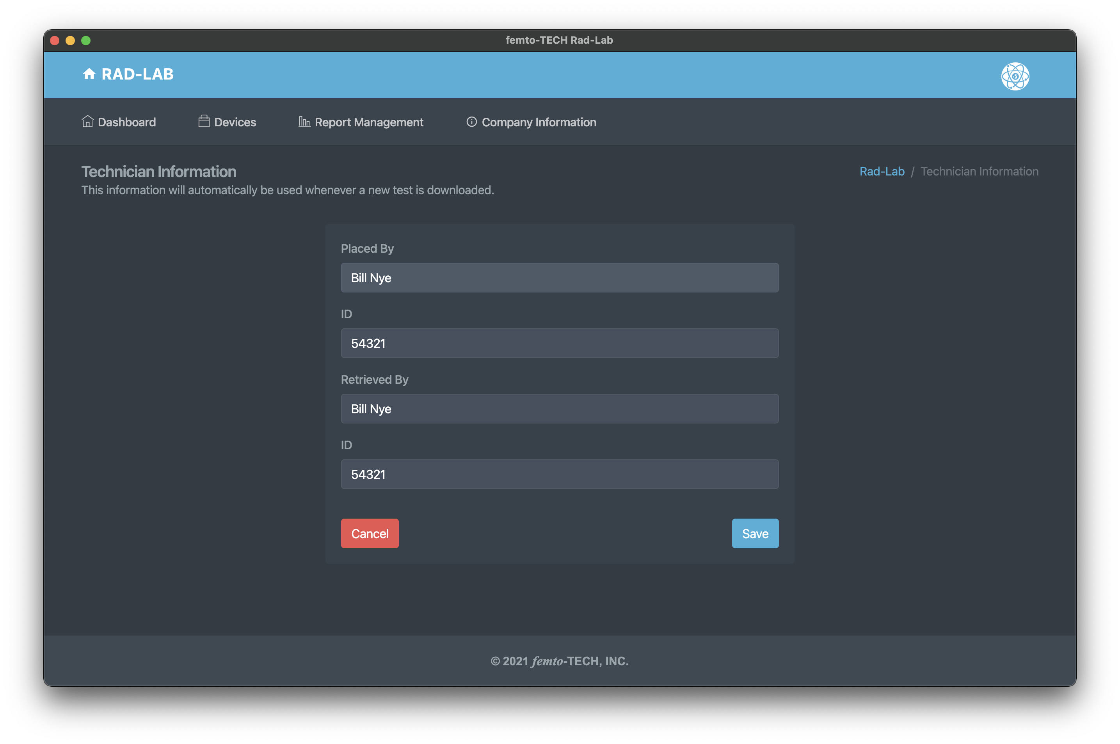
Technician
Information
Enter the name and ID of the technician(s) placing and retrieving the CRM that normally use the device.
This information can also be changed on the report itself.

Slide 23
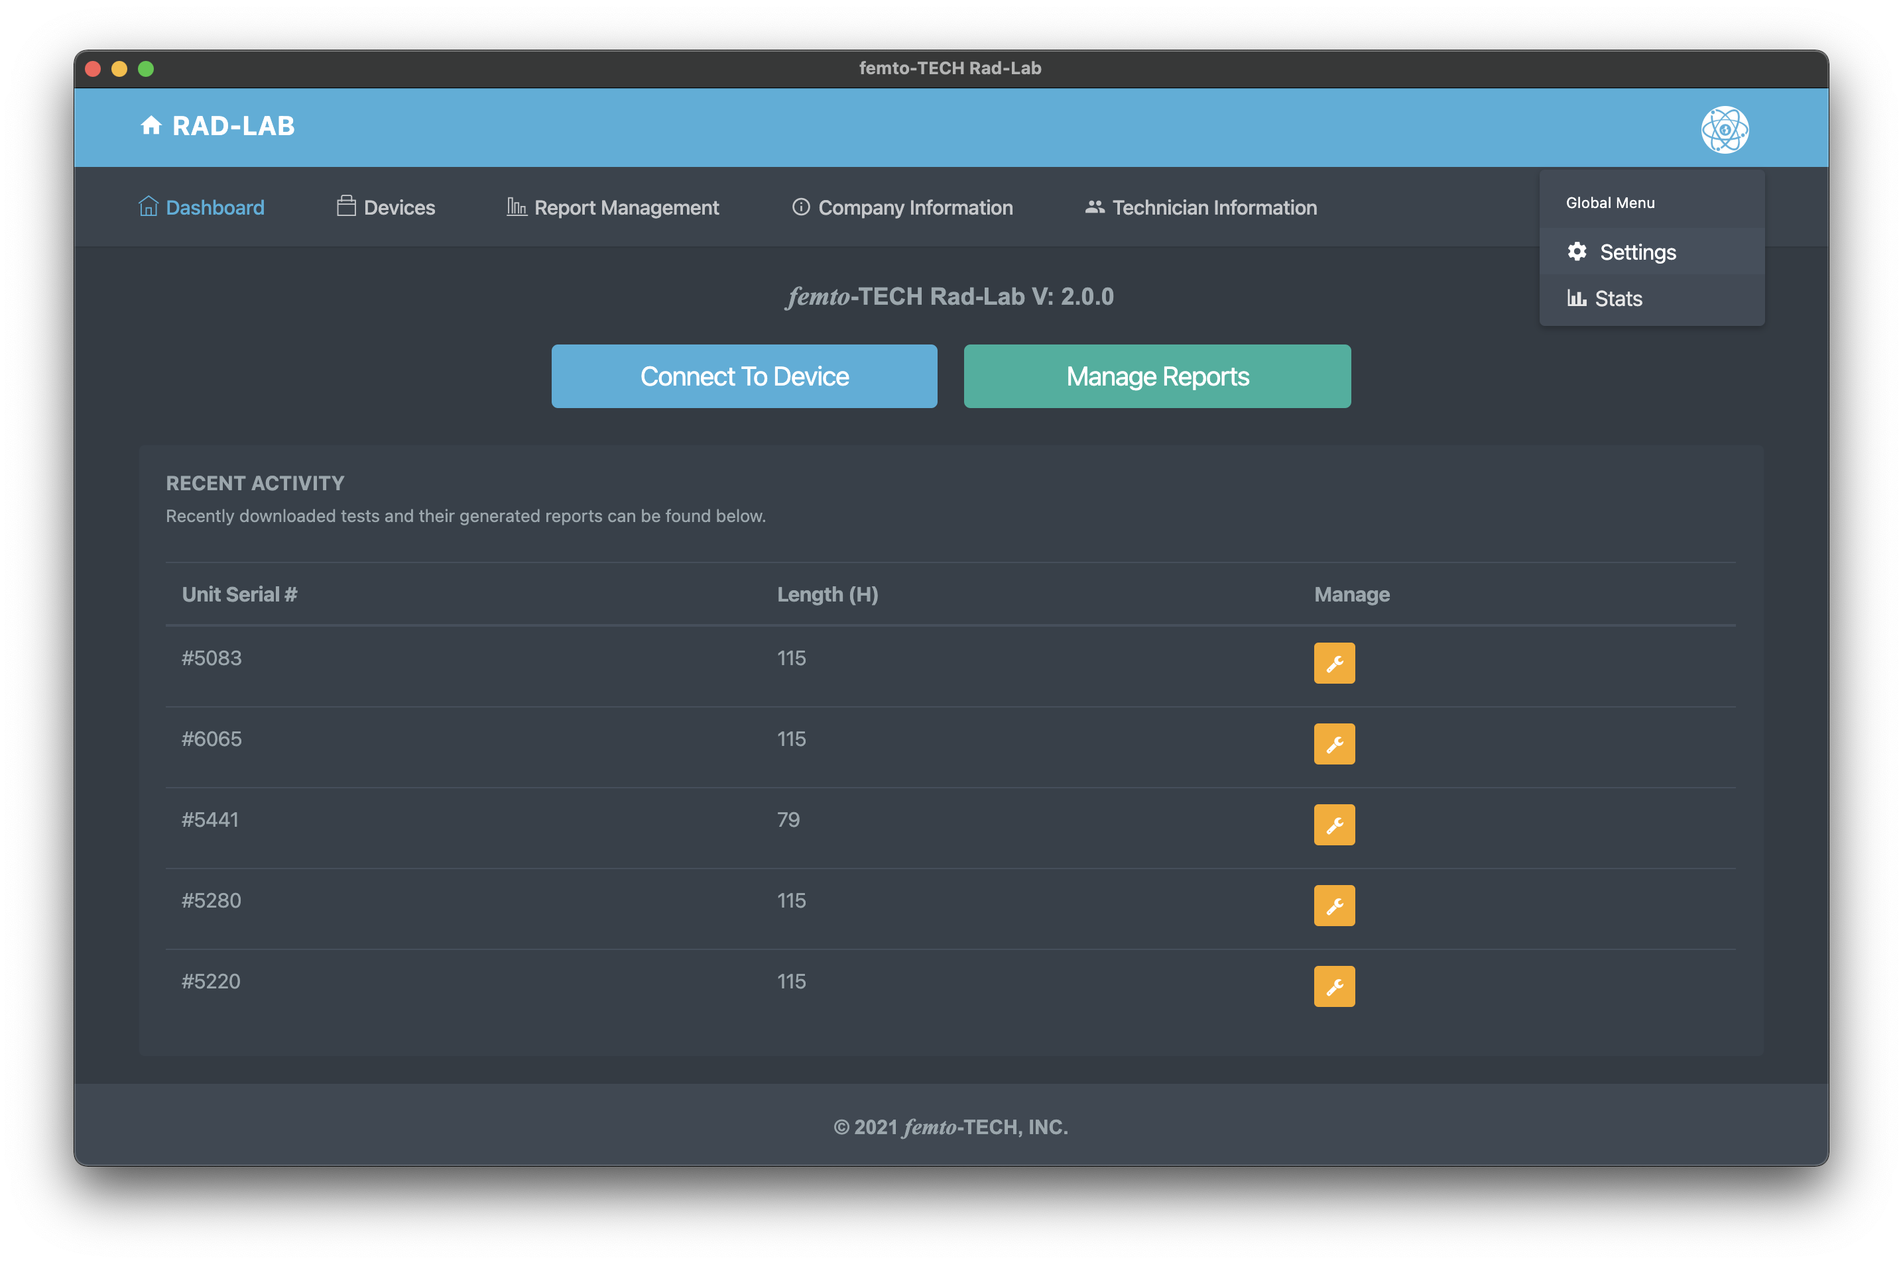
Getting Started
(continued)
Next, click the ‘Settings’ tab within the global menu in the top-right (circular icon) to further customize your generated reports.

Slide 24
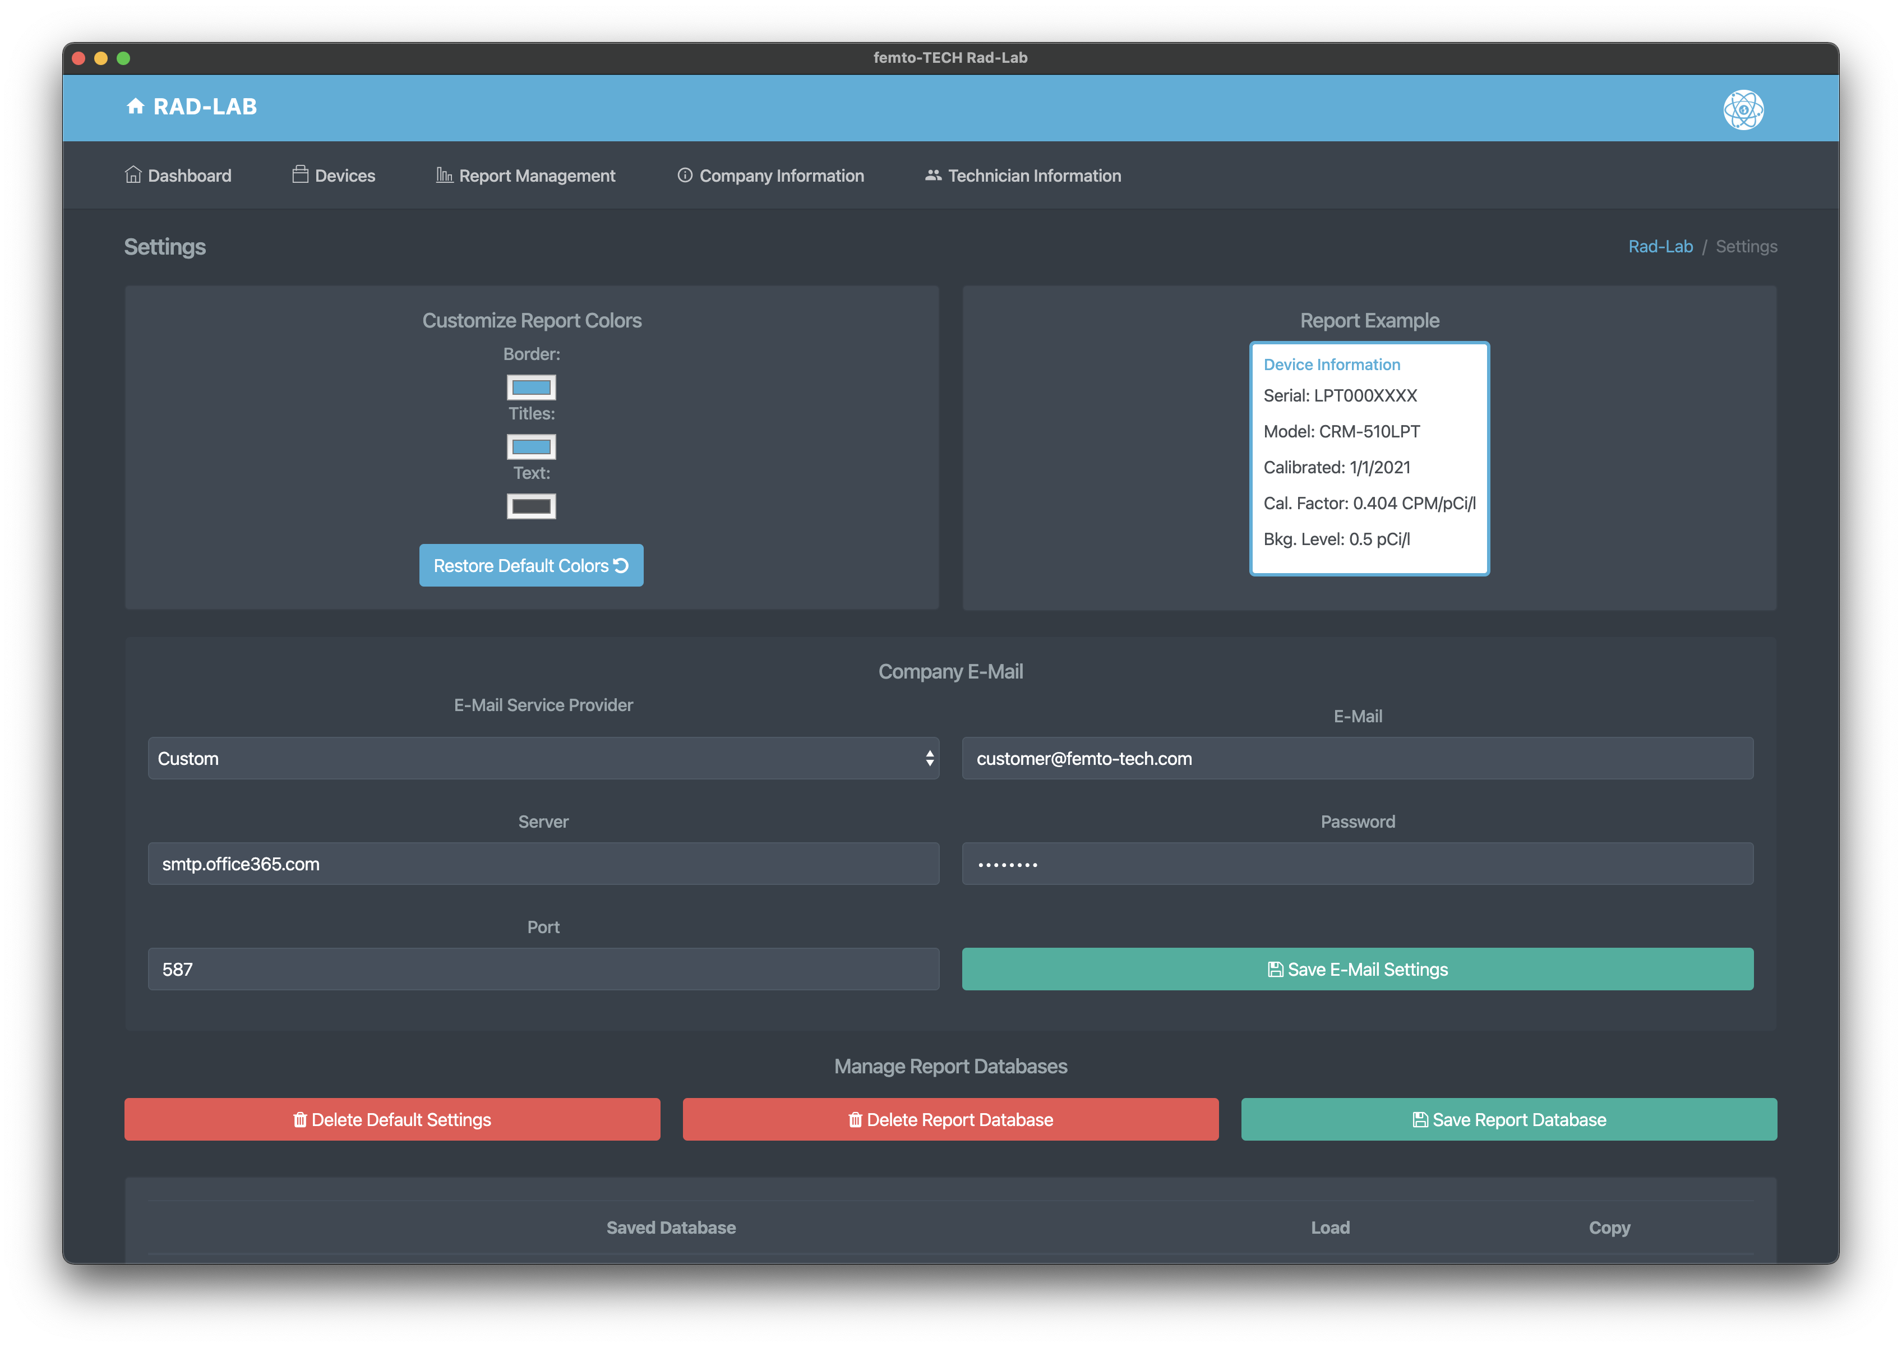
Customize Reports
Customize the colors on your reports by making color selections in the top-left.
Configure a company e-mail to be used to send reports directly once generated. If your company has no e-mail available or is unable to get it to work, femto-TECH provides an alternative option under ‘E-Mail Service Provider’. Select ‘femto-TECH’, and you will be able to send reports via customer@femto-tech.com. The Reply To address will be marked as your company’s e-mail from the ‘Company Information’ section, that way your customer can reply directly to you.
Company e-mail feature is optional. Most users prefer to save the report as a PDF and attach it to their own e-mail.

Slide 25
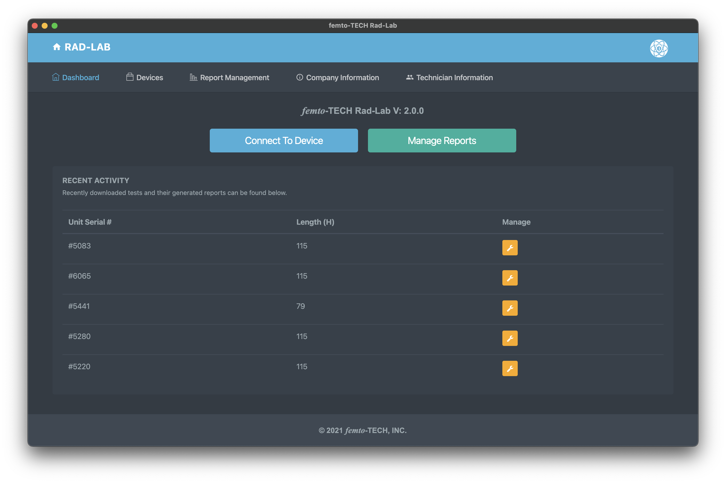
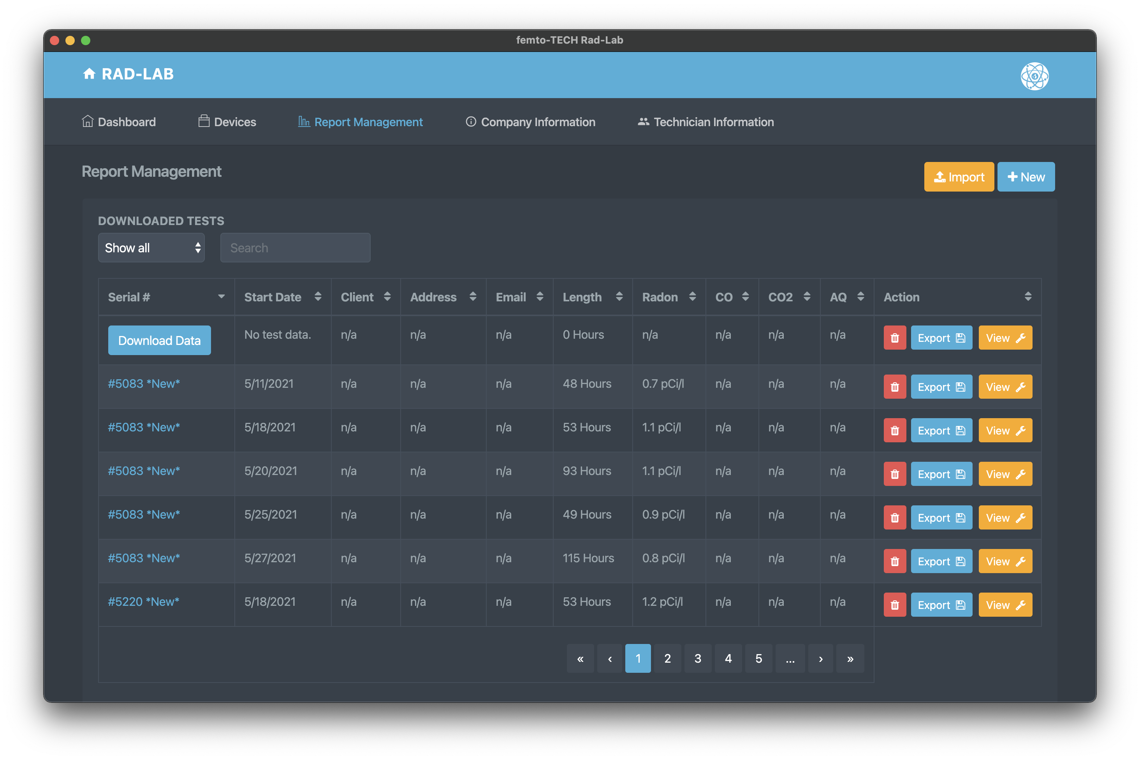
Download Data
Click either ‘Devices’ at the top left of the navigation bar or the ‘Connect To Device’ button on the Dashboard.
Data can also be downloaded to a previously created test entry by clicking ‘Download Data’ on the entry within the Report Management table.

Slide 26
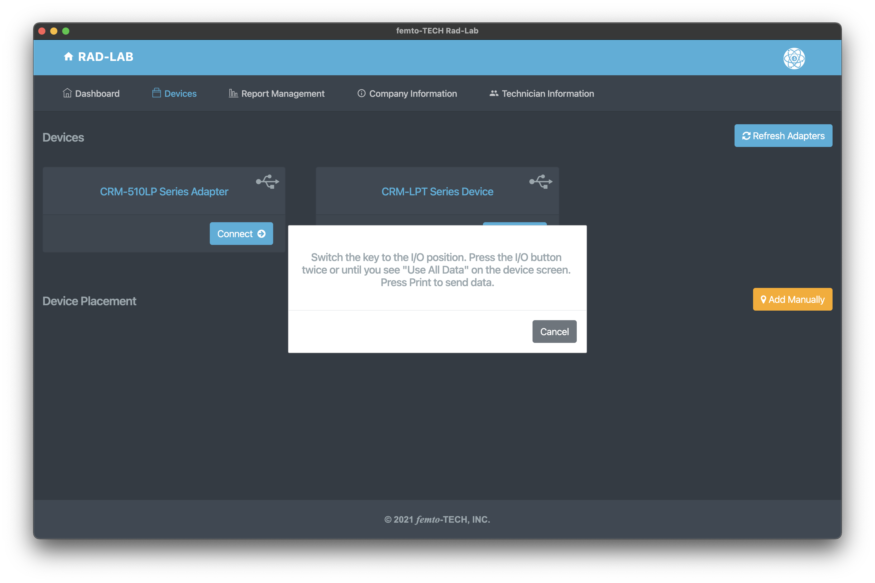
Download Data
(Desktop)
Plug the CRM-510LP into the computer using the provided download cable (USB-C cable), wake it up with the power button, and then click ‘Refresh Adapters’.
Click ‘Connect ->’ on the adapter displayed on the screen and then follow the on-screen instructions and select a test to download the data. Once the data has downloaded, a ’Download Complete!’ message will appear and then take you to the ’Report Setup’ screen.

Slide 27
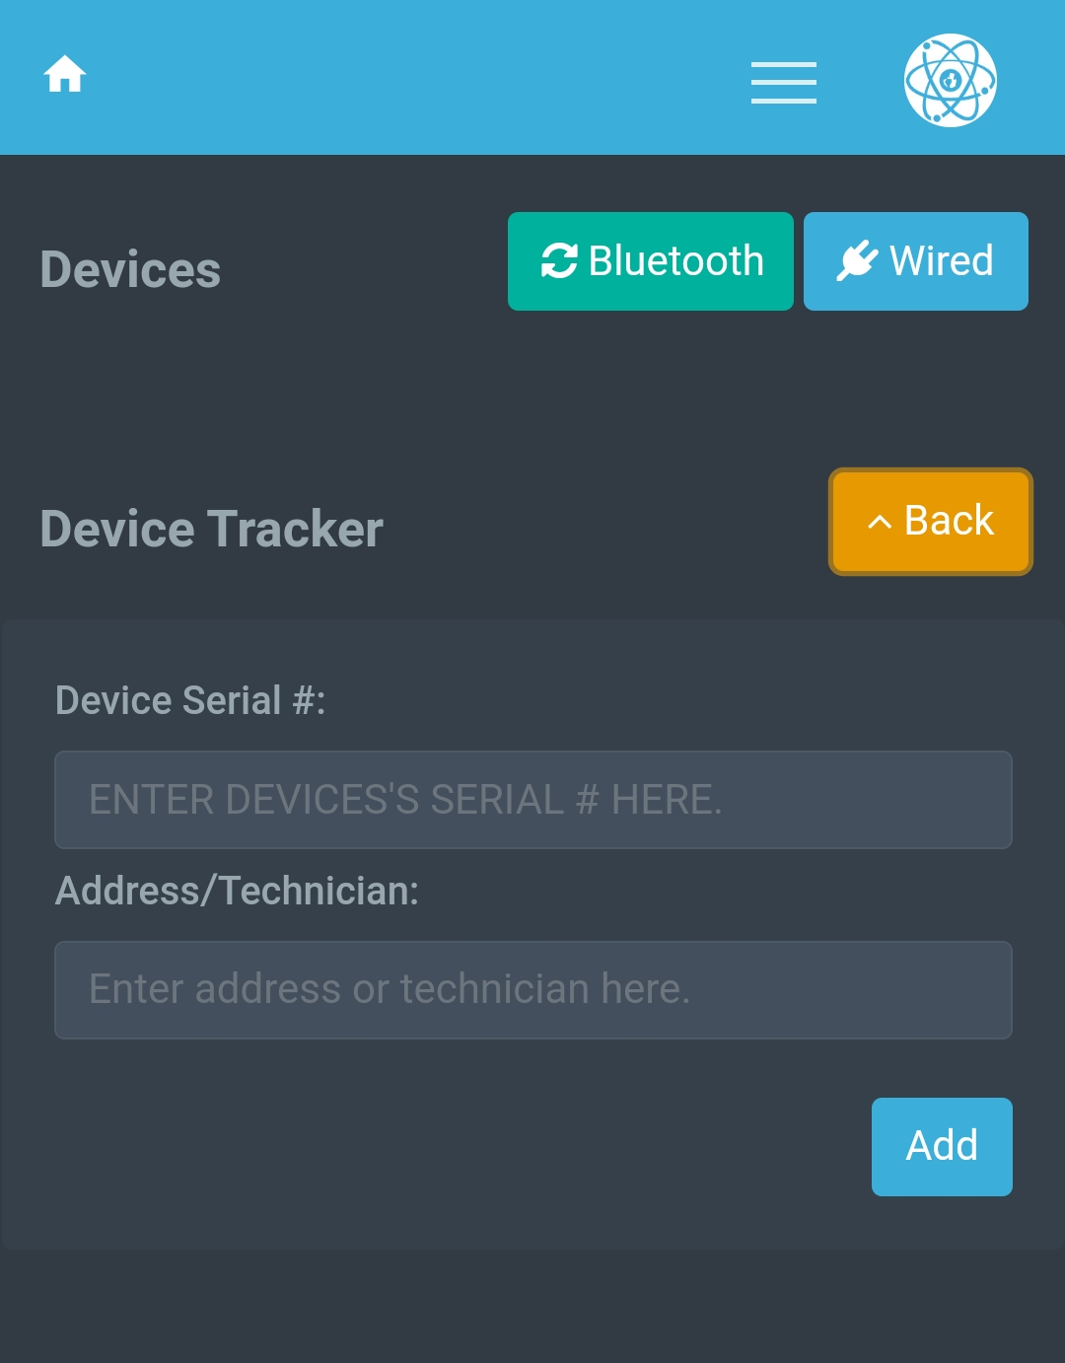

Download Data
(Mobile)
Plug the download cable into your mobile device and then into the back of the CRM-510LP.
Click the ‘Wired’ button to connect to your monitor.
Follow the on-screen instructions and select a test to download the data. Once the data has downloaded, a ’Download Complete!’ message will appear and then take you to the ’Report Setup’ screen.

Slide 28
Report Management
Use the search bar or table navigation menu to browse downloaded tests. Here you can edit, import/export, & delete existing tests.
Click anywhere within the test entry on the table to expand it for more information.
Click on the blue serial # of the entry or the ‘View’ button to load the test into the ‘Report Setup’ screen.

Slide 29
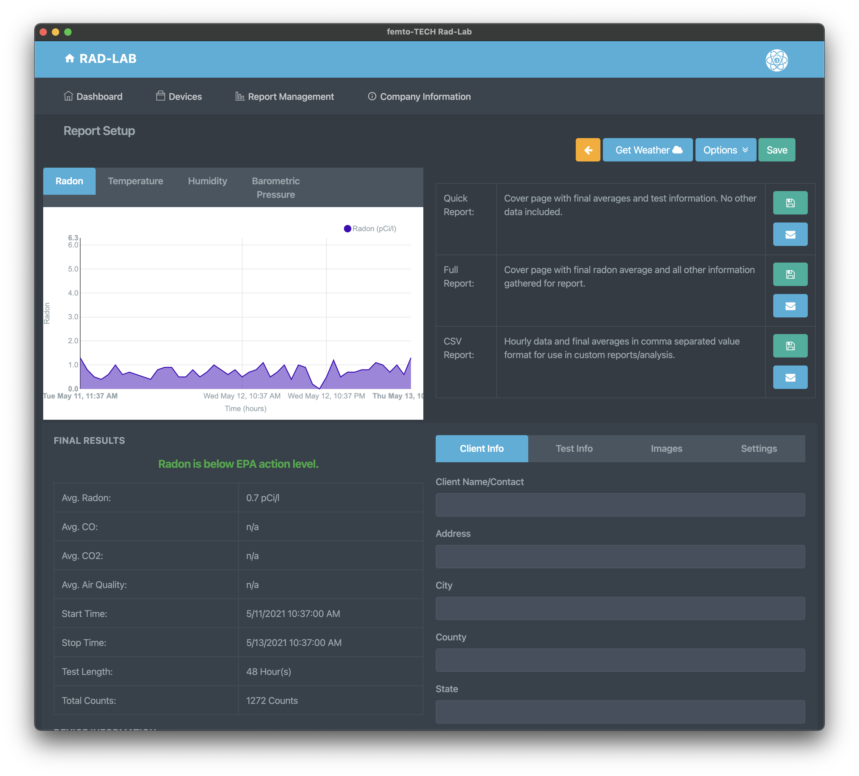



Report Management
Graphs plotted from the test data can be found in the top-left corner of the screen.
Results of the test can be found in the table on the bottom-left of the screen.
Hourly results can be read in table format via the button in the bottom-left corner below the ‘Final Results’ section.
The test-specific options menu can be found at the top-right of the screen. From here, you can change the units of each measurement as well as specify a span of time in which you would like to report on within the test.
The bottom-right section of the screen contains the report fields specific to the test being conducted. From here, you can add your customer’s information, test-specific information, images pertaining to the conducted test, and signatures.
Each section outlined on this slide will have a dedicated slide explaining its usage.

Slide 30
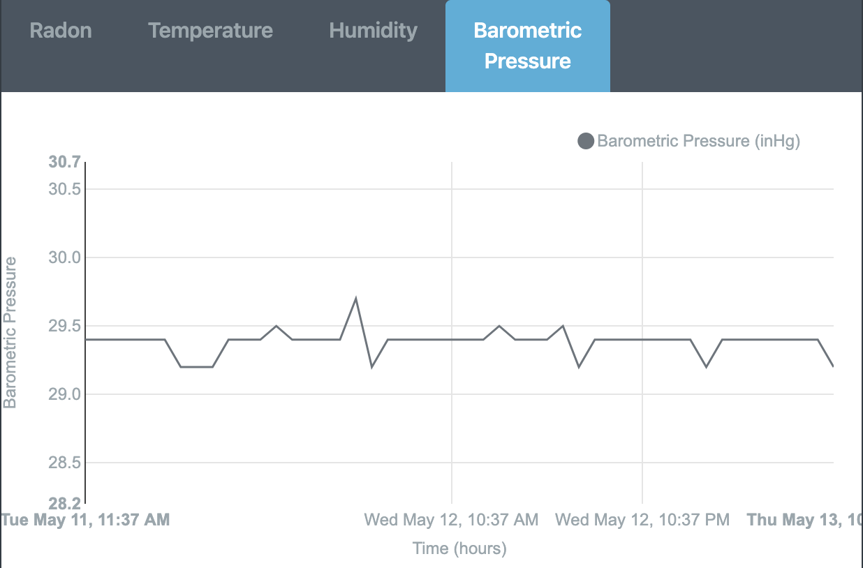
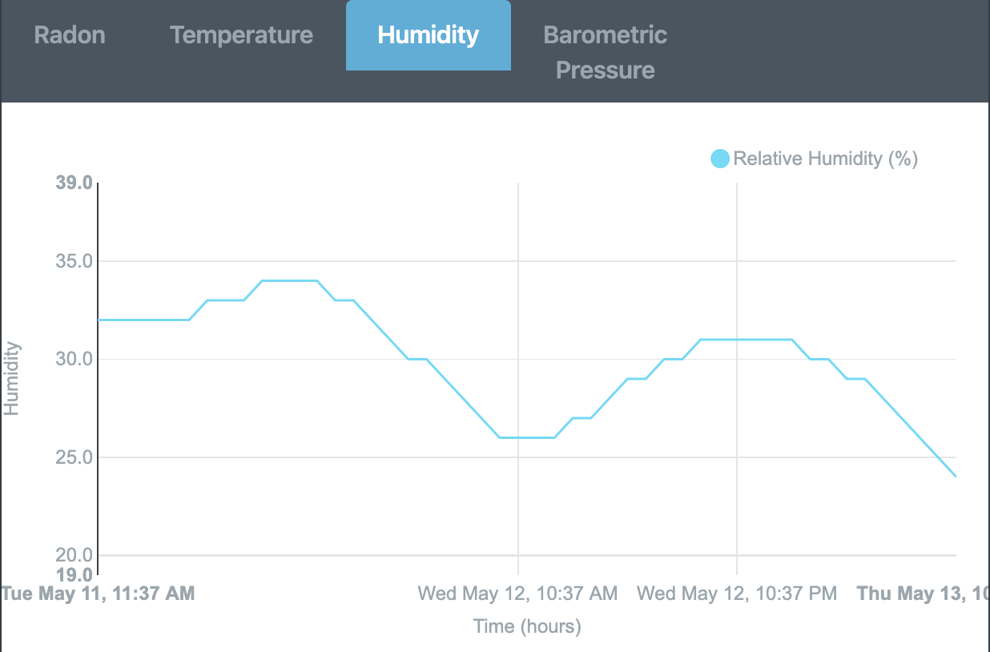
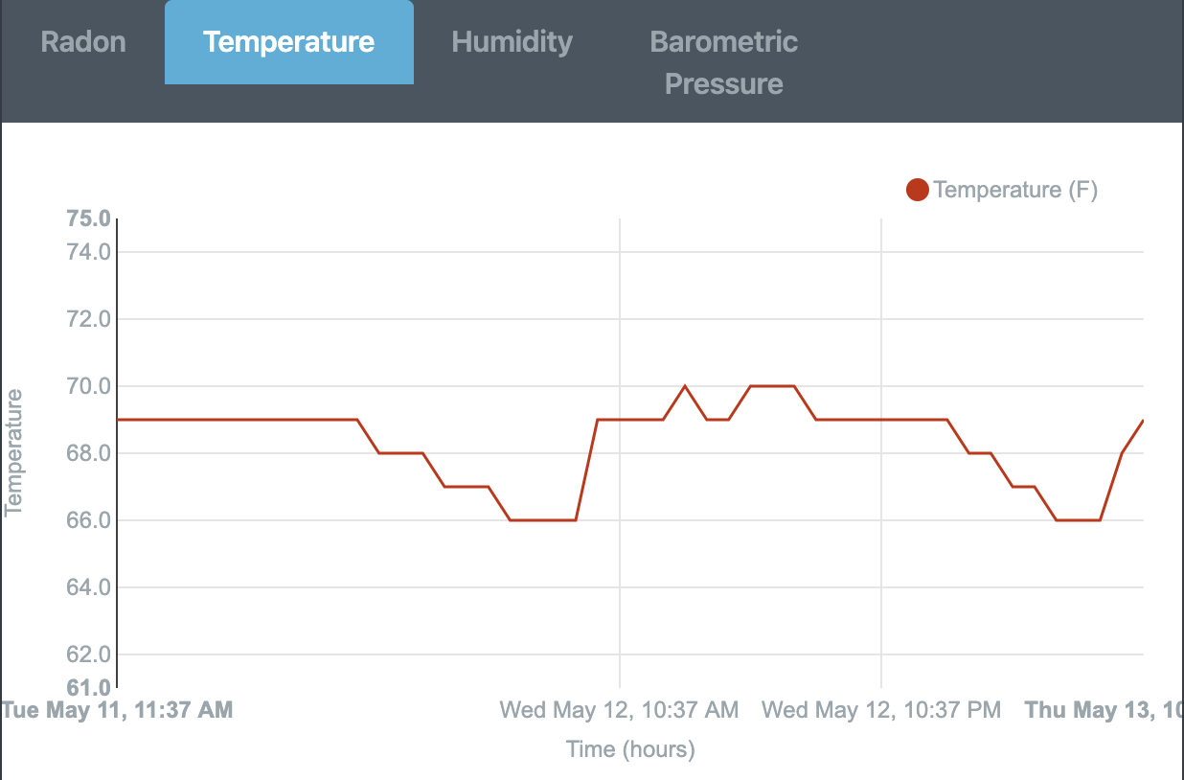
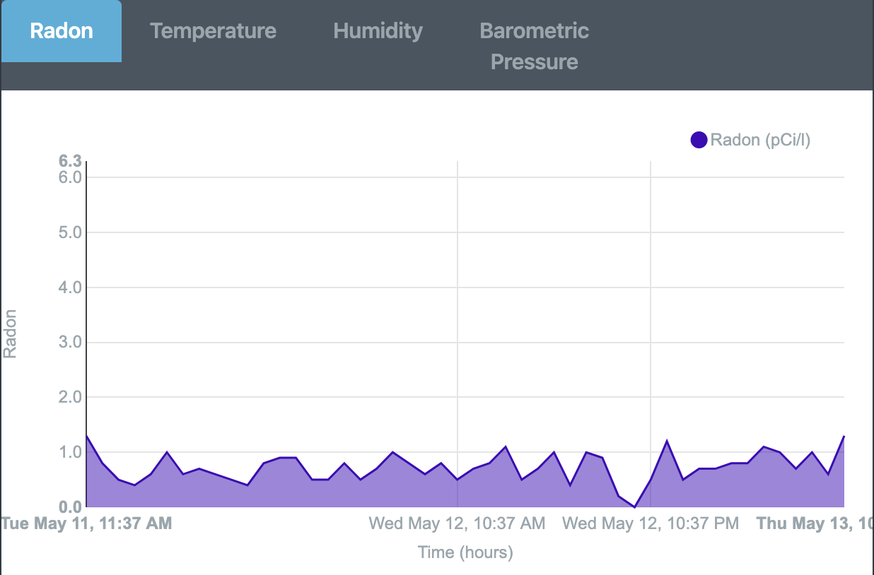
Report Setup (Graphing)
Each graph can be viewed by clicking its respective tab.
By hovering over the plots on each graph, you can view each hour’s value and exact time of recording.
Each graph is automatically adjusted/plotted whenever a specific range of hours is selected within the options menu (as seen on next slide).
The graphs can be enlarged by either maximizing your app window or turning your mobile device horizontally.

Slide 31
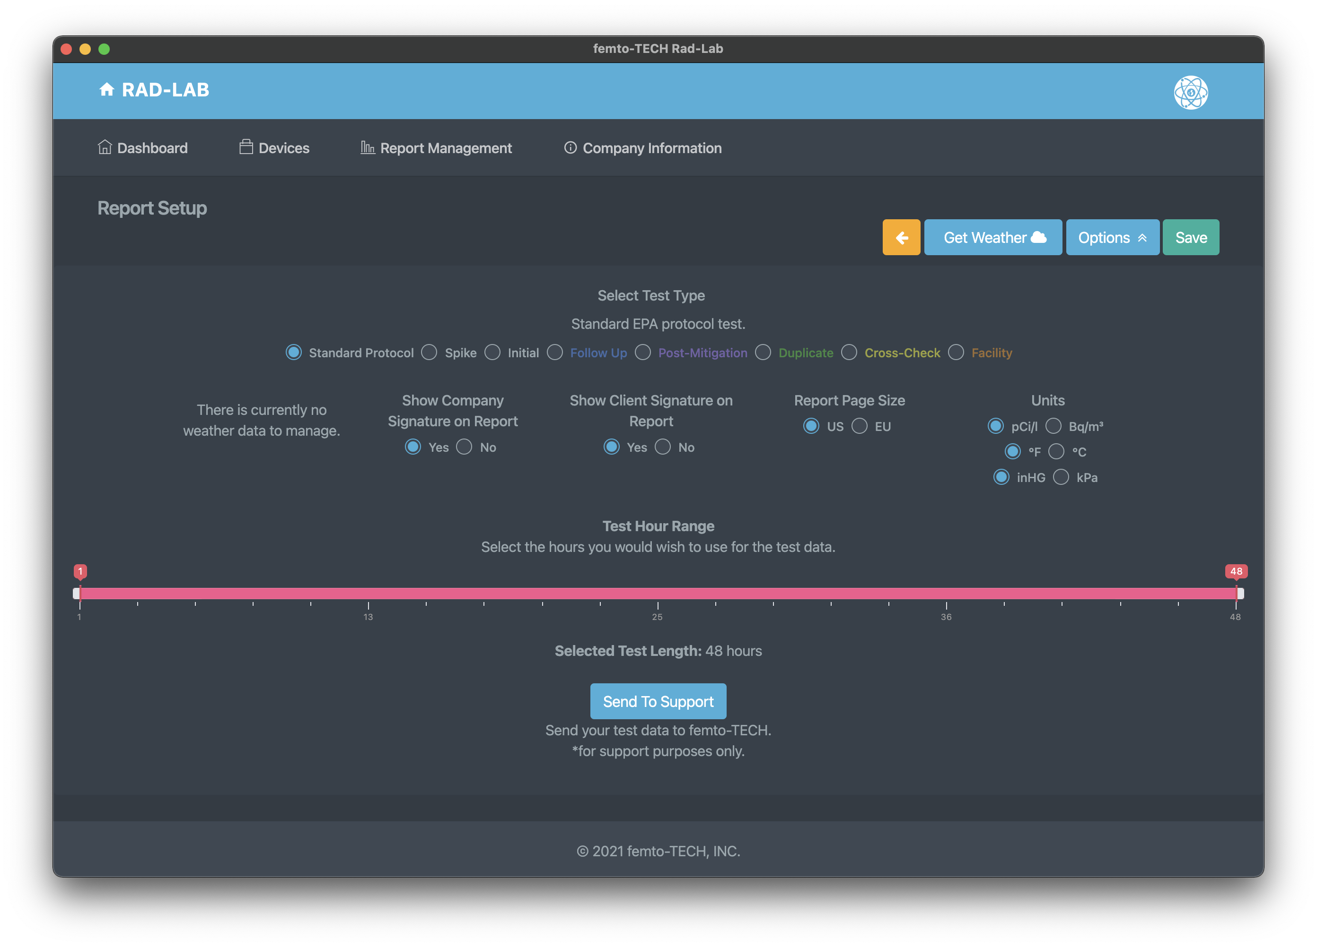

Report Setup (Options)
Click the ‘Options’ button to drop-down the options menu for the test.
From here, you can select the type of report you wish to generate. For most testing scenarios, the ‘Standard Protocol’ selection is adequate.
Below ‘Select Test Type’, you have the option to show weather data acquired for the test, as well as the company and client signatures. (All default to ‘Yes’ when applicable).
You can also change settings such as the report page size and the measurement units used for each field value and final average.
Select a test hour range to customize the hours that are being measured/reported. This feature can be used to accommodate a lack of closed-house conditions by running a longer test and manually selecting the span of hours. *Notice* a minimum of 44 continuous hours are required per the EPA for protocol testing.
Click the ‘Options’ button again to hide the menu and simultaneously save your changes.

Slide 32
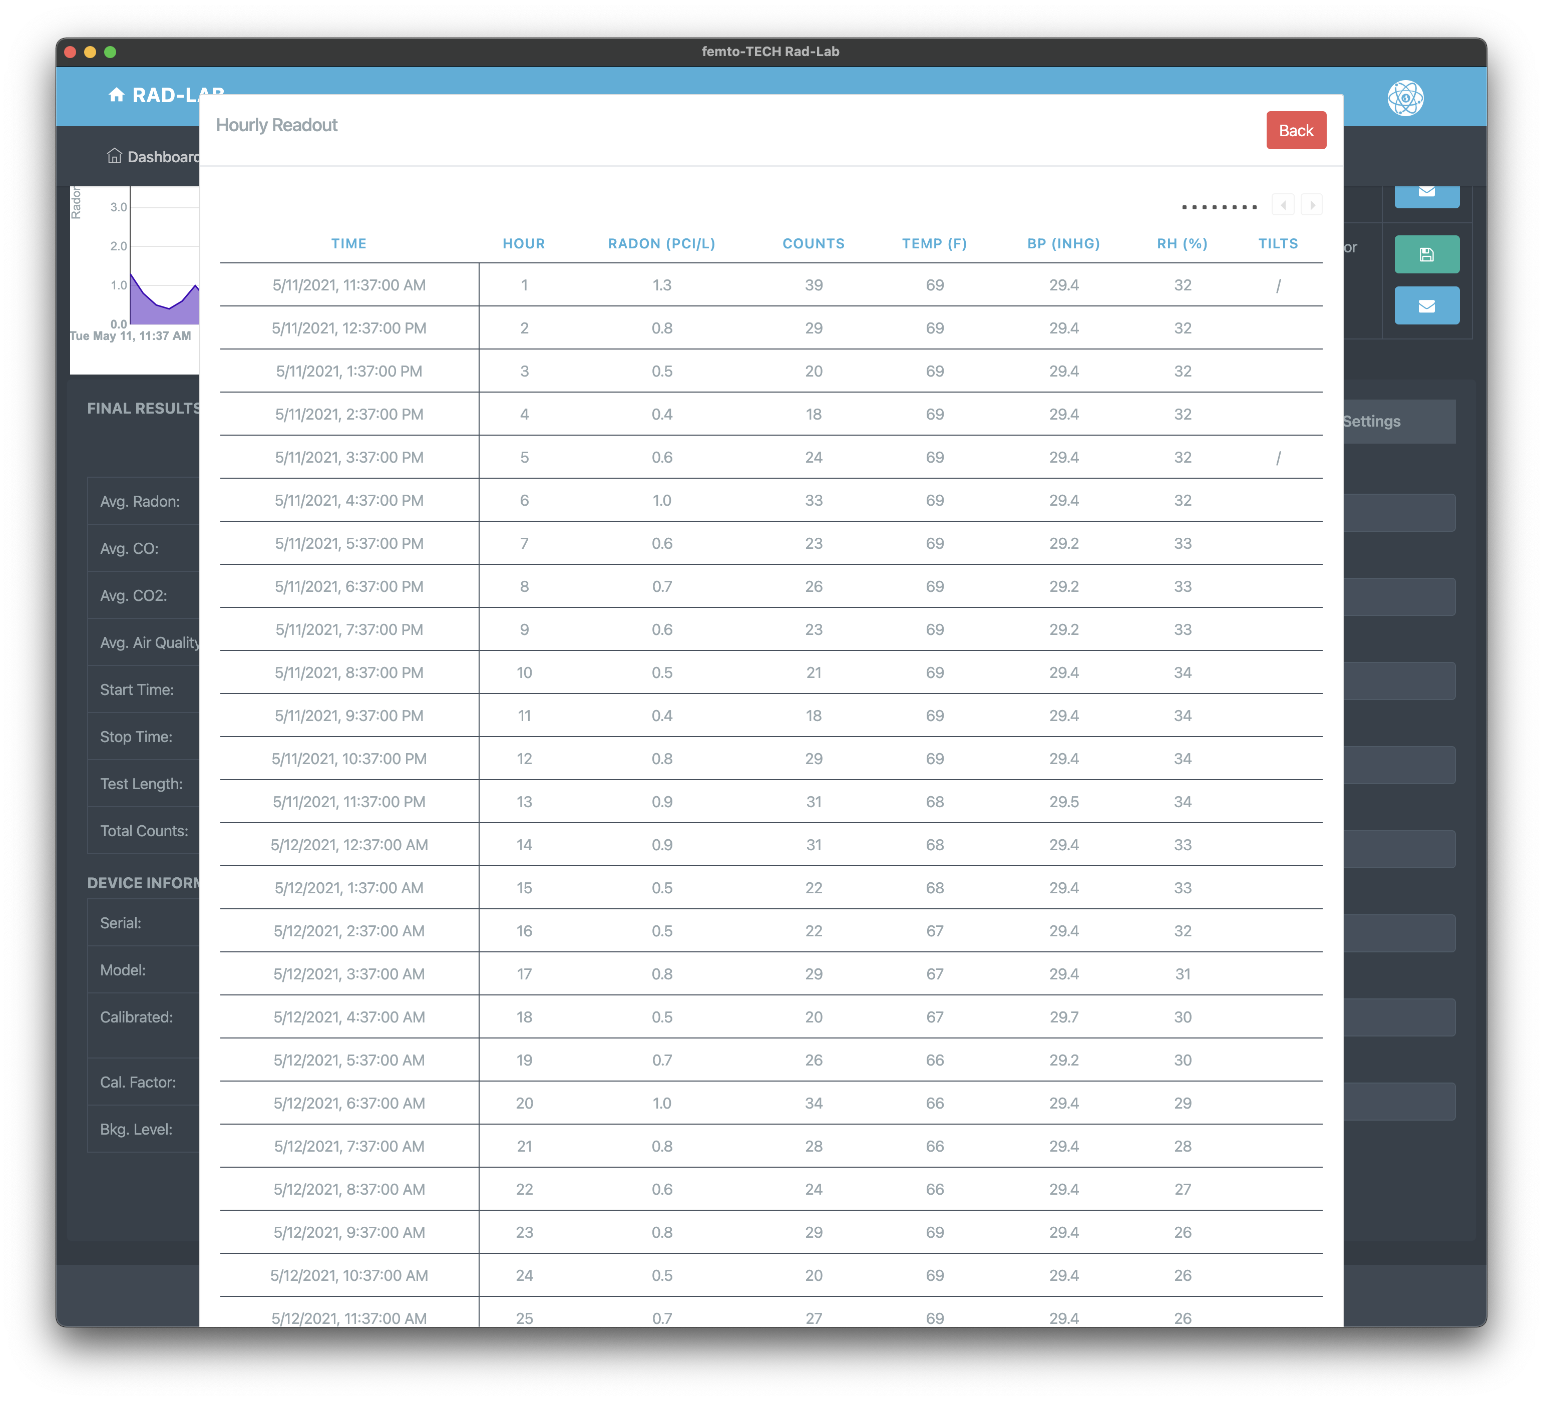
Report Setup (Hourly Readout)
Click the ‘View Readout’ button in the bottom-left side of the window to view the hourly table readout for each measured value.
If all columns are not showing on your screen, you can use the legend in the top-right of the table to navigate through the overflow columns.
Click the ‘Back’ button to close the hourly table readout and return to the previous screen.

Slide 33
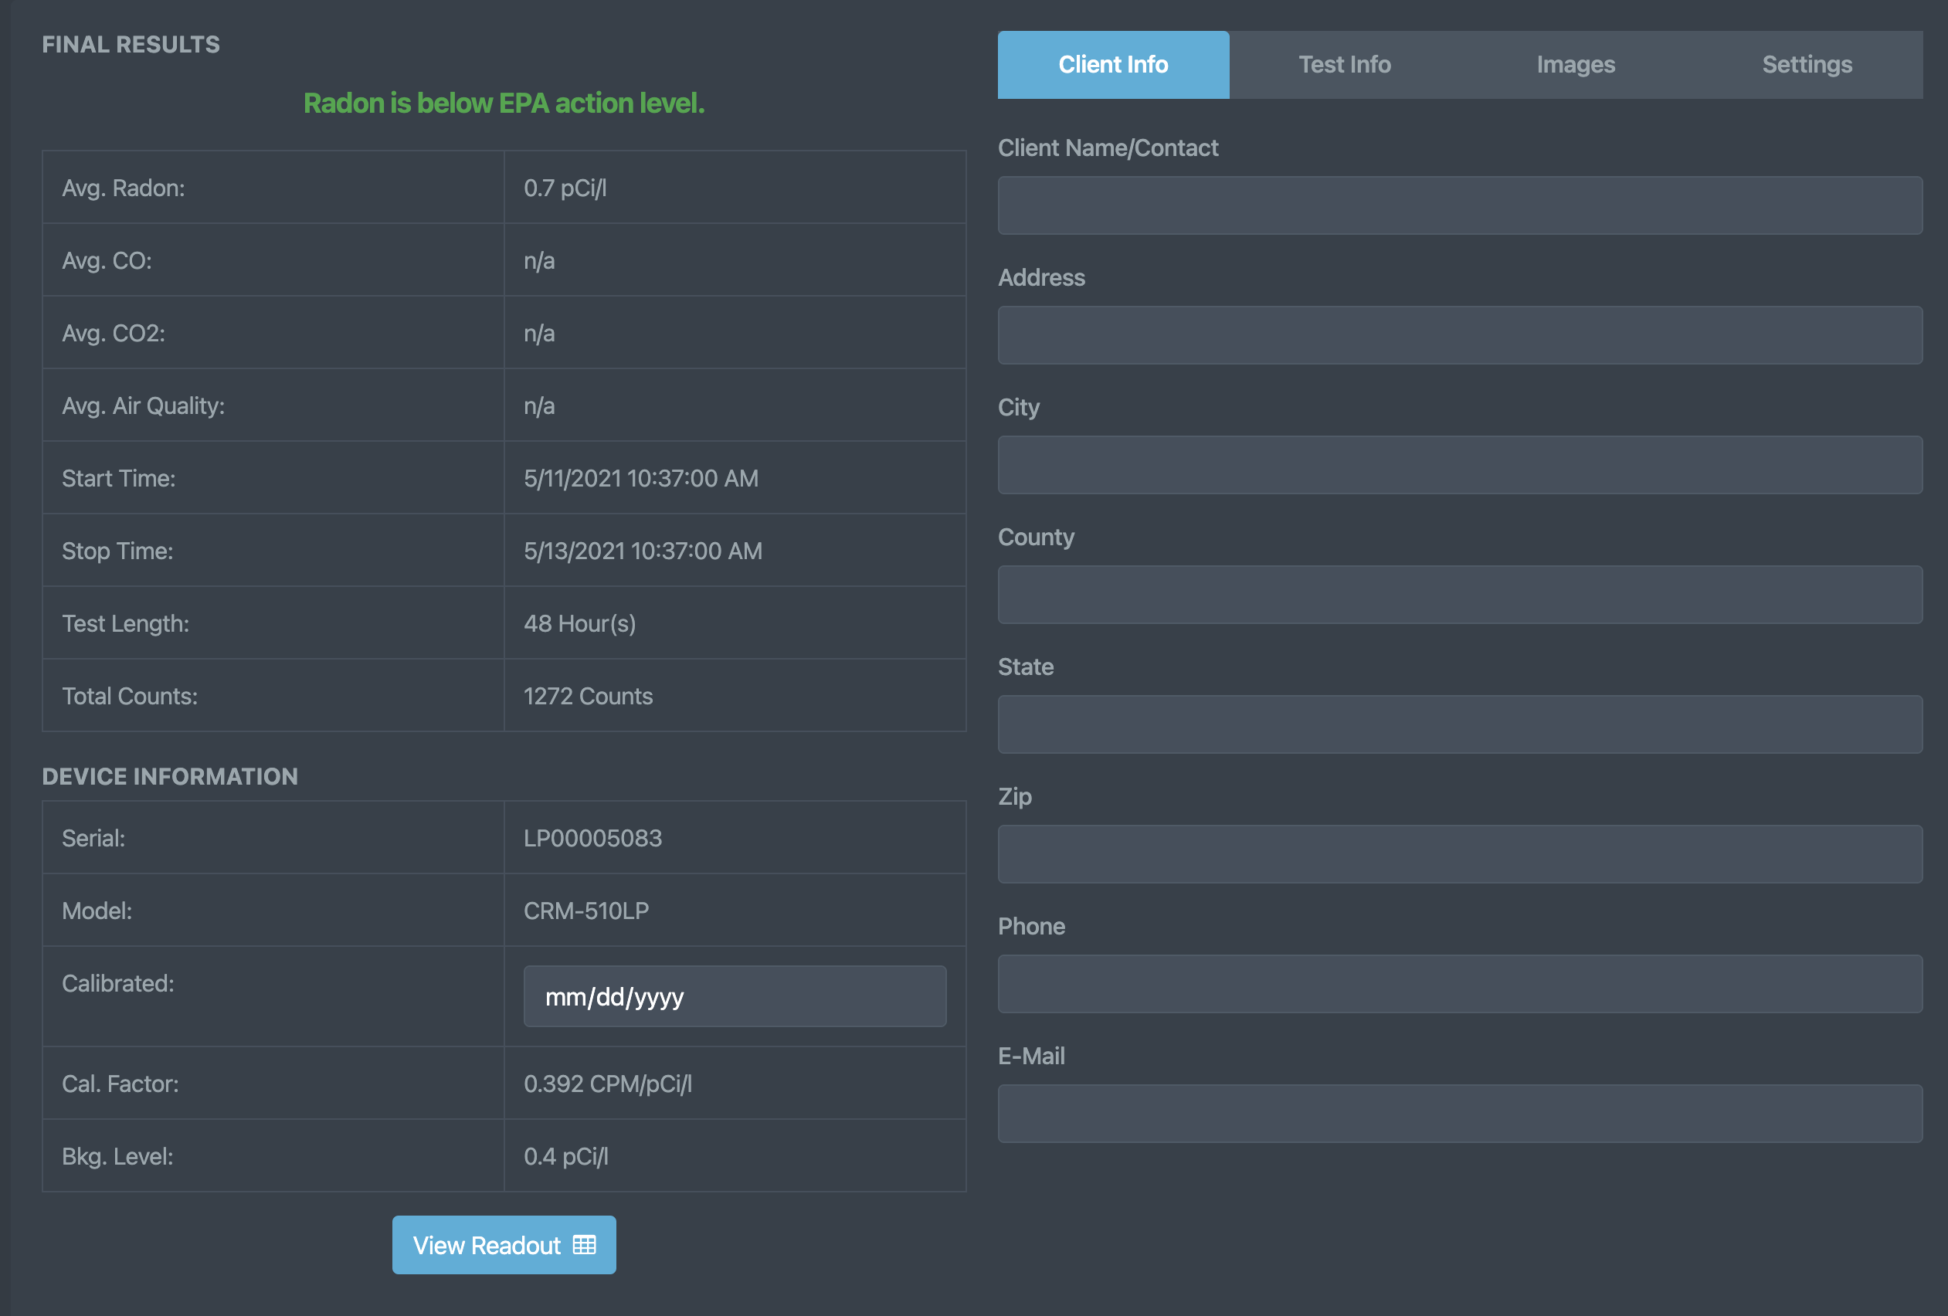
Report Setup (Client Information)
Click the ‘Client Information’ tab to enter/edit the information of the customer having the test completed.
These fields are used to populate the ‘Full Report’ as seen on the last slide of this show.

Slide 34
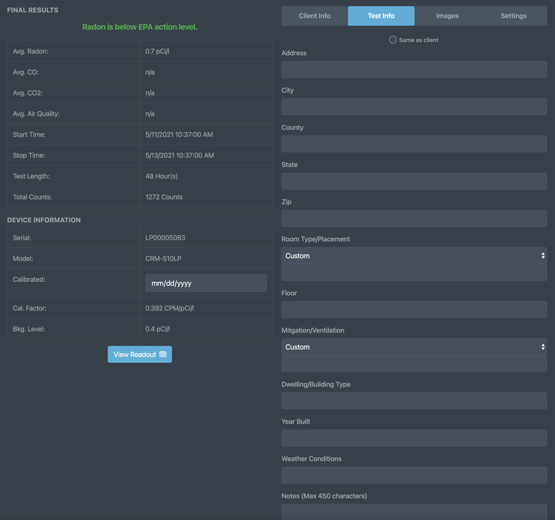
Report Setup
(Test Information)
Click the ‘Test Information’ tab to enter/edit any test-specific information.
These fields are also used to populate the ‘Full Report’ as seen on the last slide of this show.
Use the ‘Same as client’ button at the top to use the same address information as the client section.

Slide 35
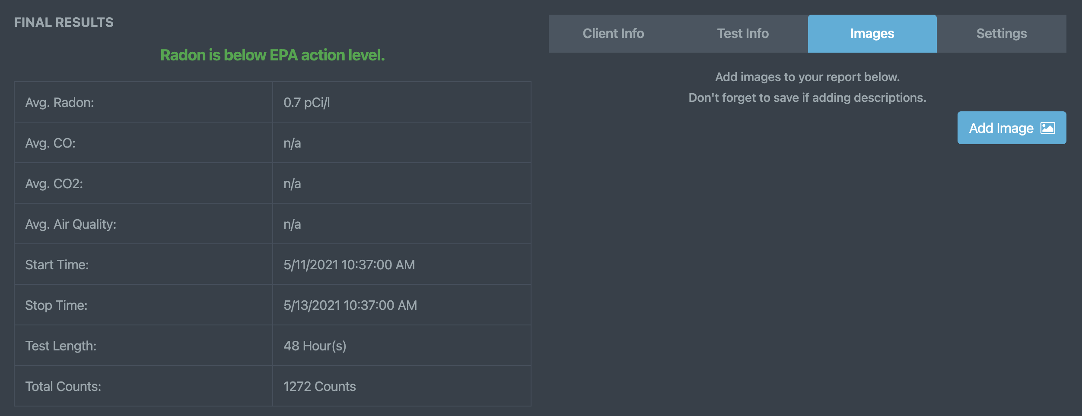
Report Setup
(Report Images & Attachments)
Click the ‘Report Images’ tab to add/take any images that are pertinent to the test being conducted.
Once an image is added, you will have the option to add an image description.
Each image and its accompanying description will automatically be added to your report once saved.
Click Add Report Page to add a PDF or other report material to the Radon Report within its own dedicated page.

Slide 36
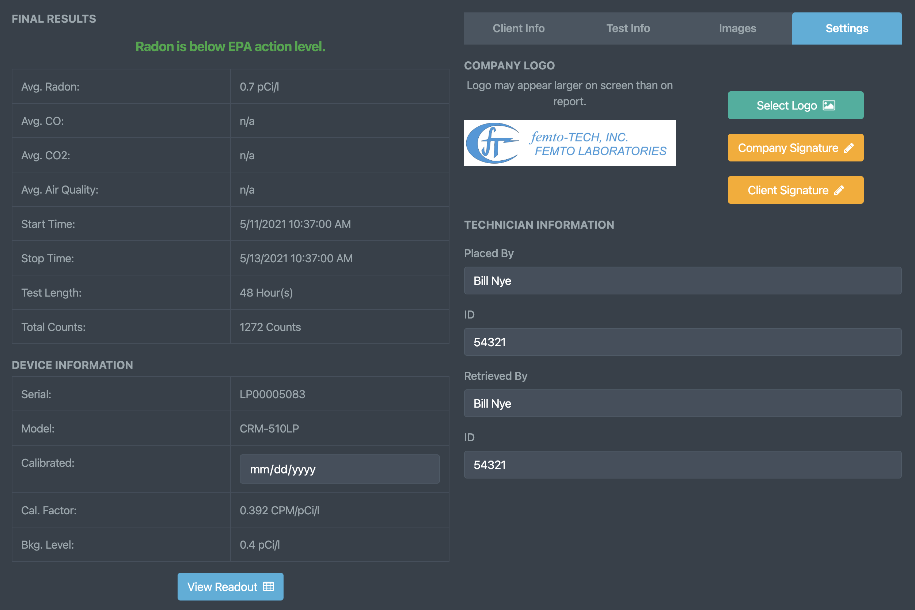
Report Setup
(Report Settings)
Click the ‘Report Settings’ tab to put the final touches on your generated report.
Click the ‘Select Logo’ button to change the logo you would like to be added to the top of the report.
Click ‘Company Signature’ to add/remove a signature for the person representing your company.
Click ‘Client Signature’ to add/remove a signature for the customer acknowledging the completion of the test.
The Technician Information can also be added/edited here in case that person were to change test-to-test.

Slide 37
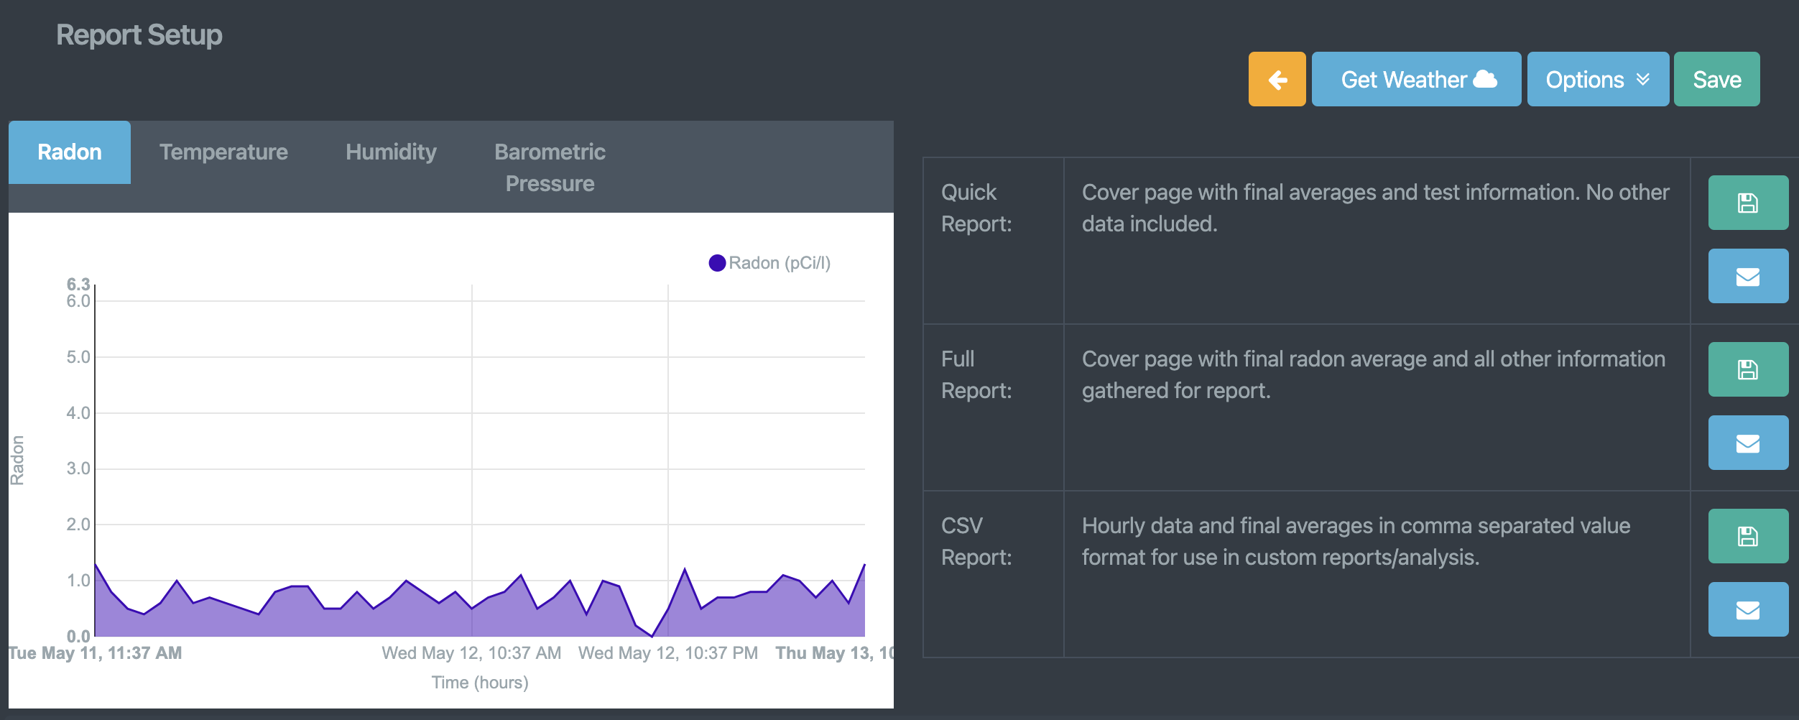



Report Setup
(Generating Report)
There are 3 types of reports that can be generated from your test data. (Quick, Full, & CSV Reports)
Quick - Cover page with final averages only. No other data included.
Full - Cover page with final test averages and all other information gathered for report.
CSV - Hourly data and final averages in comma separated value format for use in custom reports/analysis.
Mobile Only - Report can be shared/sent via your preferred method (email, message, other 3rd party apps) by clicking their respective ‘Share’ buttons.
Mobile Only - Report can be printed directly to a networked printer if the printer has already been installed for use on your phone and you are connected to the same network.
Mobile Only - Report can be printed directly to a supported BLE thermal printer from within the ‘Settings tab’ on your mobile device.

Slide 38



Report Setup
(Sharing via E-mail)
Click the button containing the mail icon for either of the 3 reports to generate and immediately share via e-mail. You can customize the e-mail that is sent and then save it as a template to be used for future e-mails. *Notice* - a valid e-mail account must be used for this feature to work properly. If you lack a valid e-mail or cannot get yours to work, femto-TECH provides a free option that can be found in the global settings menu. Select ‘femto-TECH’ as the email provider and be sure you have an e-mail configured in your company information for it to work properly.

Slide 39
Tamper Detection
Each CRM-510LP is equipped with a tilt sensor that logs movement within the hour of detection (logs to graph and hourly readout).
Along with the tilt sensor, the CRM-510LP also measures temperature, humidity, and barometric pressure – all of which can be used for tamper detection.
As you can see on the graphs to the right, there is clear indication of tampering occurring in this test due to the tilt indicators and sudden changes seen within those hours. Based on these indicators, it is also evident that this tampering has had a direct effect on the measured radon.

Slide 40





Data Interference
Condensing Humidity
EMF
Notice the sudden drop in temperature and rise in humidity at the start of the test. The average temperature and humidity are conducive to an environment in which condensing humidity can occur. With these conditions it is possible for the electrometer to ‘run away’.
It is possible to overwhelm the electrometer on the CRM-510LP if it is placed near high-powered radio equipment such as modems/routers/cellular devices. Make sure to place your CRM at least 10 feet away from any wireless transmitting devices.

Slide 41
Declaration of Voluntary Compliance Example

Slide 42
EXAMPLE
REPORT

Slide 43
Device QA Log Example

Slide 44
Environmental Interference
Avoid areas with condensing humidity
Keep away from strong EM sources (Wi-Fi, routers, radio transmitters)
The array of sensors included in the CRM-510LP help to isolate and display potential interference caused by the surrounding environment.
The CRM-510LP is designed to work at any traversable elevation. (from mines to mountains)
CRM-510LP Operating Humidity & Temperature:
  0-90% non-condensing & 50-104°F

Slide 45
Calibration & QA
Calibration information visible on calibration sticker
Calibration factor is stored within the device and set by manufacturer (cannot be tampered with)
Quality Assurance reduces the risk of error and ensures reliable results
CRM-510LP is to be calibrated annually by an approved calibration lab.
Approved Calibration Facilities for the CRM-510LP:
femto-TECH
Bowser Morner
UKHSA
Click here for more information about our radon calibration services
Click here to download a Quality Assurance Plan (QAP) for your CRM

Slide 46
Battery & Charging
Battery life rated for 1 year
Batteries are replaced during background and calibration servicing.
No need to recharge or carry additional cords/equipment.

Slide 47
Handling & Storage
Use protective case resistant to water
Avoid car storage – let device acclimate to test volume before starting a test if it has been sitting in a hot/cold car to prevent condensation on surfaces of device
Designed for long life and daily use

Slide 48
Radon Concentration Calculation
Although the built-in computer normally performs all the computations and provides the radon concentration data in pCi/l or Bq/m3, it is advisable for the operator to know how to carry out "hand" calculations. A back-up "hand" calculation should be carried out after entering a new calibration factor or background value to verify their correct entry.
To perform a "hand" calculation, record the number of counts accumulated and the elapsed time shown on the LCD display, convert to counts per minute, and apply the conversion factor (C.F.) and background (BKG) values supplied with the instrument to obtain the radon level in units of pCi/l. The following formula is used for this conversion:
Rewritten:
pCi/l = (Ending Count – Beginning Count) - BKG
[Elapsed Time (in minutes) x C.F.]
The background subtraction is generally only necessary for radon levels below 10 pCi/l. The backgrounds of femto-TECH calibrated devices are determined from aged air measurements. The background does not vary significantly with time nor from unit to unit, because the pulsed ion counter detector and open grid chamber discriminates against all ionizing radiation other than airborne alpha.
A a sample calculation:
pCi/l = (3150 - 0) - 0.5 pCi/l
[2880 minutes x .357 cpm/pCi/l]
pCi/l = 3150/2880 - 0.5 pCi/l (background in pCi/l, NOT cpm counts per min)
.357
Or
2.5 pCi/l
(2880 minutes is 48 hours)

Slide 49

Training Complete!
Congratulations on completing CRM-510LP device training!

